Slide 1


Deepening Impact: Systemic Collaborations in Home Visiting
Presenters:
Katie Rubinstein
Malkia Singleton Ofori-Agyekum
April 2025
Notes:
S and V introduce themselves

Slide 2
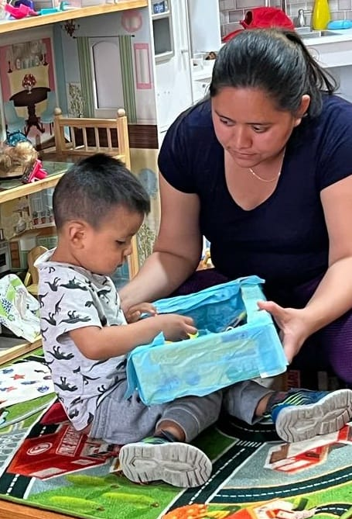

Agenda
Overview of the ParentChild+ Model in Philadelphia
History of Home Visiting Collaboration in Philadelphia
  Smith Playground/ Informal Learning Initiative
  CAN-Community Action Network
  Parents Succeeding Project
  CHOP Intimate Partner Violence(IPV) Project
  FAIR Project
Impact Of Collaborations
Notes:
KATIE- SMITH
MALKIA- CAN
KATIE- PARENTS SUCCEEDING
MALKIA- CHOP IPV
KATIE- FAIR

Slide 3

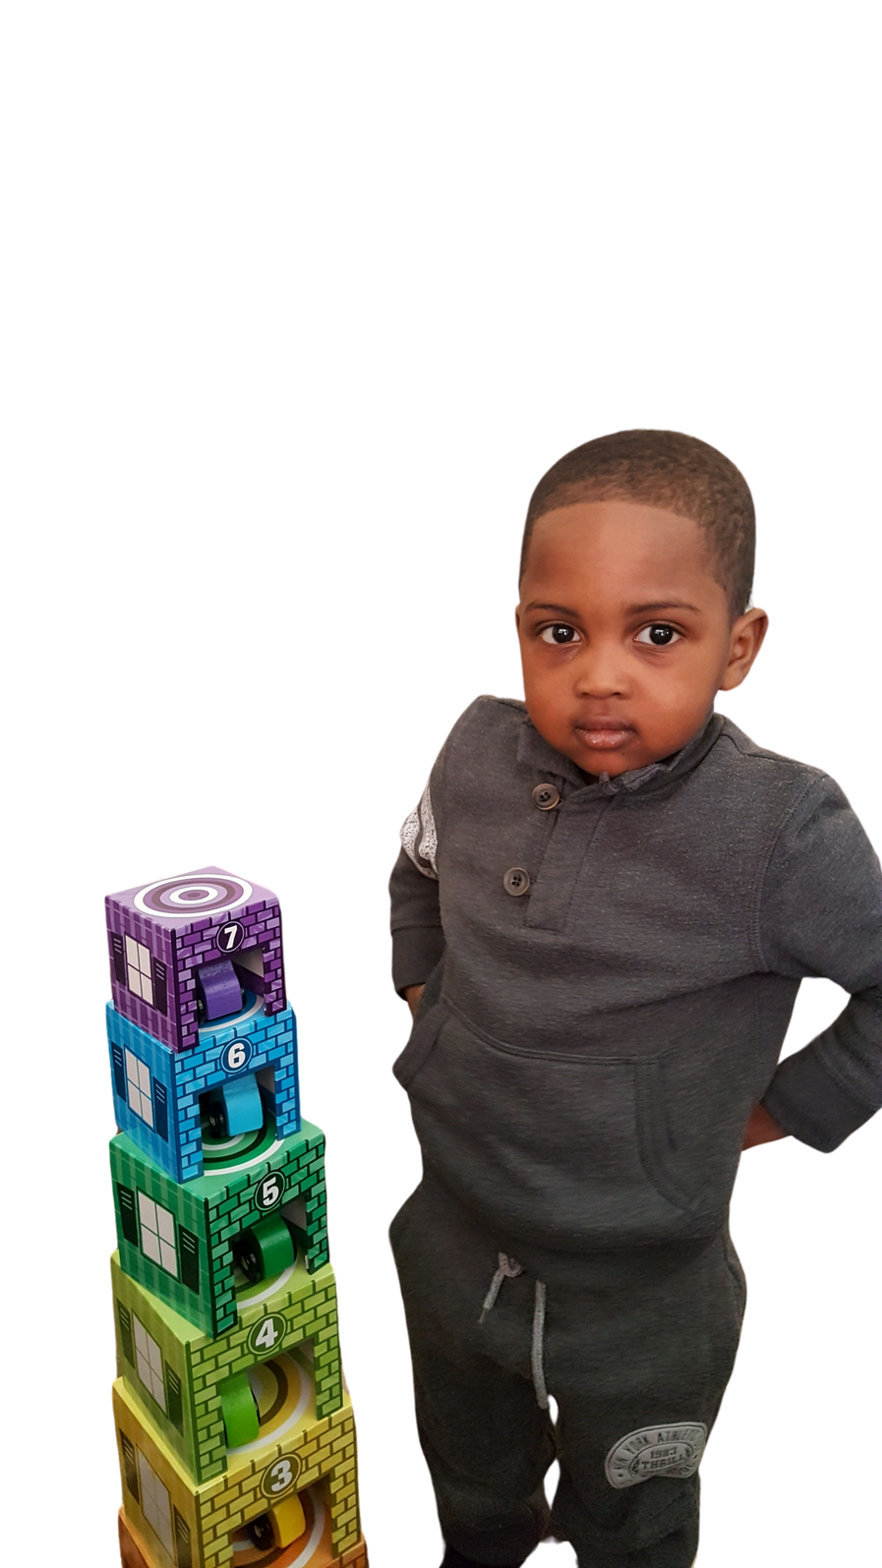
The Need in Philadelphia
Nearly 1 out of every 2.5 children lives below the poverty line
50% of the adult population has low literacy levels
13.3% of the population is Latino, with a growing Asian and African population
Only two in five Philadelphia third graders meet state reading proficiency standards

Slide 4
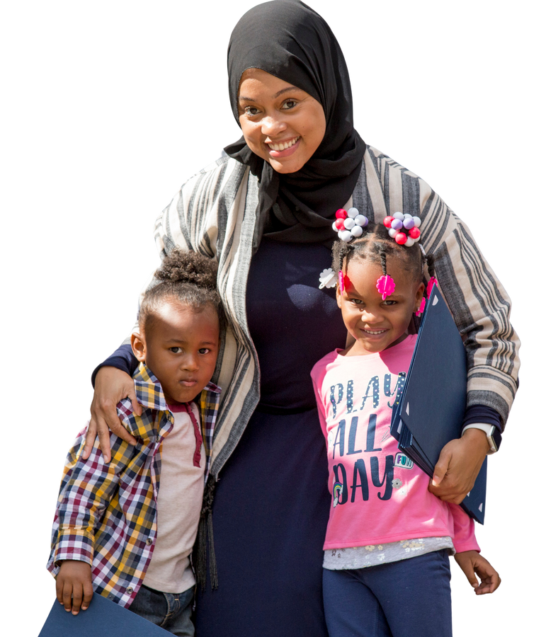
Philadelphia To Date
In the Fall of 2016, ParentChild+ at PHMC began working with 100 families – 50 in the Sharswood/Blumberg Choice Neighborhood and 50 Latino and African immigrant and refugee families in South/Southwest Philadelphia.

Slide 5


Philadelphia To Date
In 2017-18, we expanded to reach 195 families in these communities and an additional 40 families in West Philadelphia as part of the Drexel University Promise Neighborhood.
In 2018-19, ParentChild+ worked with an additional 10 home-based providers in West, South/Southwest, North and lower Northeast Philadelphia. We worked with approximately 345 families and children across the Family and HBCC models.
In 2019-20, we worked with 19 home-based providers, and expanded our work with families in North, South/Southwest and West Philadelphia including, families experiencing homelessness and residing in Philadelphia Housing Authority living in West Park, Wilson Park, and Bartram Village.
From 2020-Present, ParentChild+ has worked with over 400 families and 30 HBCC providers through the Family and HBCC models in North, West, South and Southwest Philadelphia.

Slide 6
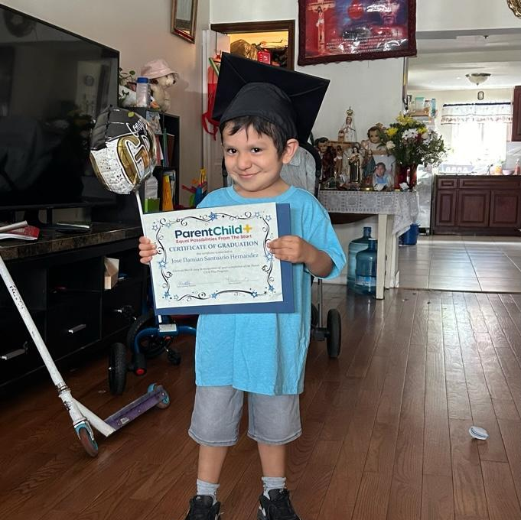
Philadelphia To Date
To date ParentChild+ has reached over 1000 families across both models and created over 30 local jobs, including 3 ParentChild+ graduates.

Slide 7


Smith Memorial Playground and Playhouse Partnership
2017–2022:
The Informal Learning Initiative offered monthly Everyday Literacy Sessions to North Philadelphia families, providing transportation, meals, and books to promote the idea that learning can happen anywhere — and to help families build lasting connections with Smith.
2023–2024:
Families and the program continued strong partnerships with Smith through events, summer camps, tutoring, and volunteer opportunities.
2025:
New funding is expanding Everyday Literacy Sessions to families across North, West, and South/Southwest Philadelphia.

Slide 8
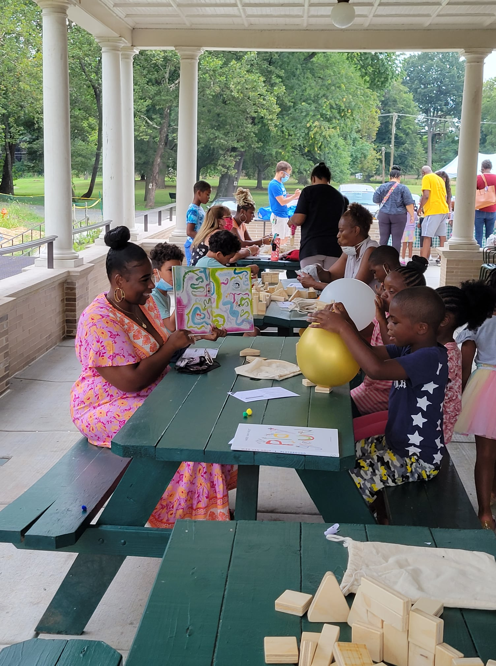
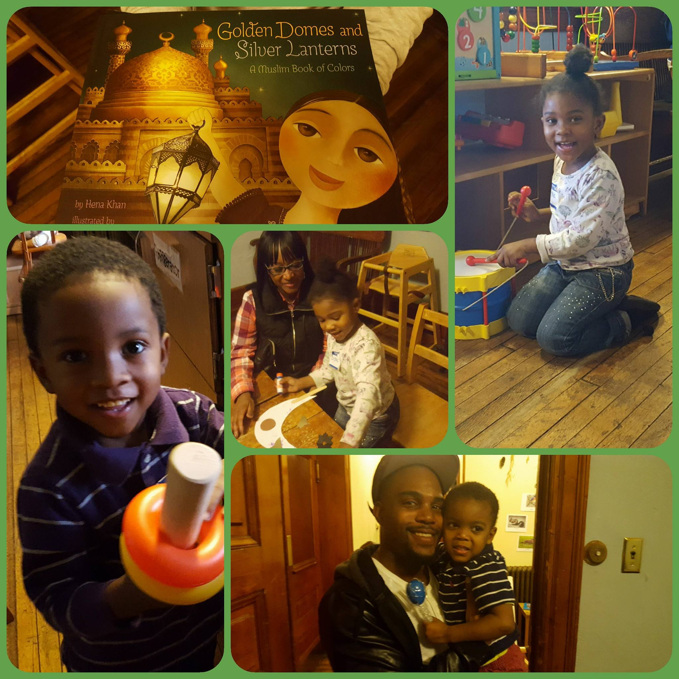
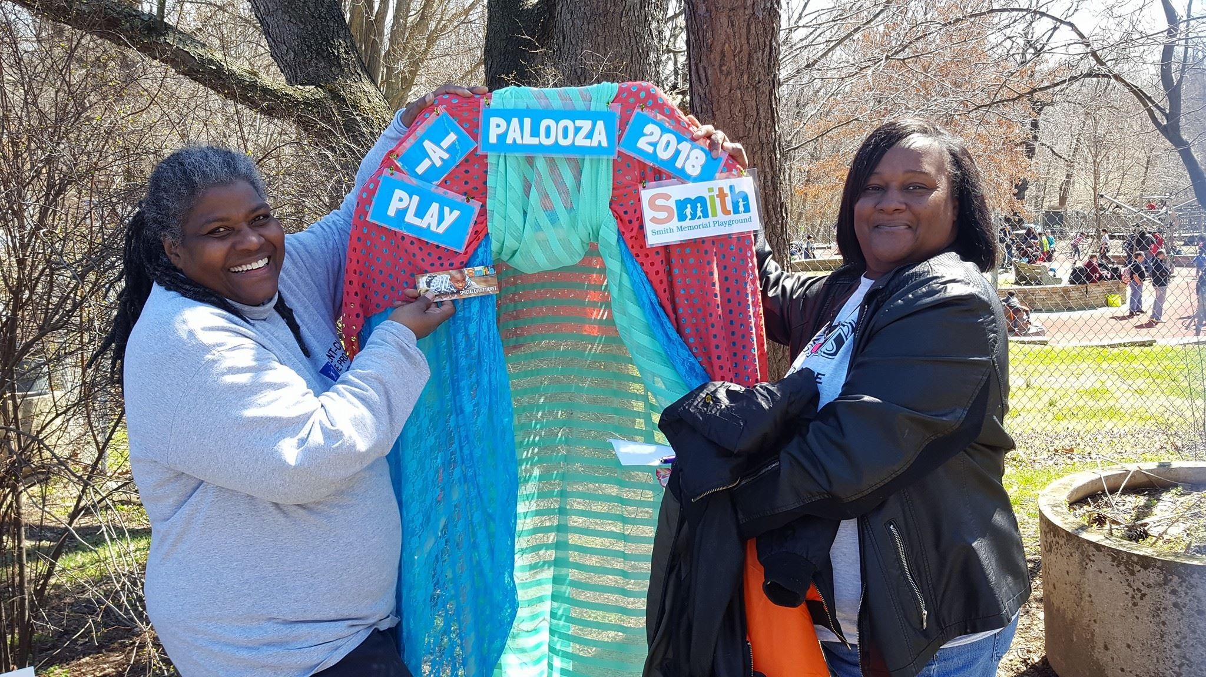
Families Enjoying Smith

Slide 9
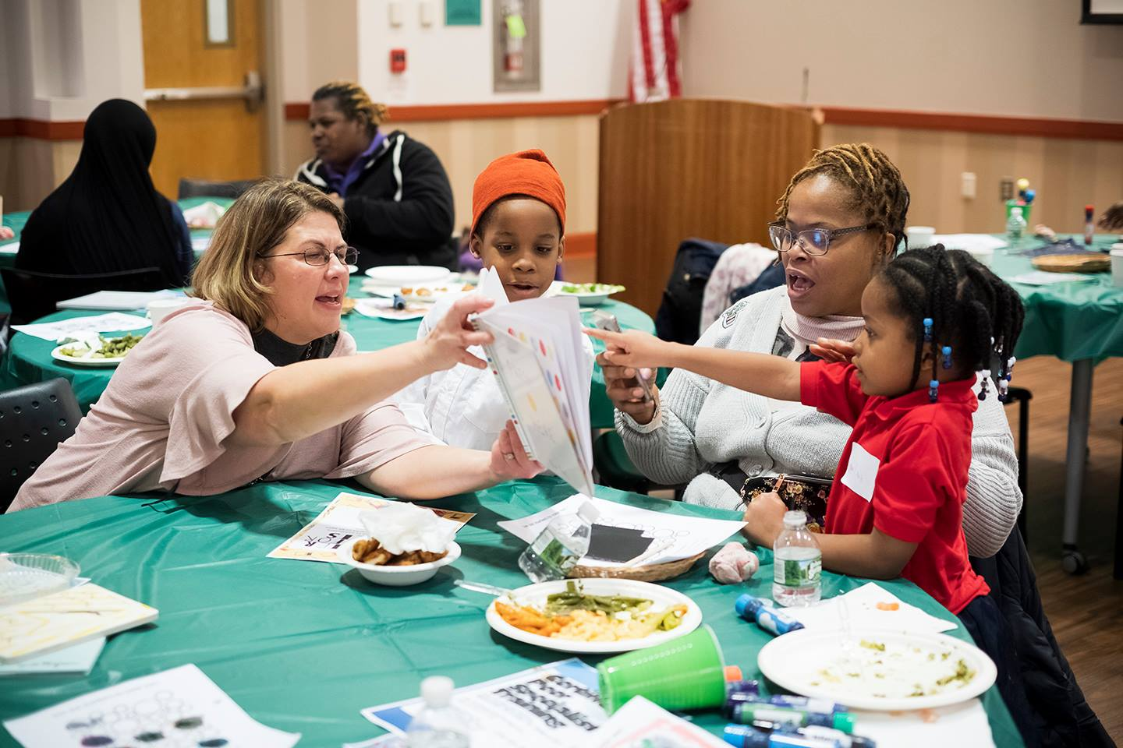
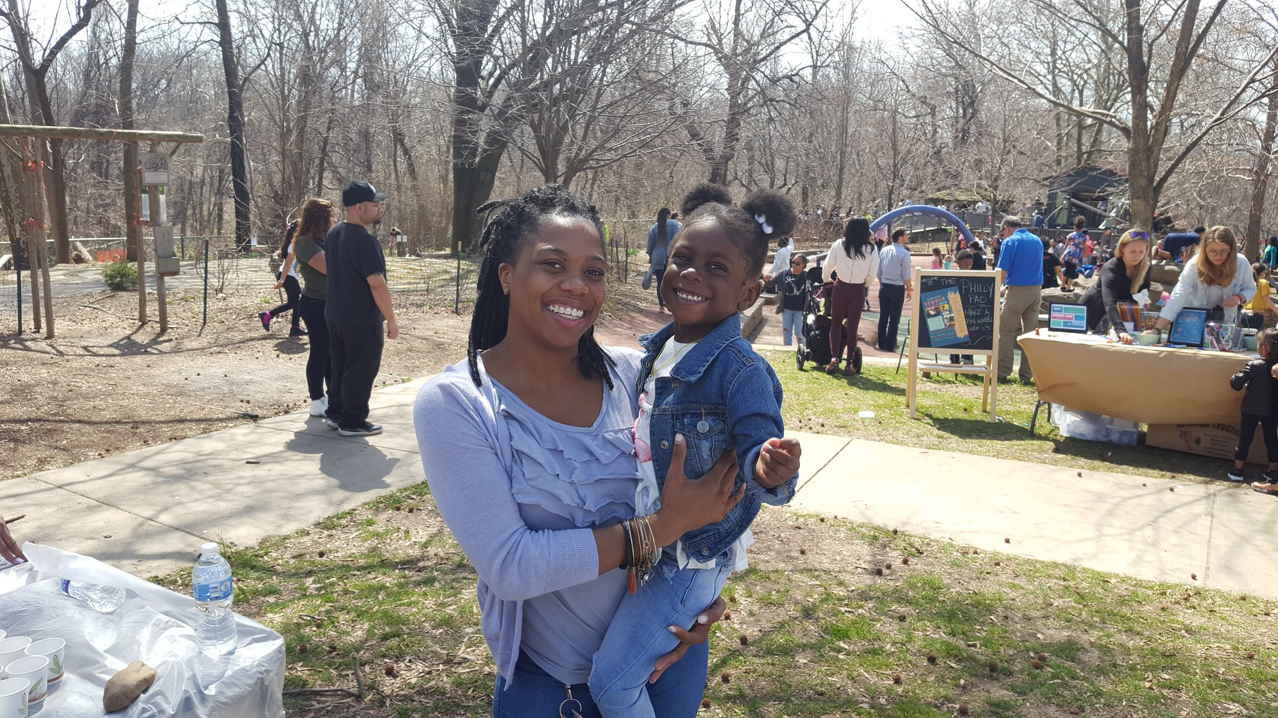
Families Enjoying Smith

Slide 10




Home Visiting Collaboration and Centralized Intake in Philadelphia
Section Title

Slide 11


Program model description
Philly Families CAN (PF-CAN) Overview
PF-CAN includes 22 programs:
  20 evidence-based home visiting programs
  2 Family Empowerment Centers offering community-based case management for families with children ages 0–18
Since October 2020, PF-CAN has sent over 2,000 referrals for home visiting services.
In 2024, PF-CAN received over 2,000 referrals for:
  Home visiting
  Concrete goods
  Community resources

Slide 12
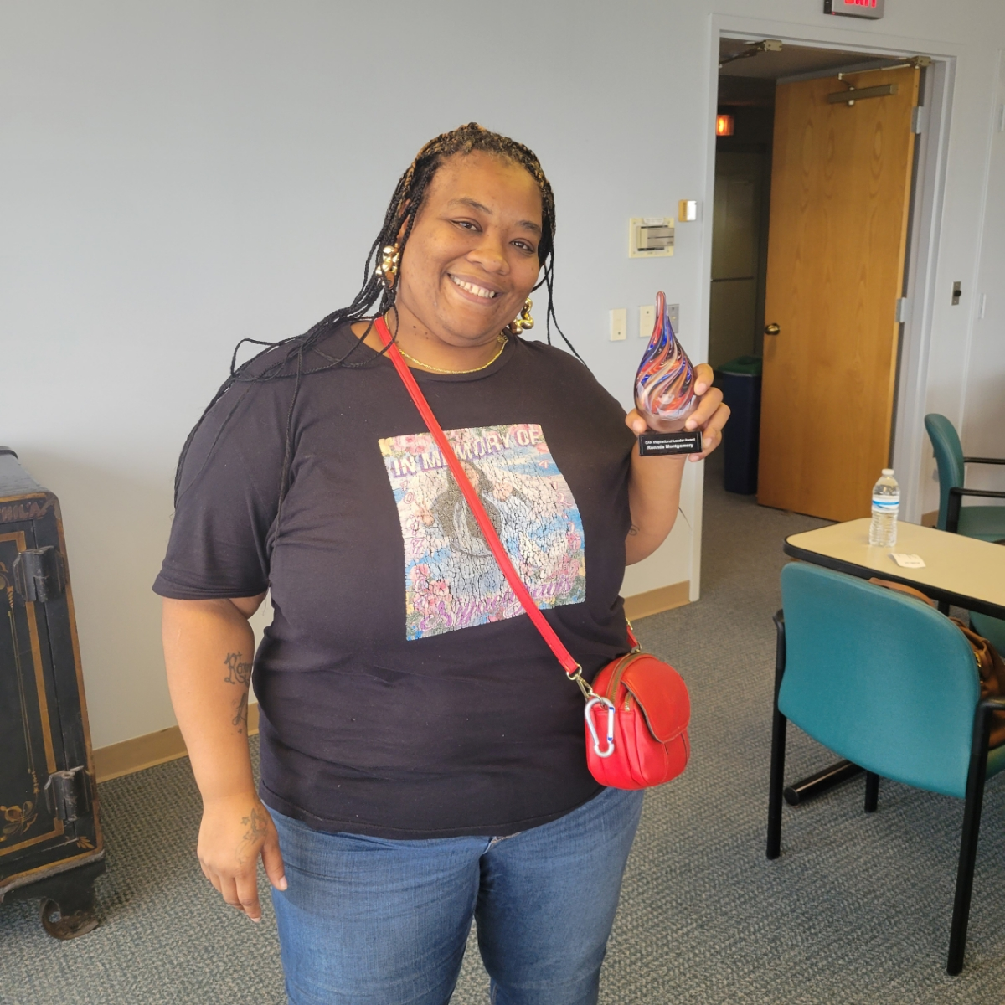
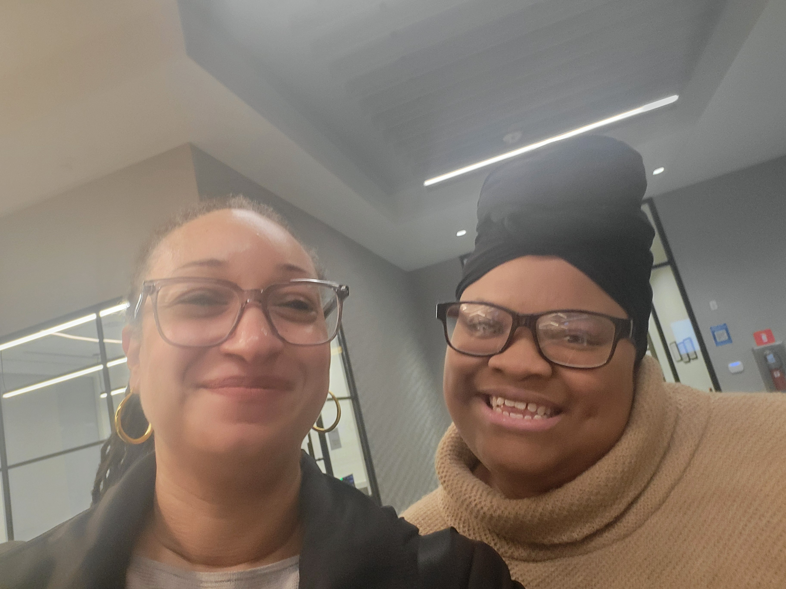
Together We Can
Together We Can is a community group made up of lived experience experts.
They serve as advisors to organizations joining the centralized intake system and on other key initiatives.

Slide 13
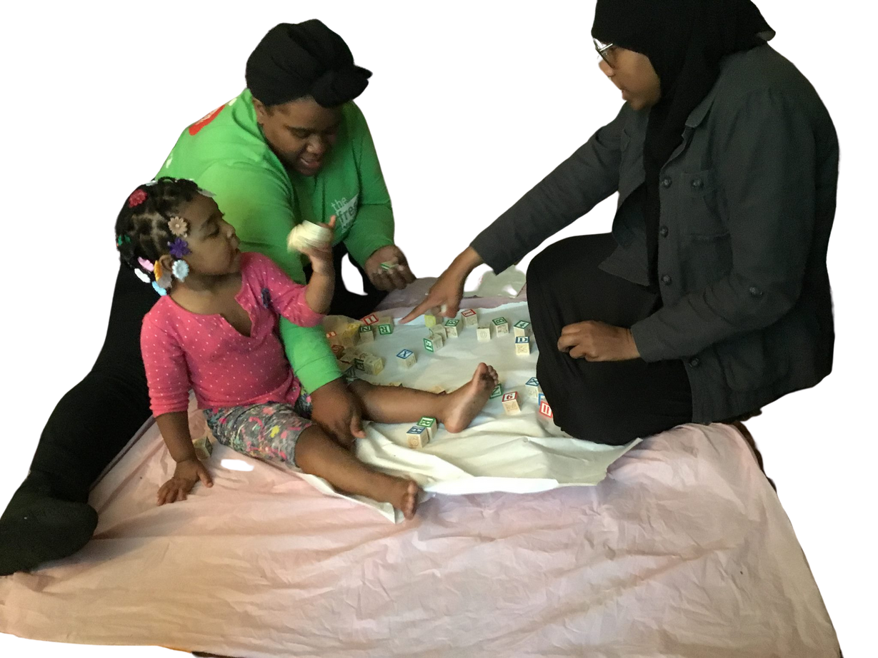
Parent Succeeding Project
Parents as Co-Producers: Parents are empowered as partners in achieving better outcomes for their children.
Project Goals:
Strengthen families’ agency and self-confidence
Create lasting, meaningful experiences for parents, children, and their relationships
Connect families with enriching cultural, educational, recreational, and social activities in their communities
ParentChild+ Supports:
Help families engage with local amenities (e.g., museums, parks, exhibits, events)
Remove barriers by covering admission, transportation, and meals
Fund and assist families in planning a special final event (optional)

Slide 14
Choosing Amenities
Invited families to meetings on Zoom (3 groups)
“Many of the families have never been to a museum here or in their home country.”- Gonzalo Carvajal, ParentChild+ Coordinator
Provided information on available amenities, what they could see or do there
Broke into small groups to discuss the various opportunities and decide what they would like to do

Slide 15
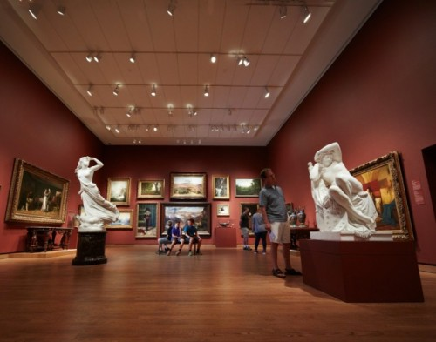

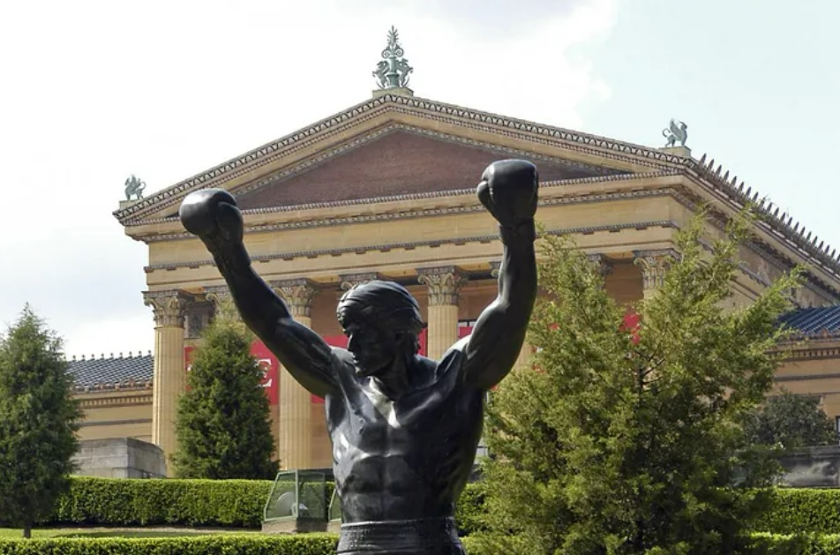

Art Museum of Philadelphia

Slide 16
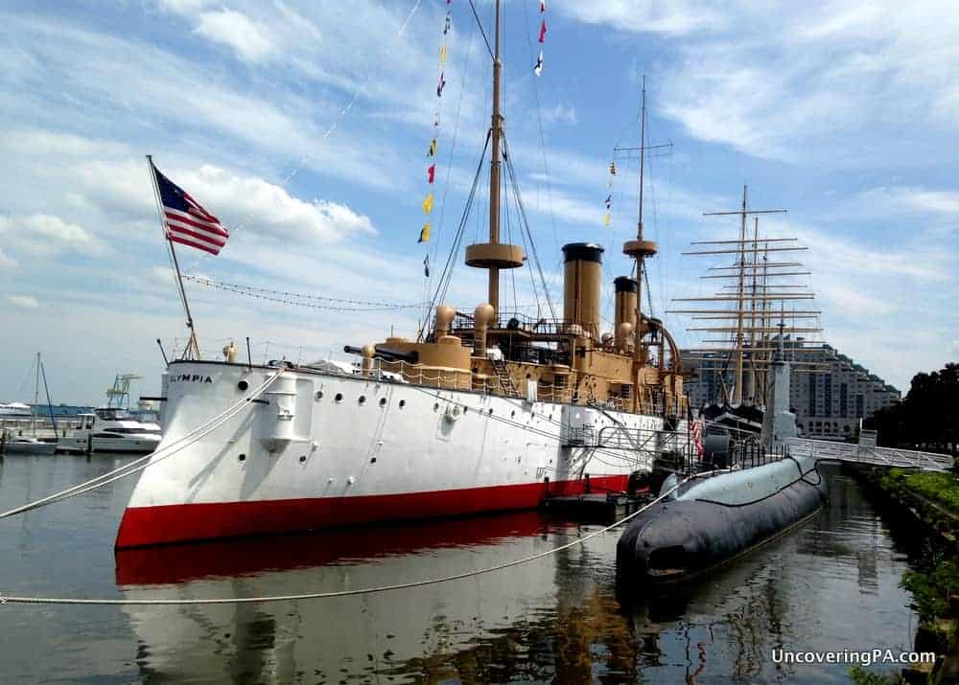
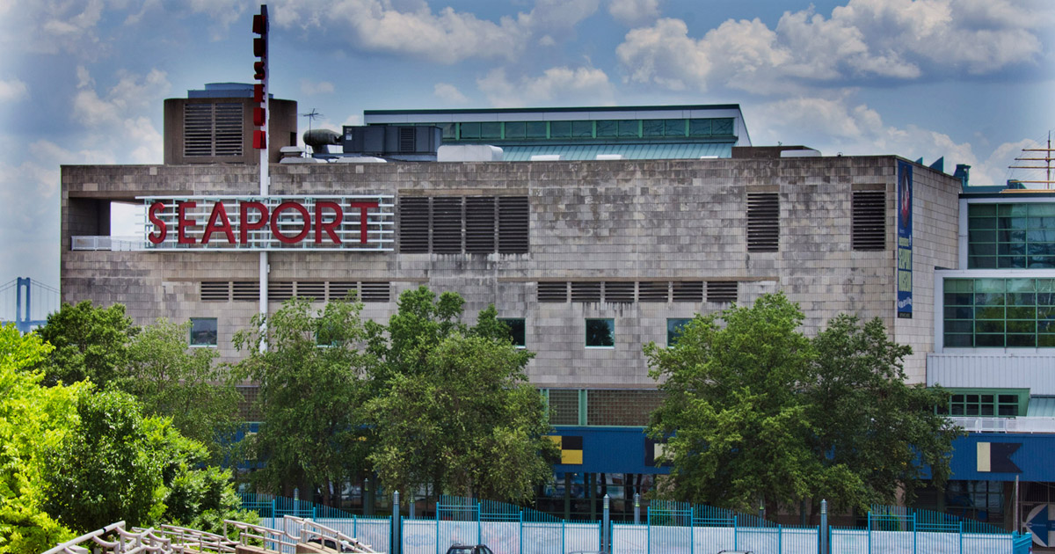
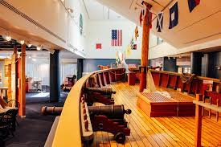
Independence Seaport Museum

Slide 17
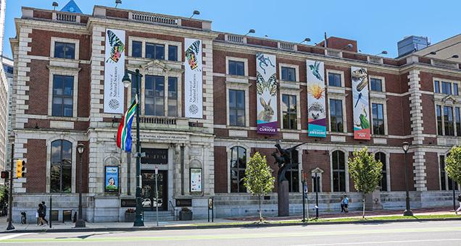
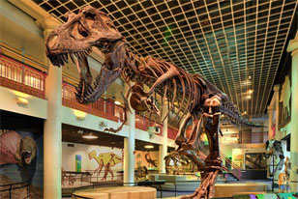
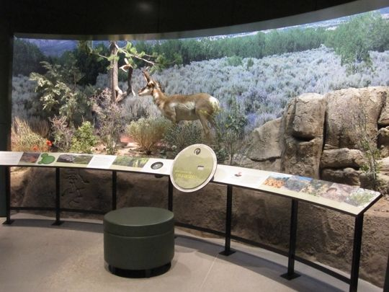
Academy of Natural Sciences 1900

Slide 18
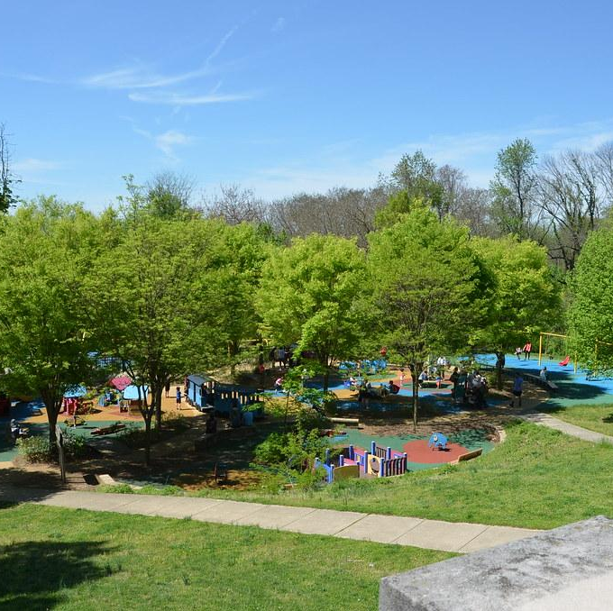
Choosing Amenities
3/3 groups chose the Adventure Aquarium and the Zoo
2/3 groups chose the Please Touch Museum
1 group chose the Insectarium
All were invited to Play-A-Palooza at Smith Memorial Playground
This Photo by Unknown Author is licensed under CC BY-SA-NC

Slide 19
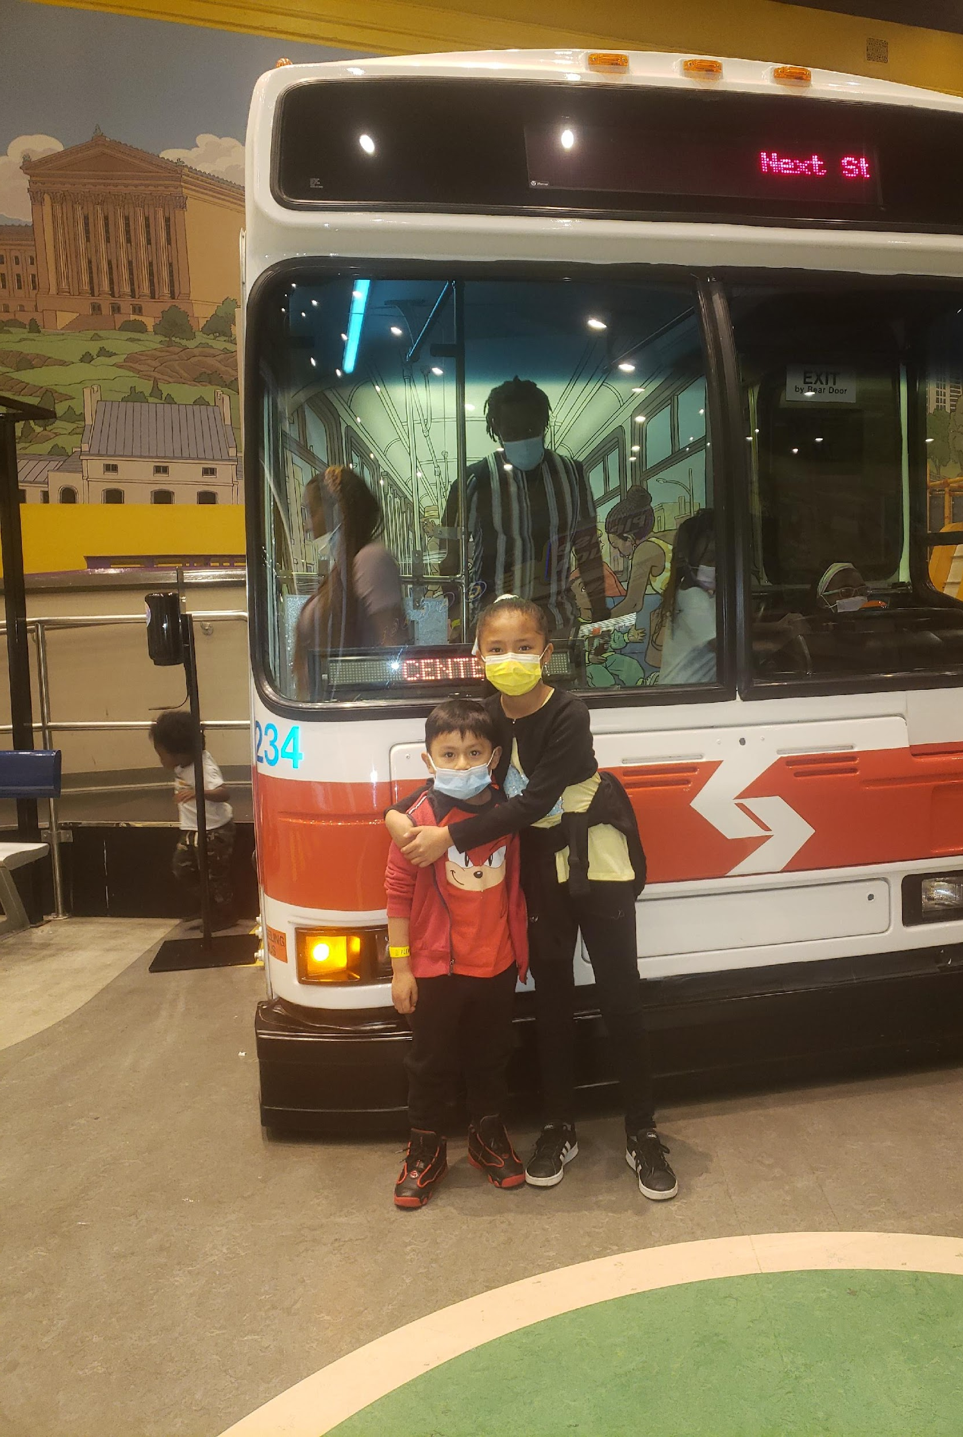
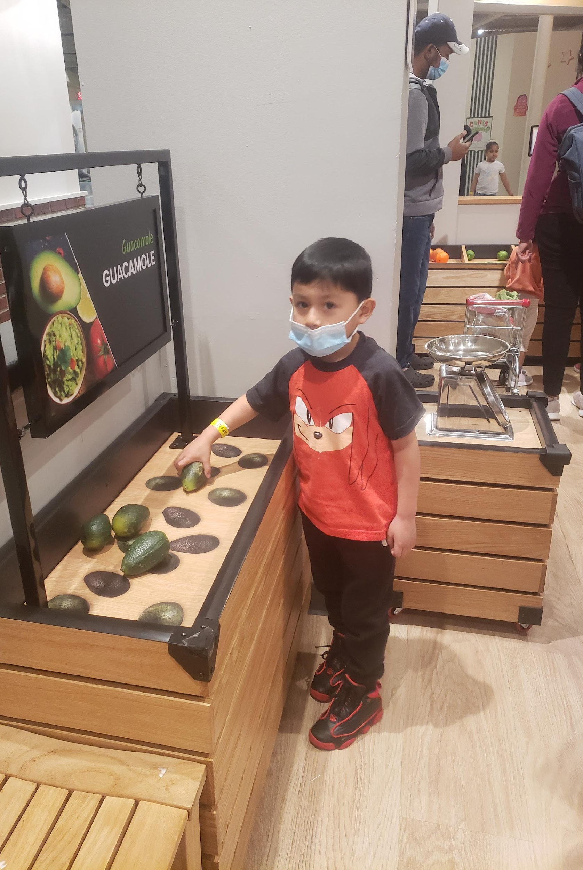
Please Touch Museum

Slide 20
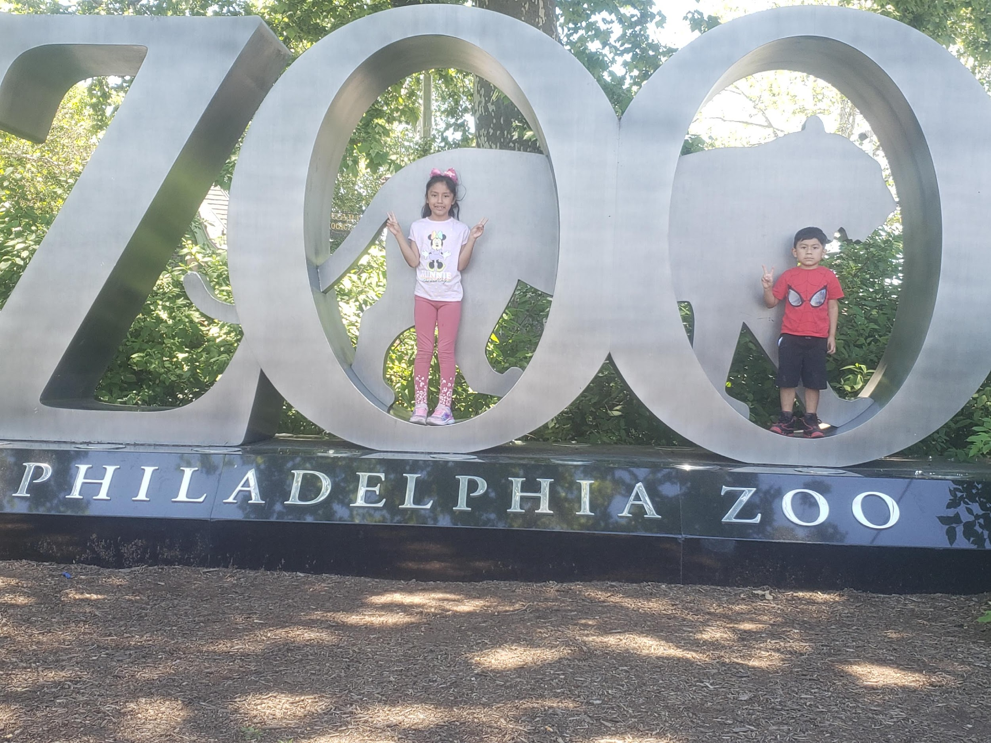
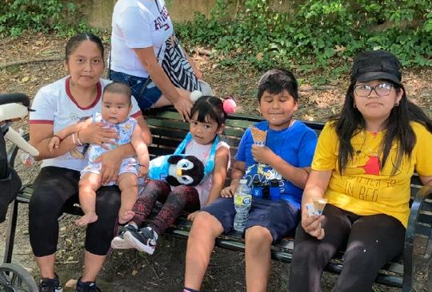
The Philadelphia Zoo

Slide 21
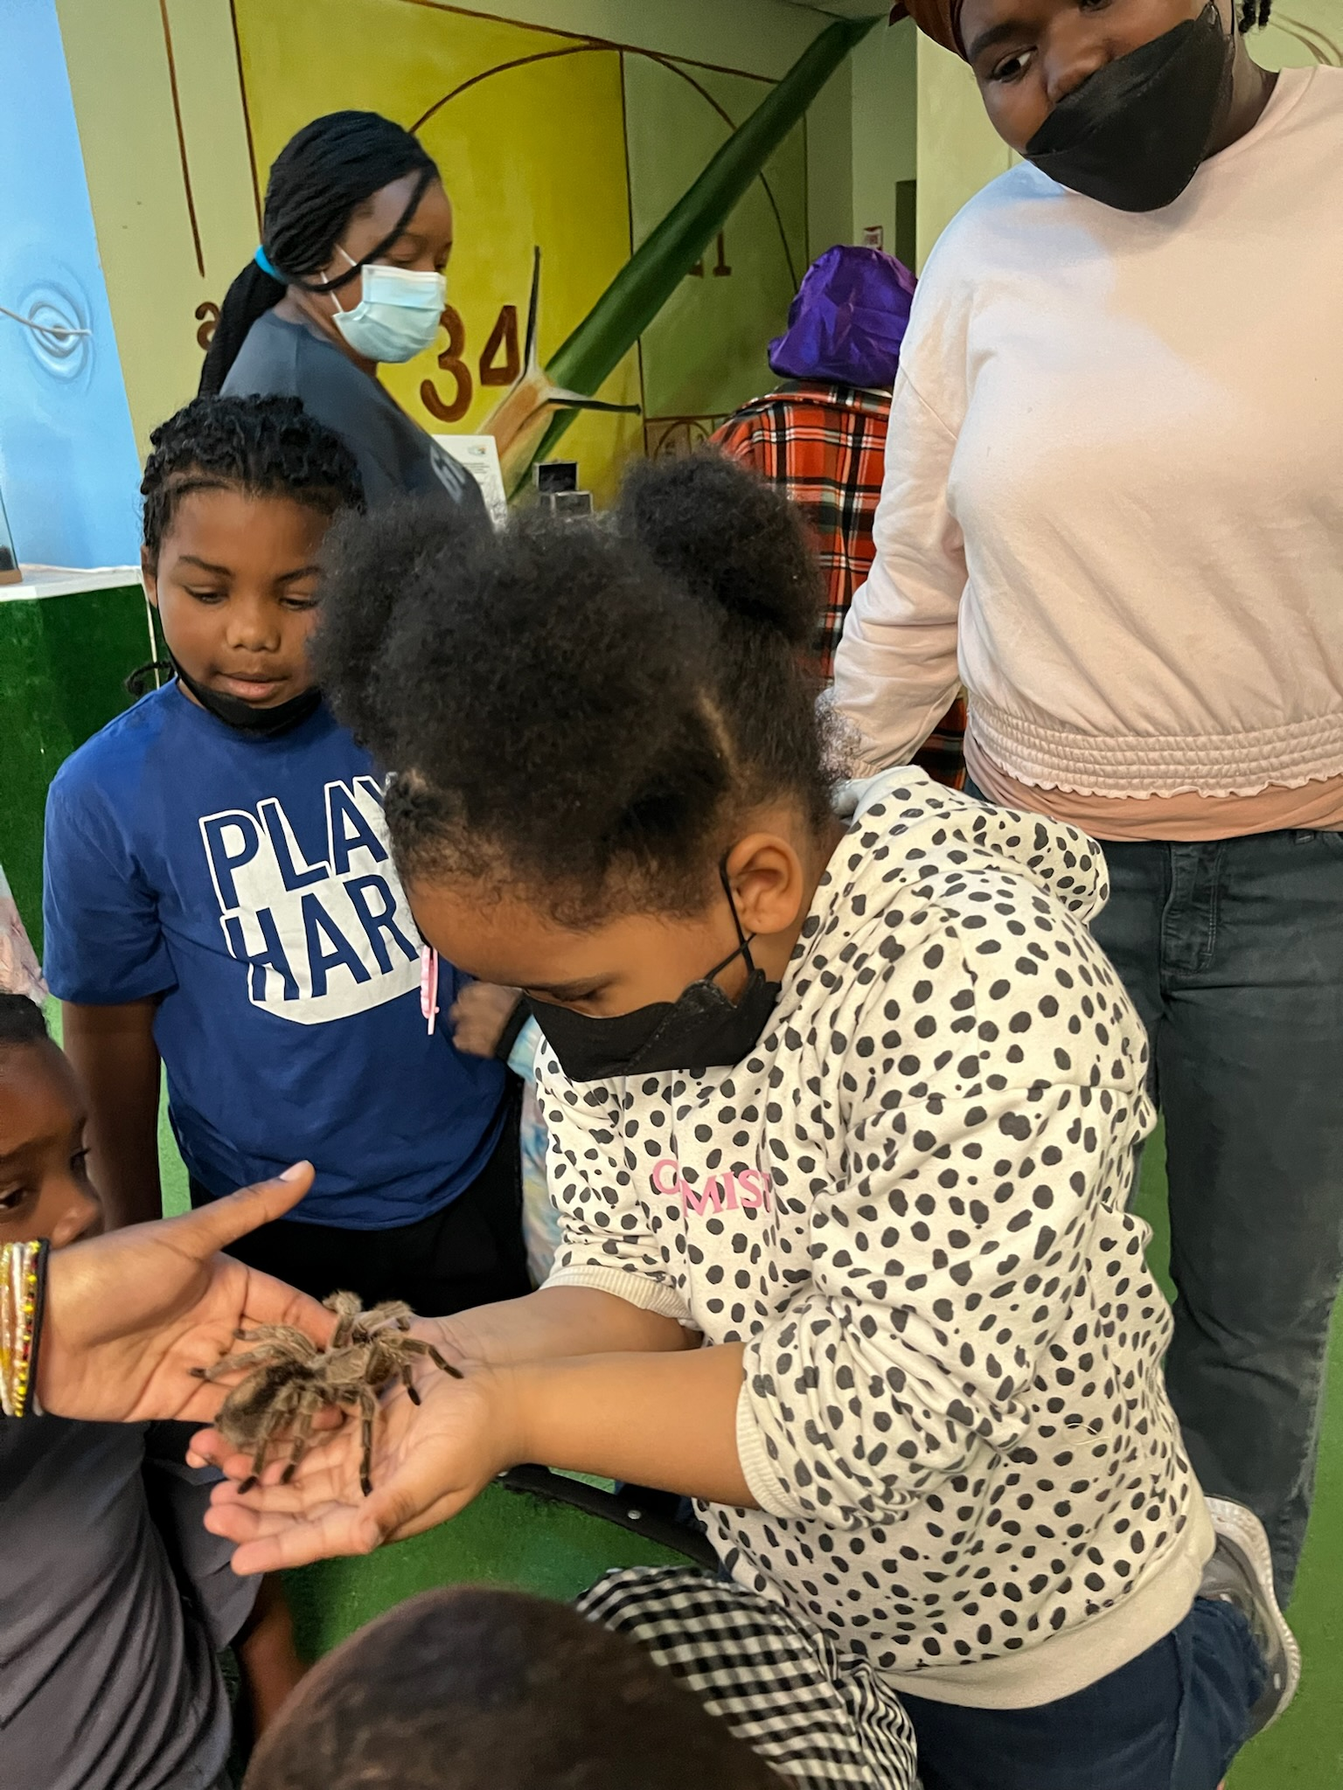
Insectarium
“My child really enjoyed being to see touch hold and feel many insects and reptiles.”- Parent
“We had a really good time at the Insectarium. This was the first time knowing about this place and coming to this place. It was an awesome experience.”

Slide 22
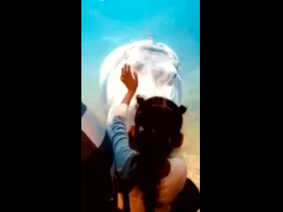
Adventure Aquarium
“The mother was very happy yesterday during the zoom visit with the ELS. She hear for the first time her spouse grateful to live in United States. He felt for the first time one program help to know a new place. He said probably the family never would go to the aquarium if this program never help. Also the mother said the father work a lot and sometimes feels nobody help the family, until now.” –Early Learning Specialist
video acuario 2.3gp - Google Drive

Slide 23
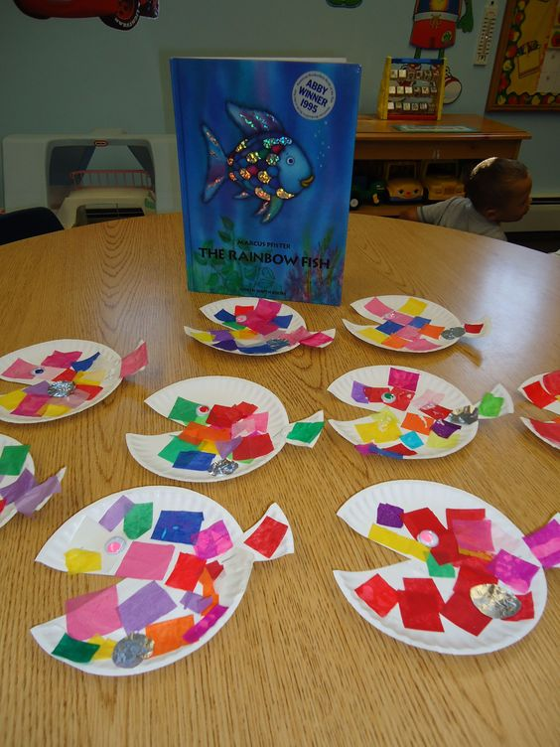
Support
Guide Sheets
Books
Activities
“Passport” and maps
Transportation, meals and tickets provided

Slide 24

Improving Outcomes for Families Experiencing Intimate Partner Violence (IPV) Through the Precision Home Visiting Project
In collaboration with IPV agencies, home visiting programs, city leadership, and lived experience experts, the project aims to strengthen services for families impacted by IPV.
  The project has explored how IPV affects families in home visiting programs and piloted a research-informed training and interagency champion model since 2023.
  We are excited about the new skills and insights this work is bringing to the home visiting landscape.

Slide 25



The Family Advocacy and Integrated Resources (FAIR) Project
In 2016, NNCC and HELP MLP In 2016, the Nursing-Legal Partnership (NLP) was created.
  Partners: Health, Education and Legal Assistance Project: A Medical-Legal Partnership (HELP: MLP) and National Nurse-Led Care Consortium (NNCC).
  Goal: Provide Legal Services along with HV to decrease stress and improve quality of life
In 2022, the William Penn Foundation awarded $5.4 million to NNCC (National Nurse-Led Care Consortium) and partners.
Notes:
Shamyra

Slide 26
The FAIR Project
In 2022, the Family Advocacy and Integrated Resources (FAIR) Project was created.
  no-cost civil legal services (housing, public benefits and income and insurance)
  crisis prevention funding (low barrier) within maternal child health home visiting programs to improve outcomes for families with low incomes in Philadelphia.
To date, over 2,400 legal matters have been resolved, and $1.1 million have been dispersed resulting in positive outcomes for families, including improved housing and income stability.
Notes:
Shamyra

Slide 27

Impact on ParentChild+ Families
To date, ParentChild+ staff referred 49 unique participants for support. Many participants had more than one unmet need.
Housing insecurity was most frequent need
Other needs included educational, utilities, furniture

Slide 28
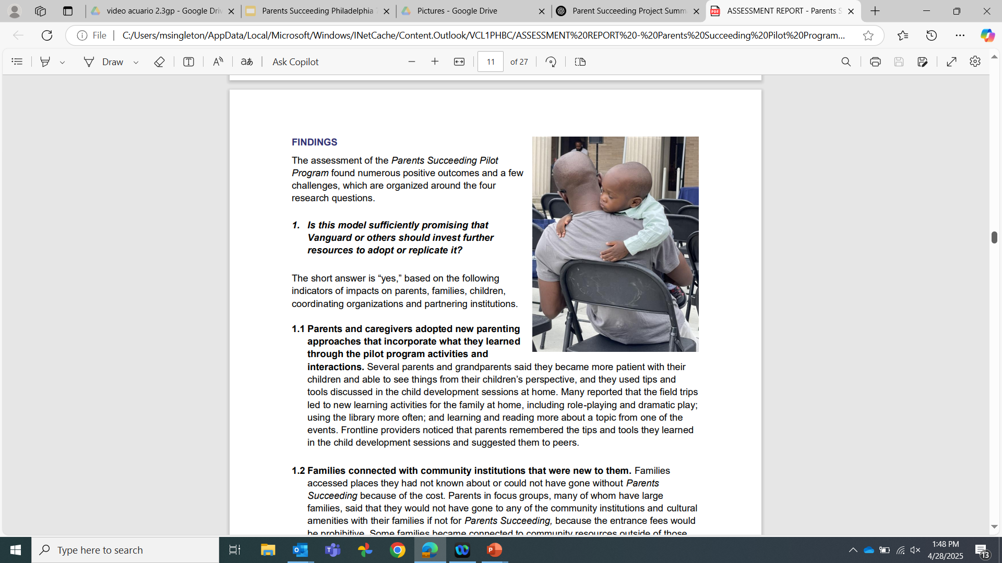
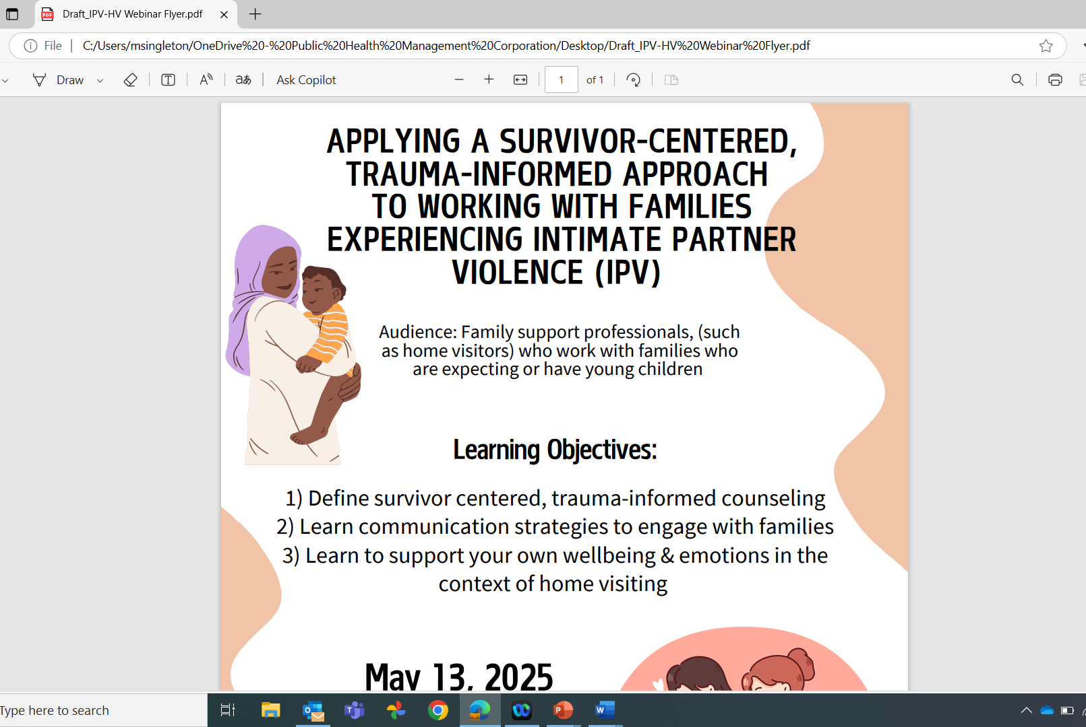
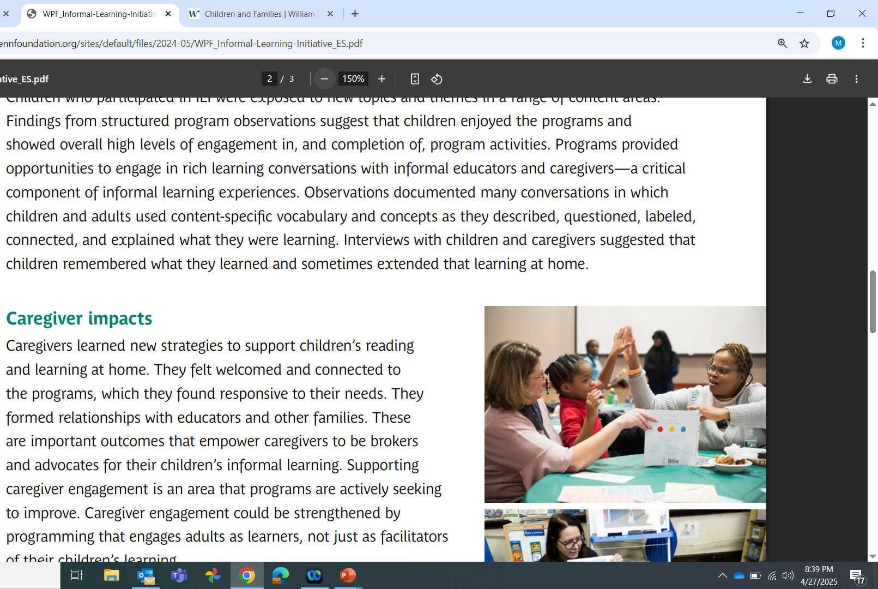
Impact on Systems

Slide 29
Lessons Learned
Communication
Relationships
Relinquishing control

Slide 30
Section Contact Info:
Katie Rubinstein
Director of Home-Based and Informal Learning Initiatives, Public Health Management Corporation(PHMC)
kmeister@phmc.org
Malkia Singleton Ofori-Agyekum
Mid-Atlantic Regional Director,
ParentChild+
msingleton@parentchildplus.org

