Slide 1
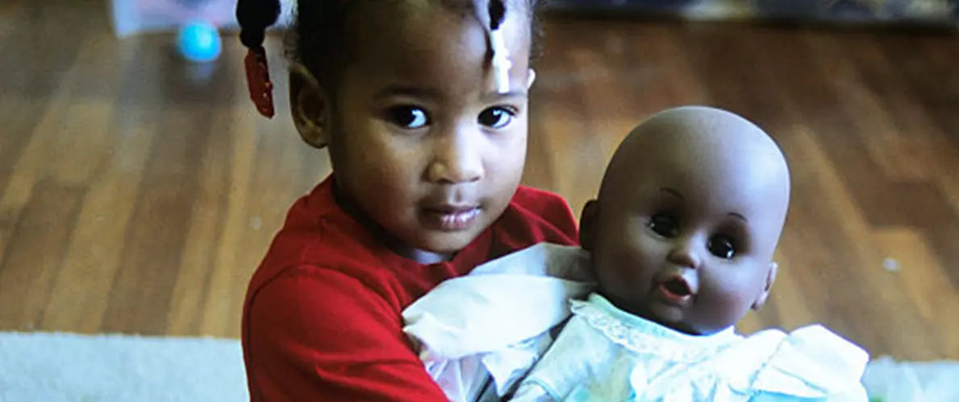

Promoting Black Children’s Positive Identity Development 70 Years After Brown v. Board

Slide 2
Agenda
Introductions (10 mins)
Opening Activity (25 mins)
Past Research (15 mins)
Recent Research (20 mins)
Concluding Activity (15 mins)
Closing Thoughts (5 mins)

Slide 3
Introductions
01

Slide 4
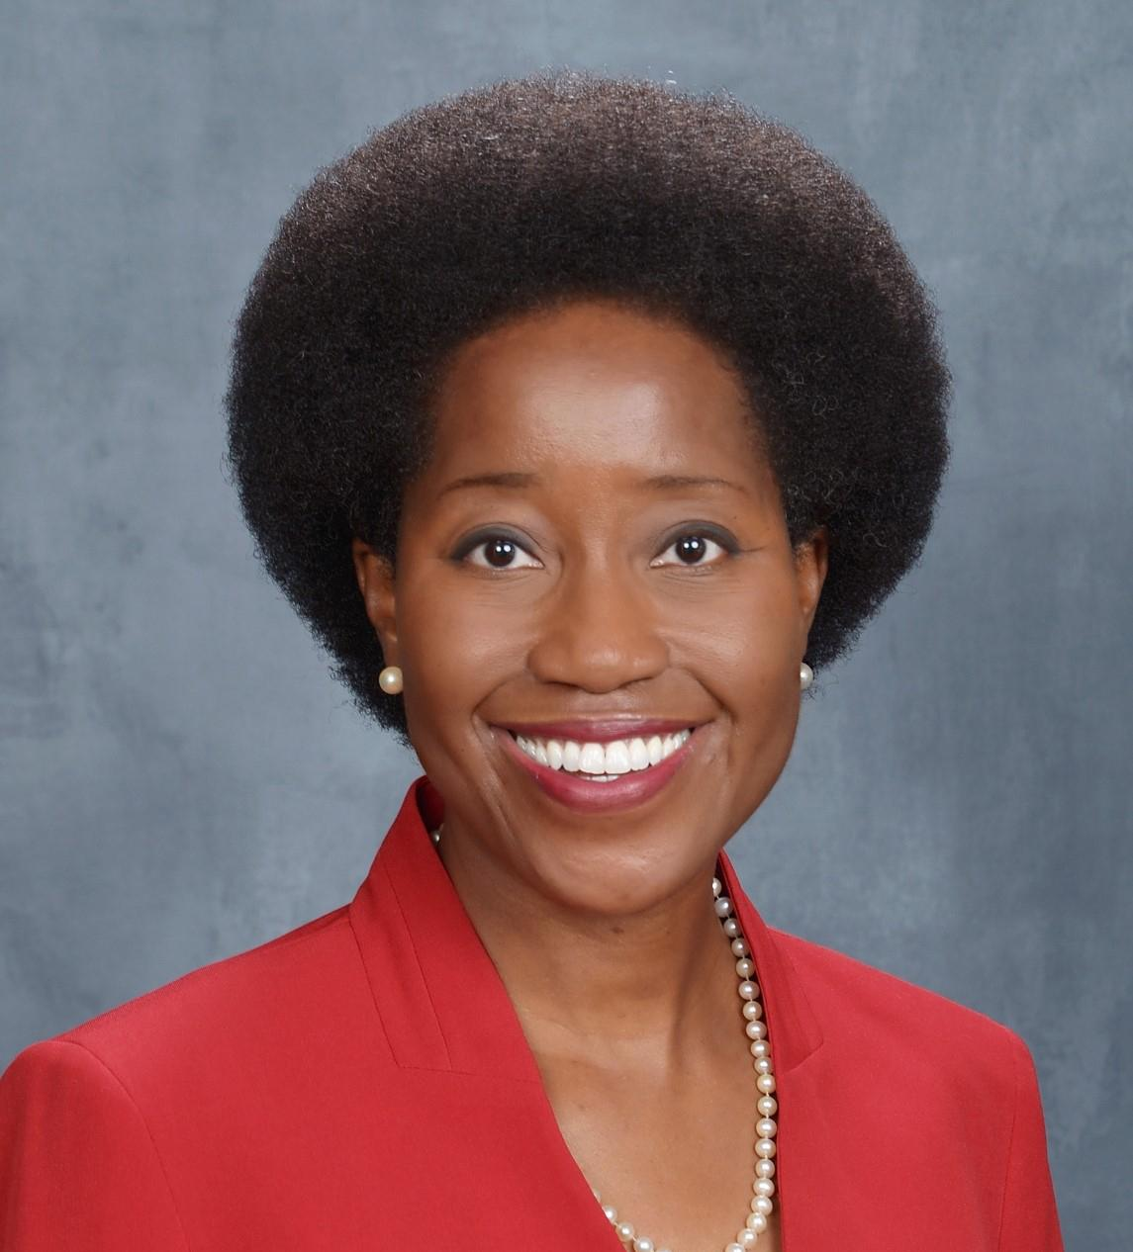
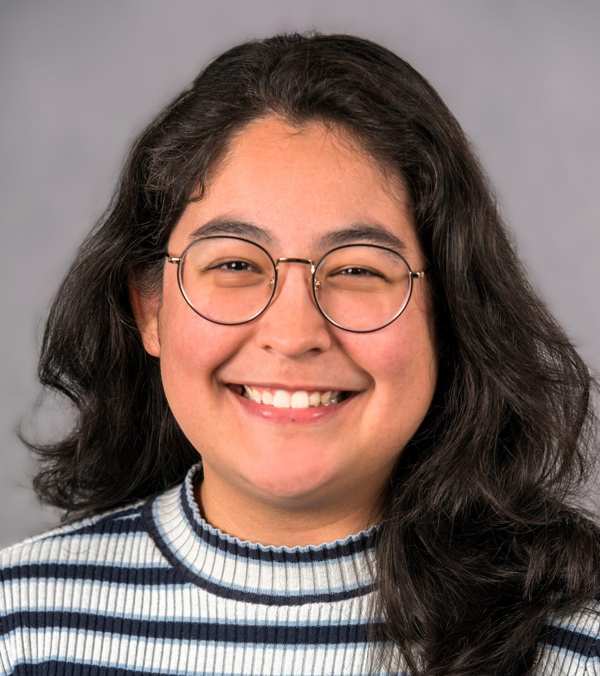
Facilitators
Mavis Sanders
Senior Principal Researcher
Learning Policy Institute
Dominique N. Martinez
Research Analyst
Child Trends

Slide 5
Opening Activity
02

Slide 6

Childhood Reflections: Small Group Discussion and Share-Out
Prompt: Think about the books from your childhood.
  What memories or emotions do you associate with those books?
  Did you see yourself in those books?
  What books do you remember from childhood, and why?
  What images do you remember?
  Looking back now, what kinds of books do you wish had existed when you were younger?

Slide 7
Past Research
03

Slide 8
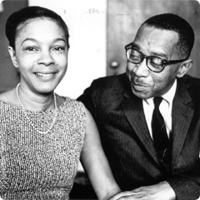
Dolls Studies (1939)
Drs. Mamie Phipps Clark and Kenneth B. Clark
Background/Methods:
Children were presented with dolls differing in skin/hair color and given prompts to reveal: a) racial preferences, b) knowledge of racial differences, and c) awareness of racial self-identification.
Key Findings:
Children were aware of “racial differences” as defined by skin color, with most preferring the White doll over the Black doll.
What about those students who did not reject the Black doll?
  Most attended racially segregated schools in the South led by Black educators rather than racially mixed schools in the North.
Photo courtesy of Columbia C250
Notes:
Understanding the factors that shielded these children from the effects of racism on their identity development could have informed desegregation plans/methods, preserving sources of support, resilience, and protection for Black students.

Slide 9
Discussion Question
To what would you attribute the study’s findings? What features might have been present in those segregated schools that contributed to these results?
Notes:
Understanding the factors that shielded these children from the effects of racism on their identity development could have informed desegregation plans/methods, preserving sources of support, resilience, and protection for Black students.

Slide 10
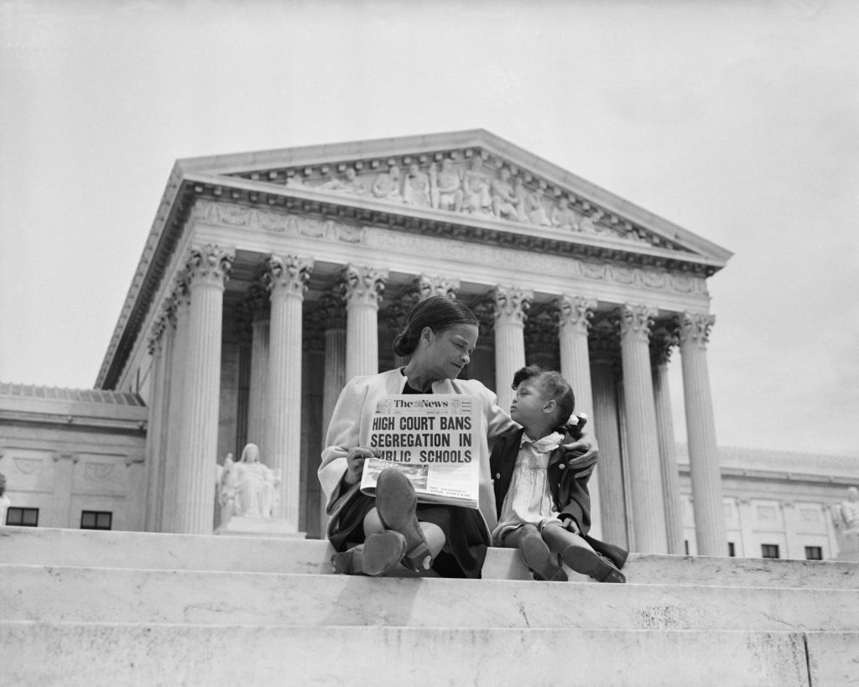
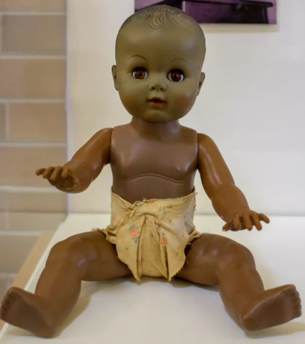
Influence on Brown v. Board (1954)
NPS Photo by Visual Information Specialist Preston Webb
Photo by UPI/Bettmann
The doll studies were critical to the Supreme Court's unanimous ruling against school segregation, highlighting the impact of segregation on racial identity and preferences in Black children.
Notes:
The session will examine how these studies revealed the profound impact of racial bias on children's self-perception and identity, as well as the protective factors that shielded some children from its harmful effects.

Slide 11
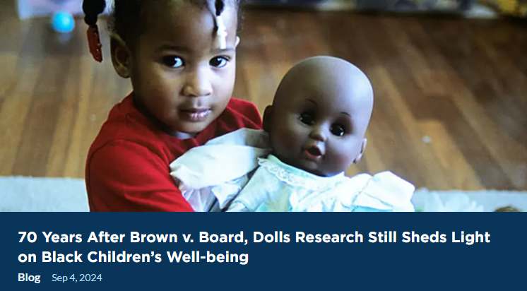
70 Years Since Brown
Subsequent Doll Studies: Differences Based on Child’s Demographics:
Income:
  Middle-income Black children show greater out-group preferences than their Black peers with lower incomes (1969).
Age:
  Age affects racial preferences among Black children, with older children showing either greater in-group preference or no racial preference (1995).
Sex and Gender:
  Black boys exhibit higher rates of out-group preferences than Black girls under some conditions (1969) but not others (2017).
Notes:
The session will examine how these studies revealed the profound impact of racial bias on children's self-perception and identity, as well as the protective factors that shielded some children from its harmful effects.

Slide 12


Interventions Can Make a Difference
Anti-Black preferences are at least temporarily malleable among young children (1988) through interventions such as exposure to heroic Black figures in moral stories.
Notes:
The session will examine how these studies revealed the profound impact of racial bias on children's self-perception and identity, as well as the protective factors that shielded some children from its harmful effects.

Slide 13
Recent Research
03

Slide 14
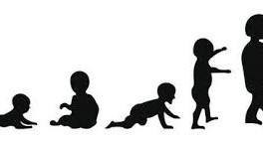
Recent Research: What We Know
  Positive racial identity is a critical part of a child’s development that is linked to:
  Academic Achievement
  Socioemotional Well-being
Factors influencing young children’s racial identity development:
  Families
  Schools/Teachers
  Community (e.g., faith-based orgs.)
  Media (e.g., books, tv, videos)
Source: https://equity-coalition.fpg.unc.edu/wp-content/uploads/IIruka-et-al_Ethnic-Racial-Identity-Collaborative-Research-Summary-2021.pdf
Notes:
Participants will also learn how more recent dolls studies continue to shape our understanding of identity development in Black children today

Slide 15
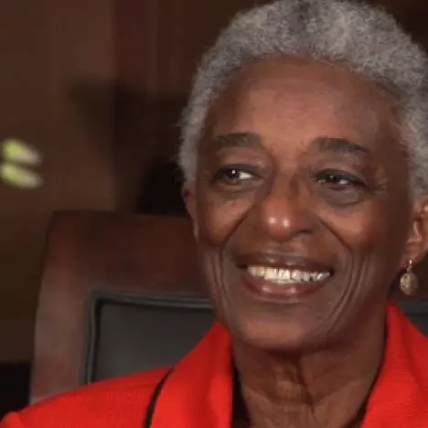
Diverse Books and Positive Racial Identity
Rudine Sims Bishop, professor emerita at
Ohio State University, AKA the
mother of multicultural children’s literature
“Books are sometimes windows, offering views of worlds that may be real or imagined…[They] are also sliding glass doors, and readers have only to walk through in imagination to become part of whatever world has been created or recreated by the author…. Literature transforms human experience and reflects it back to us, and in that reflection, we can see our own lives and experiences as part of the larger human experience. Reading then becomes a means of self-affirmation, and readers often seek their mirrors in books.”
Notes:
Participants will also learn how more recent dolls studies continue to shape our understanding of identity development in Black children today

Slide 16
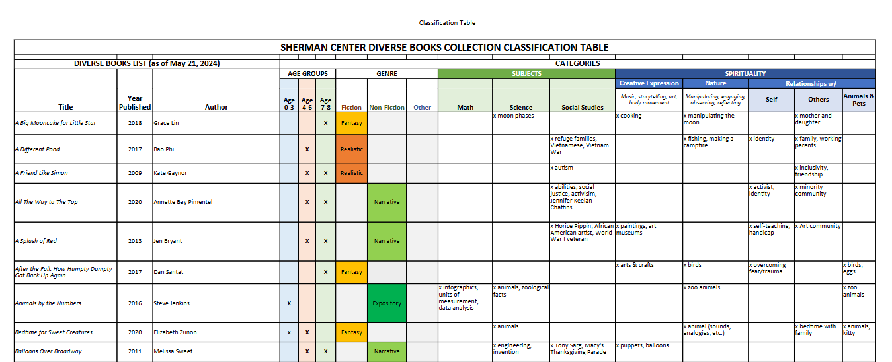
A Curated List of Diverse Children’s Books
https://umbc.app.box.com/s/eeo8yfn8cuey63ophnlzysagyi7pad0j
Notes:
Participants will also learn how more recent dolls studies continue to shape our understanding of identity development in Black children today

Slide 17

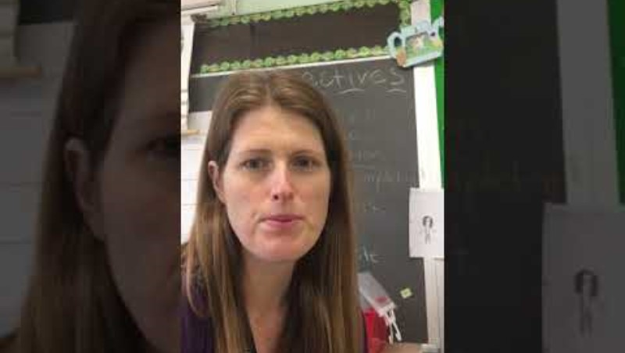
Diverse Books in Practice
https://www.youtube.com/watch?v=YT-n-uL9n6A
Marisol McDonald Doesn’t Match
https://www.youtube.com/watch?v=kkAd4si49X0
Separate Is Never Equal: Sylvia Mendez and Her Family’s Fight for Desegregation and Green is a Chile Pepper

Slide 18
Concluding Activity
04

Slide 19

Takeaways and Application
Prompts:
  What is one takeaway that you want to remember or share with others from this session?
  How do you plan to apply what you’ve learned?

Slide 20
Closing Thoughts
05

Slide 21

Closing Thoughts
Thank you!
Stay in Touch
We’d love to hear from you!
https://www.childtrends.org/
Mavis Sanders
msanders@learningpolicyinstitute.org
Dominique N. Martinez
dmartinez@childtrends.org

