Slide 1
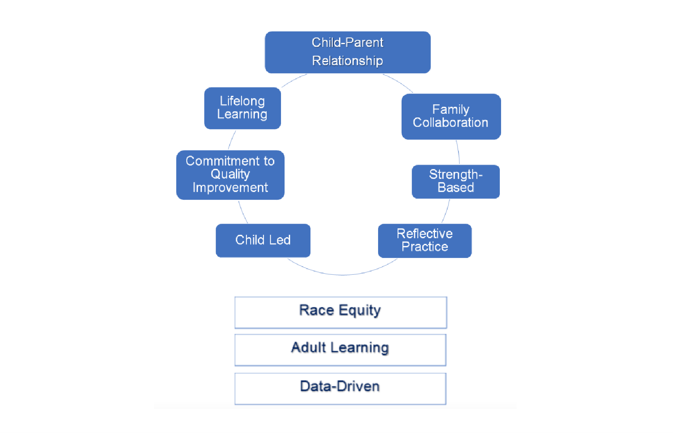
ParentChild+ core values

Slide 2
In your small group, select one person to facilitate the discussion and another to report back to the larger group.
As a group, develop a working definition of your assigned core concepts, focusing on how they connect to program implementation.
Go beyond the “what” of the concept—discuss the “how:” How do we move from broad, conceptual ideas to real, practical steps that can be operationalized in our work?

Slide 3
Group 1: Race equity, parent–child interaction, child-led practice, parent collaboration
Group 2: Adult learning, strength-based approach, reflective practice
Group 3: Data-driven practice, commitment to quality improvement, lifelong learning

