Slide 1

Equal Possibilities from the Start
Coordinator’s Role as Trainer: Parallel Process and
Turn-key Training
Vidya Ragoo, National Director HBCC Model
September 30, 2025
Notes:
We’ve been reviewing the parent’s role in home visiting, the ELS role in home visiting, and now we’re going to look at your role in home visiting, your role as a coach.
When I first met with you last week, we discussed your role as trainer, gathering information about what trainees need, listening to their experiences, and providing skills and knowledge through training, online training, and technical support (portal/DAISY).

Slide 2
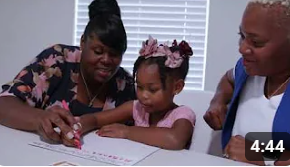

How We Support Families and Providers
Family Home Visiting Model
30 min visits
46 weeks
Home Based Child Care (HBCC) Model
45 min visits
24 weeks
2xs per week
92 visits total
2xs per week
48 visits total
https://www.youtube.com/user/ParentChildHomeProg
2
Notes:
V

Slide 3

Agenda
Training Content Review
Parallel Process
Turnkey Strategies

Slide 4
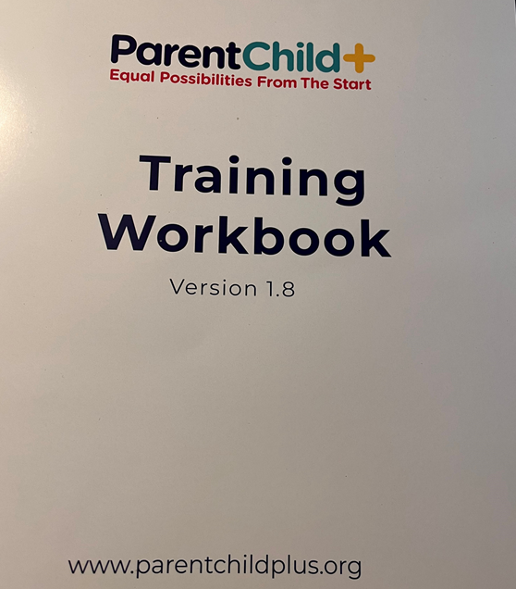
By show of emoji hands, how many people:
Trainee Questions:
Read the agenda or reviewed the workbook?
Reviewed the Elevate content prior to training?
Accessed DAISY or the Staff Portal?
Trainee Suggestions:
1. Review the daily agenda and take notes.
2. Check your log-in status and explore the tech resources.
3. Communicate any difficulties, either via email, survey, or stay after the training.

Slide 5


Slide 6
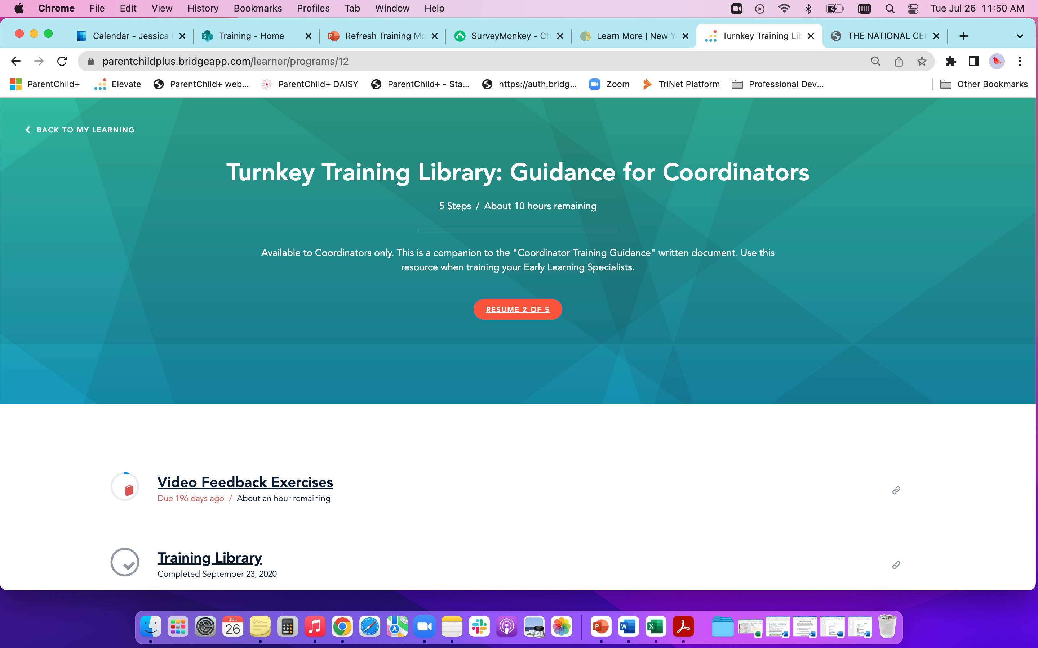

Slide 7
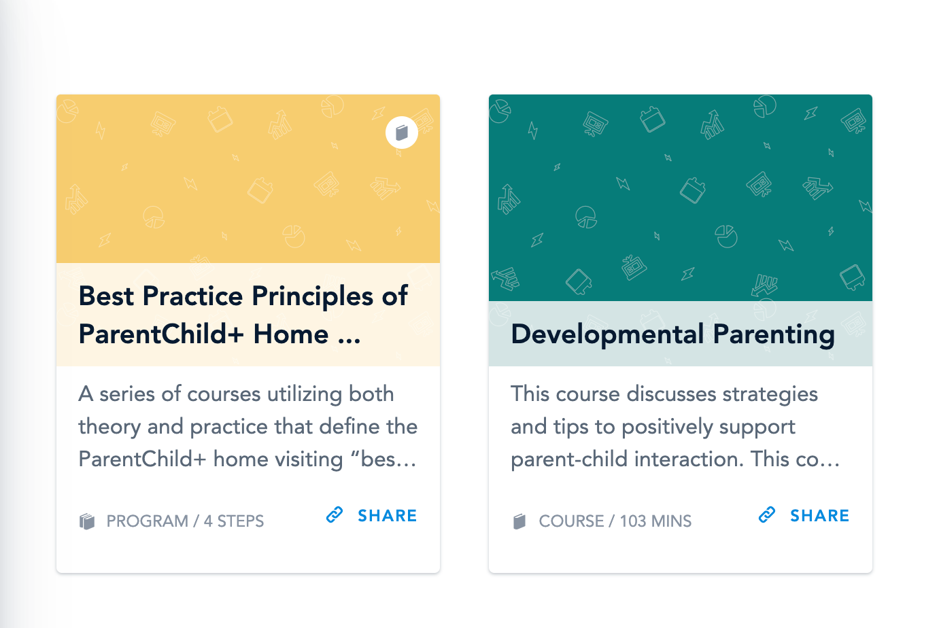
Elevate Courses

Slide 8


Access Staff Portal:
Training Guidance and Turn-key Training Strategies
Universal login: staff@parentchildplus.org
Password: parentchildstaff1965!

Slide 9
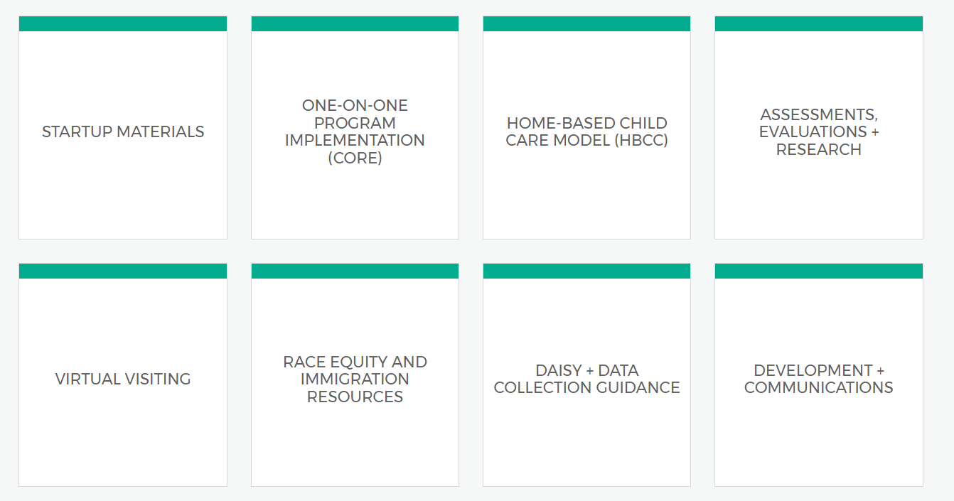

Slide 10

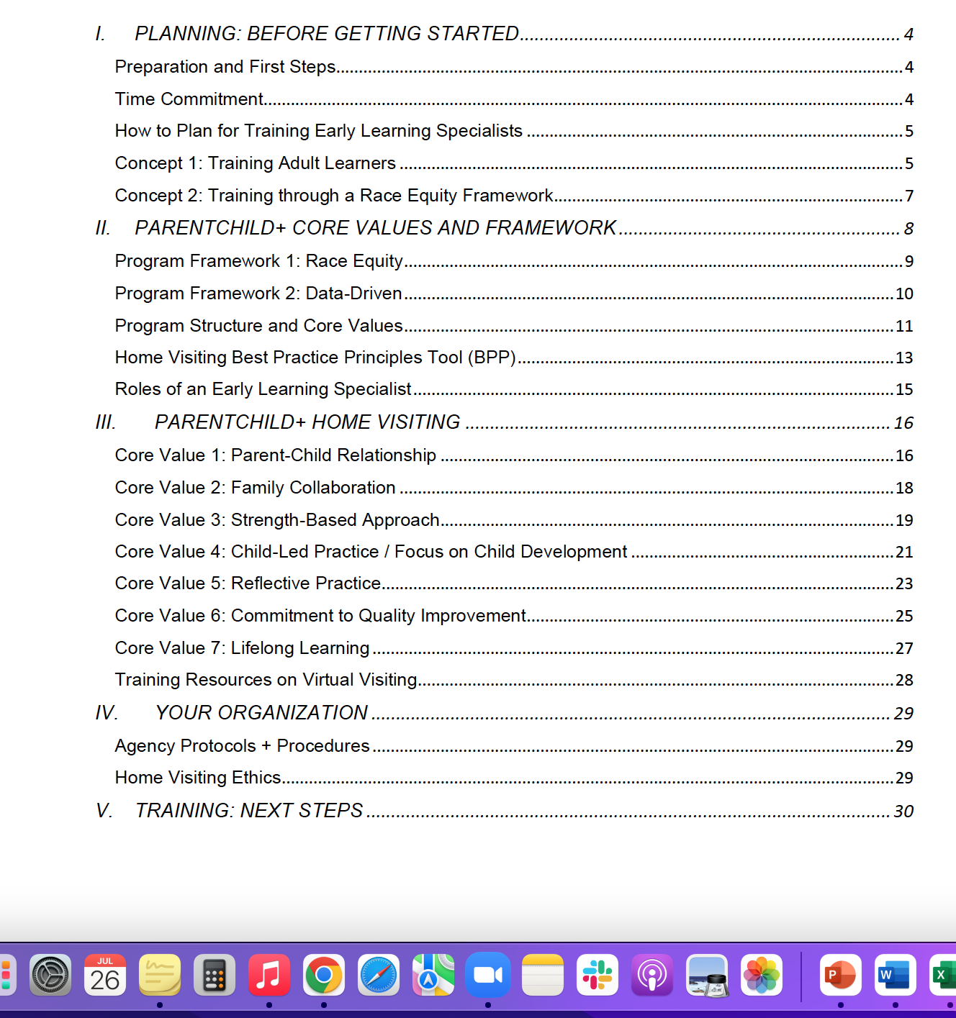
Start-Up Folder

Slide 11

Coordinators as Trainers

Slide 12

In small groups – use p. 6 and p.7, the “Know, Wonder, and Learn” framework to create a shared definition of parallel process.
Notes:
Meet as a group. Assign a speaker for the large group chat. Assign a scribe who will be prepared to write the definition in the chat. (Do not write it in the small group chat – it will not save.

Slide 13
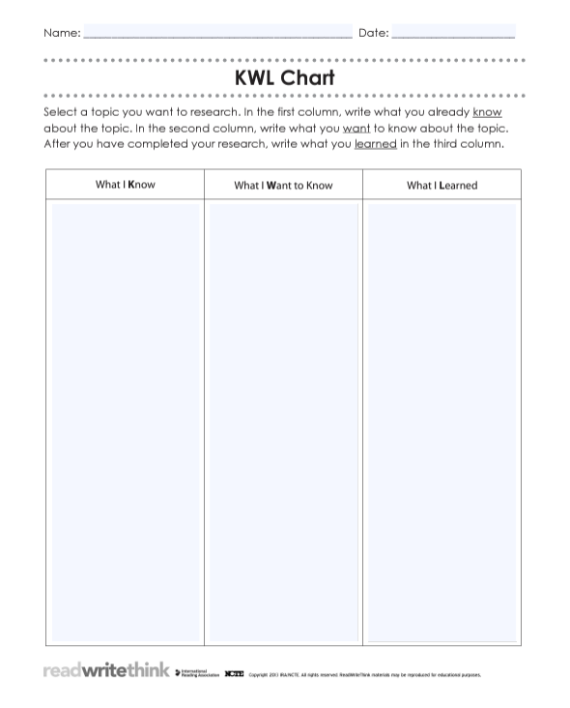

Know, Wonder, Learned
Notes:
https://www.readwritethink.org/sites/default/files/KWL%20Chart.pdf

Slide 14
What We Know: Training Session: September 2025 | What I Want to Know: | What I Learned:
Group 1: | Side by side learning and teaching
Group 2: | Involves the staff learning side by side with another staff member; guiding parents – when a situation happens during a session, we help them side by side – to enhance learning opportunities – what we want to know: when is it appropriate to use it – reflective practice for staff and parents
Group 3: | Parallel means side by side – ELS learn from coordinators/coordinators learn from ELS; parents learn from children and children learn from parents; wonder – what is the actual difference
Group 4:

Slide 15
Parallel Process at ParentChild+
Parallel process means the way in which the supervisor interacts with the supervisee and models for the supervisee what he/she should do with his or her clients (Shulman, l., 2008).
In our case, national center provides guidance for coordinators who provide guidance for specialists, who provide guidance for parents/providers, who support positive child outcomes.
At the end of this process is the feedback loop, also known as data!

Slide 16
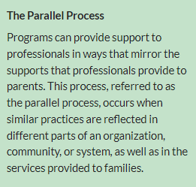

Slide 17

Turn-Key Strategies
1. What did trainers do today, already, that you can use as a trainer with ELSs?
2. What did the trainers do that is a practice an Early Learning Specialist can use with families or providers?
Notes:
1. What did the trainers do to assess your knowledge and skill?
2. What did the trainers do to establish a learning journey?
3. What strategies from this training would be useful for you in your work as trainers?
4. What do you hope your ELSs take away from training with you?
5. What strategies would be useful in their home visits?

Slide 18
Trainers support ELS’ professional development.
Training Techniques to
Support ELS'
Knowledge, Skills and Disposition

Slide 19

What did trainers do today, already, that you can use as a trainer with ELSs?

Slide 20
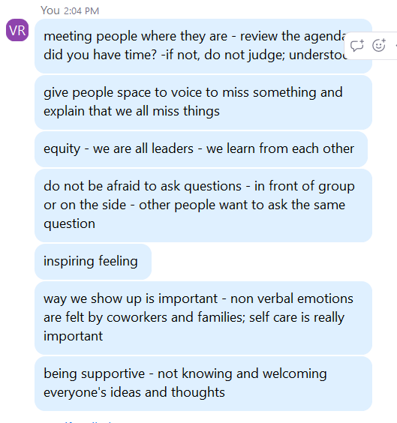
What did trainers do today, already, that you can use as a trainer with ELSs?
(responses from Sep 2024 cohort)

Slide 21
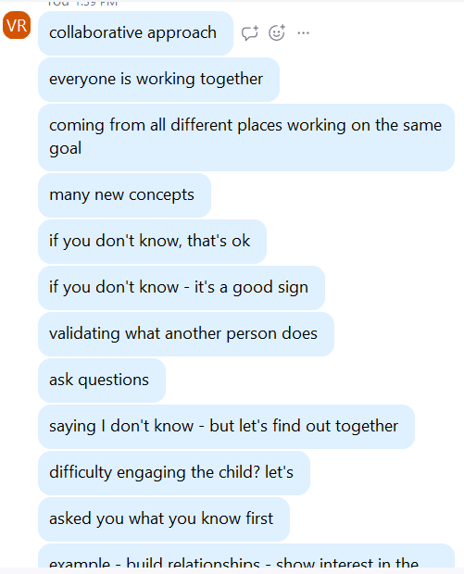
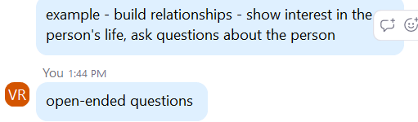
What did trainers do today, already, that you can use as a trainer with ELSs?
(responses from Feb 2025 cohort)

Slide 22
What techniques can we use to support adult learning, our own, ELSs, and parents/providers?
Parallel Training Techniques
Ask participants about their career paths and goals
Use videos to demonstrate process
Ask open-ended questions
Reflect together
Have an agenda, co-create the agenda
Share resources for people to use on their own time
Review accessing resources/referrals

Slide 23
Parallel Process for Trainers
Create conditions that:
Establish a strengths-based mindset – Say, do, act in a way that validates the learner and fosters growth mindset.
Establish relationship – Ask and respond to an open-ended question to build connections.
Explore the purpose: Why are we learning this? and How does this apply to my work?
Demonstrate resources: What else can trainees use and access on their personal time, according to their personal interests?
Establish guidelines – Develop two-way teaching and learning, a strengths-based and responsive approach to meeting trainees where they are.

Slide 24
Coordinator Supports from the National Center: People Tools
Conference/Training
Community of Practice
Focused Community of Practice
1:1 Meetings
Small Group Meetings
Large Group Meetings
Community Resources
YOU!
Parents/Providers!

Slide 25
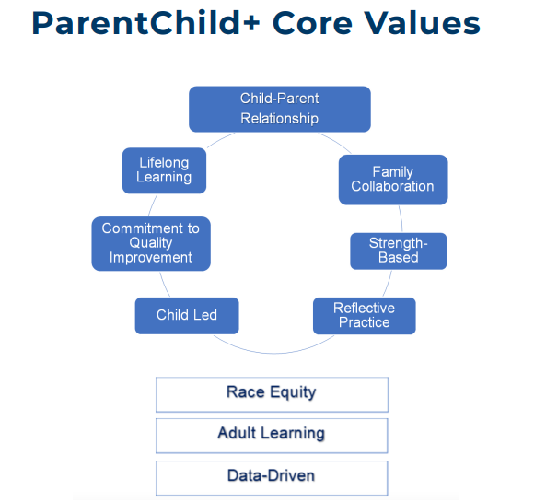
Application of Core Values Throughout PC+

Slide 26

Training is an ongoing cycle.
Take the time to practice with us.

