Slide 1

Introduction to data: data collection, data management, and data quality
Oct 2nd, 2025
You Zhou
Sarah Aparicio
Notes:
Poll
Agenda:
Some basic facts about data (Slides 1-7) - YOU
Aims
What are data
Data are…
Types/forms of data
ParentChild+ data collection
How are data used with examples (Slides 8-14) – SANDRA
How do you use data in your daily practice (activity)
A data-driven process
Example 1 - Observation data video
Example 2 – Numeric Data
Understand data in practice (Slides 15-17) – YOU
Fictional examples
Contextualizing data

Slide 2






About the trainers
I AM
Dr. You Zhou
Associate Director
Research + Learning
International
Psychology
Things I like

Slide 3




About the trainers
I AM
ABOUT ME
Sarah Aparicio
she/her
Assistant Director
Data Quality + Analysis
I’m a member of the research and evaluation team. I co-lead the work we do on internal program evaluation. I also manage our management information system DAISY.
THINGS I LOVE
NEW YORKER

Slide 4
Aims
What data means for ParentChild+? What's data-driven approach?
Your role in data collection; What are the data collection forms
Your role in data analysis
Your role in data quality
Turn-key training

Slide 5

Warm up
Introduce yourself
Where do you work
What’s your favorite children’s story and/or toy growing up?

Slide 6

Basic Facts about Data

Slide 7
What are data?
Which of the following items do you consider to be data?
Number of visits the child has attended
The conversation you have had with the participating adult
The color of the child’s clothes you observed today
A picture of the child reading a book
A video of the child and dad playing together
Ages and stages questionnaire reported by parent
All of the above
Notes:
What data means for ParentChild+

Slide 8
You use data every day. Data are...
Everywhere.
They are a collection of information that we can use to understand things or phenomenon such as facts or observations about objects, people, relationships and more.
Notes:
What data means for ParentChild+

Slide 9




Types and forms of data
Types |  | Forms
Numerical | 105 families | Videos
Categorical | Pre Mid Post | Self-assessment
... |  | Interviews and focus groups
 |  | Observations

Slide 10


Model description
ParentChild+ NC
Coordinators
ELS
Support
Support
Design the model
Train coordinators
Provide directives and implementation
support materials
Recruit ELS and providers
Train & support ELS
Order supplies and books and toys
Deliver resources
Provide 1-on-1 mentorship, skill building, and support to families and providers
Feedback
Feedback
Providers
Families
Expand provider-child-family interaction
Promote developmentally appropriate practice
Improve family engagement
Increase parental capacity and engagement
Improve school readiness skills

Slide 11
You are the key
You are the co-creator of knowledge
Your relationship with families
Your knowledge about the families and communities
You are the bridge connecting us and the families and providers
You help collect more accurate data. We can understand data in its context and better interpret data and inform practice.
Being data driven

Slide 12
Data collection and tools
Family-Level Data
Provider-Level Data
Site-Level Data
Family Information
Program outcomes
Visit information
Referrals to other services
Program completion
Program satisfaction survey
Provider Information
Program outcomes
Visit information
Referrals to other services
Program completion
Program satisfaction survey
Program fidelity
Staff information
Books and toys used
Recruitment events

Slide 13
Family-level data collection
① Demographics | Language(s) spoken in the home Age of child at program entry (DOB, Program Start Date)
② Referral data | Referrals to basic needs and community resources Referrals to EI and child development services
③ Visit data | In-person vs. virtual visits Visits completed
④ Assessment data | On-time developmental milestones (ASQ) Parental involvement in early learning (PIEL)
Notes:
You’ve received some training on DAISY on Elevate and will get more guidance next week on DAISY database, but as a refresher → This is some of the basic data or information we collect in Daisy. We collect data from the participant and the program to understand what is going on in your sites and the families’ you serve, helping us adapt and modify our decisions moving forward. Four we would like to highlight. Important for a consistent data-driven process.
Participant data
Demographics: site coordinator - all participants' demographic factors are collected. These data include - age, native language, race/ethnicity, and annual household. This does not include sensitive information such as a parent's immigration status.
Assessments: for the Core model, assessment data are collected on child behavior and parent-child interaction outcomes. For the FCC model, assessment data are collected on childcare environment and caregiver-child interaction outcomes.
Referrals: throughout the program, all referrals to other services or resources made to participants are collected. This includes referred date and follow-up dates.
Program data
Scheduled visits: the number of visits completed per participant are collected through the participant's scheduler. The scheduler also collects additional data such as the duration of the visit and the book or toy used in the visit.
Program completion: DAISY collects the status of the participant's program (whether they dropped or completed the program).
We also gather other data like:
Replication site data
Contact information: DAISY serves as a site directory. Information such as address, phone number, and email are collected for each use.
Site information: Similarly, DAISY also collects the information on the replication site for the site directory.
Staff demographics: Demographics are collected for each DAISY user.
Books and toys: a list of the books and toys used throughout the program are entered into one master list for all users to see.

Slide 14

Data-driven approach

Slide 15

What does it mean to be data driven?
How would you define data driven?
What are examples of using data in your everyday life?

Slide 16
Being data driven means
Making strategic decisions and changes based on data analysis and interpretation (avoid using assumptions)
Source: https://datascientest.com/en/data-driven-definition-benefits-and-methods

Slide 17
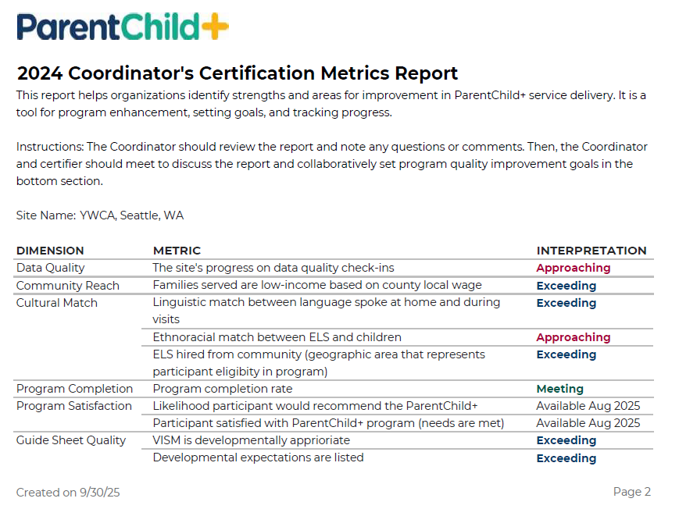
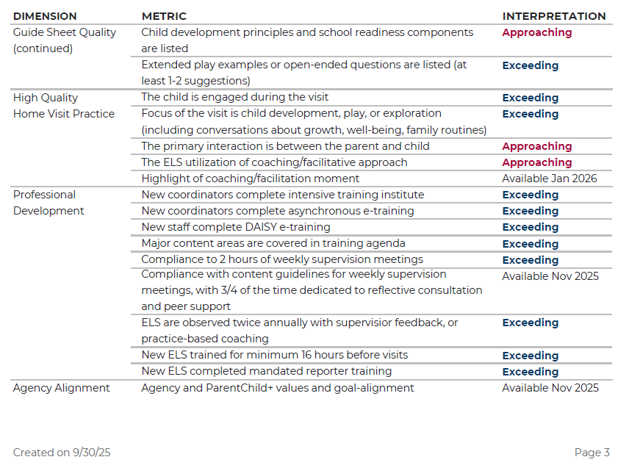
Example: Site certification

Slide 18
Steps to being data driven
1
Provide training on data
ELSs should understand and use information to make better decisions
2
Set clear targets and metrics
Measurable goals that align with the program’s mission
Prioritize data quality
Focus on collecting accurate, relevant, and timely data to ensure insights are actionable
3
Act on insights
Interpret the data in the program and community context, and make a plan
4

Slide 19
BREAK – 10 MINUTES

Slide 20

Your role in data collection

Slide 21
Data collection guidelines
Explain data is part of program, getting consent
Support participants in completing intake information
Support participants in completing the assessments or any other data forms
Support your team in observation and documentation during the program (e.g., reflection record)
Completing data entry and updates

Slide 22
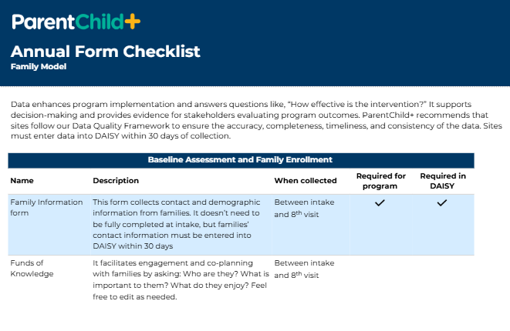
What are the data collection forms
Page 23 in workbook

Slide 23
What are the data collection forms
Form | Why?
Intake form Family Information | To ensure we are working with families in under-resourced communities To uncover hidden disparities and identify specific needs within communities
Family strength and culture practices Funds of knowledge | To facilitate engagement and co-planning with families
Caregiver self-report survey PIEL | To measure caregiver involvement in early learning
Developmental screeners ASQ-3 and ASQ:SE-2 | To increase parental knowledge of child development To increase identification of early delays To track family access to EI and child development services
Referrals | To track family access to basic needs and community resources
Reflection record | To highlight family goals and self-reflect on family visits and engagement
Family satisfaction survey | To use family-voice to guide program adjustments
Program completion survey | To track completion rates and next steps after the program

Slide 24

Where is data stored?
Scenario | Database usage
① Agency does not have internal database and is not required to use an external database by funder
② Agency does have internal database and/or is required to use an external database by funder | Use DAISY for: Intake forms First and last visit completed Use other databases for all other data entry. Must submit data files annually per agreement with state director and data support team

Slide 25
How to talk to families about data collection
Tips
Have a conversation prior so you can answer the parents’ questions
Have ELSs practice “collecting data” together
Spend a few minutes with the parents going over the form. Once parents understand how the question relates to their child, it is easier for them
Make pre-measures apart of the enrollment process
Source: Adopted from ASQ User Guide

Slide 26
How to talk to families about data collection
Examples for self-report questionnaires and surveys
Share the purpose with parents | “ASQ-3 provides a quick check of your child’s development” “Your answers will show your strengths and areas where we can provide support”
Give parents guidelines and make them feel prepared to successfully complete a survey | “Try each activity with your child before you mark a response” “Make sure your child is rested and fed before the visit”
Explain how each survey works | “Here are the five areas of development we’ll look at on the ASQ-3” “We collect the same survey at the beginning, in the middle, and end of the program”
Review what the response options are and what they mean | “Yes means that your child is performing the skill” “You may do these activities sometimes, always, or not at all”
Tell parents that you’ll share the results with them | Let parents know that you’ll be in touch to share the results. Give them a timeframe.
Source: Adopted from ASQ User Guide

Slide 27

How to talk to families about data collection
Activity: role play being the practitioner and caregiver
Practitioner: explain the data collection process
Caregiver: ask questions and express concerns

Slide 28
How to ask tricky questions
Example questions:
Income
Race/ethnicity
Country of birth
License status (HBCC)
Tips:
Validate how they might be feeling in the current social/political climate
Talk about why we are asking these questions
Remind them of privacy policies
Offer to do the form over time so it feels less overwhelming
Remind them you are there to support

Slide 29
When a family doesn’t want their data shared
Participation in the program is top priority
Collect but don’t share
Deidentify data before sharing
Reach out to national center so we can walk you through the steps to do this in DAISY

Slide 30
BREAK – 10 MINUTES

Slide 31
Your role in data analysis

Slide 32
Data analysis guidelines
We can pull the data, run analysis, produce the report
Interpret the data in the program and community context (e.g. ASQ, PIEL)
Use the data to inform your practice
Feedback loops with families and providers, feedback to the NC
Share the findings with stakeholders

Slide 33
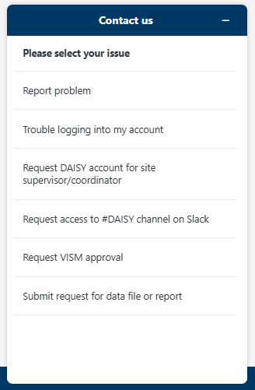
Requesting data or report
Go to daisydata.org
Click submit request for data file or report

Slide 34
Data informs your site practice...
Look closely at the satisfaction data collected from Site A families.
Discuss:
What works and doesn’t work for site A?
How can site A use the data?

Slide 35
Data informs your site practice...
What works, what doesn't work
Support & resources provider and family needs
Continuous improvement in professional development
Tailor program to your own context and community
How did you know your changes worked?

Slide 36
Your role in data quality

Slide 37
Data quality guidelines
Participate in data quality check-ins
Complete action steps in between check-ins
Complete regular internal data quality reviews

Slide 38
What do we mean by “data quality”?
The methods and processes for establishing quality data that is ready to be analysed and included in reports
Quality data should be complete and timely
Quality data should be consistent and reliable

Slide 39
How does “data quality” fit in?
Identify what you need to collect
Collect the data
Enter the data
Complete data quality check-in
Complete action steps

Slide 40
Additional information
Step | Who/where to find additional info
Identify what you need to collect | Workbook page 23
Follow the guidelines for when records are collected | Workbook page 23
Follow the guidelines for when records are entered into DAISY | Workbook page 39
Complete data quality check-ins | Data support team member
Complete action steps to ensure data quality | Data support team member and your team

Slide 41
What is a data quality check-in?
Review data entry goals
  Data entry goals are designed to specify data entry expectations to our entire network. They are not performance standards
Review data quality report
  Determine what data entry goals are being met and where you need support
Set action steps together

Slide 42
When are they?
Jan | Feb | Mar | Apr | May | Jun | Jul | Aug | Sep | Oct | Nov | Dec
 | Cycle 1 |  |  | Cycle 2 |  |  |  | Cycle 3
How frequently you meet will depend on how many goals were met the previous year
76% to 100% | 51% to 75% | 26% to 50% | 0 to 25%
Once/year | Twice/year | Three/year | Three/year*
* Additional support from state director or program staff
** New sites receive three check-ins during first year of implementation

Slide 43
Internal data quality reviews
We strongly recommend supervisors and coordinators review data entry monthly
What does that look like in practice?

Slide 44
Internal data quality reviews
Have data entry goals document available
Cross check data entry goals with data entered
Identify which participants are meeting and not meeting each goal

Slide 45
Checking for data quality
Netflix Top 20: Analyzing Weekly Chart-Toppers
This dataset comprises Netflix’s weekly top 20 lists for the most-watched TV shows and films worldwide. The data spans from June 28, 2021, to August 27, 2023
Notes:
AnalyzingWeeklyChartToppers_DataFile_2025-09-30.xlsx

Slide 46
Checking for data quality
2016 Summer Olympic Medal Holders
(Highest medal received)
Explore the dataset. Look for:
Blanks or NA: data that are missing
Outliers: numbers higher or lower than reasonable
Duplicates: Same data point listed more than once
Variations: Using different words or spellings for the same things
Notes:
OlympicAthletes_DataFile_2025-10-01.xlsx

Slide 47
Checking for data quality
2016 Summer Olympic Medal Holders: Data quality issues
“France Olympic Team” is listed as Athlete Name
Duplicate rows for Sandra Aguilar Navarro and Aaron Brown
Ages are incorrect: 2, 3, 150 years old
Height and weight missing
Duplicate country name in team name (e.g., China, China-1)
Inconsistent abbreviation of United States (USA and US)
2014 and “winter” were included
Non-medal holders were included

Slide 48
More training opportunities

Slide 49
Assessment training
PIEL training Oct 29th, 2025
ASQ training (ASQ3 & ASQ-SE2) Nov 5th & 7th, 2025
CCIS Nov 6th
FCCERS-R Nov 13th

Slide 50
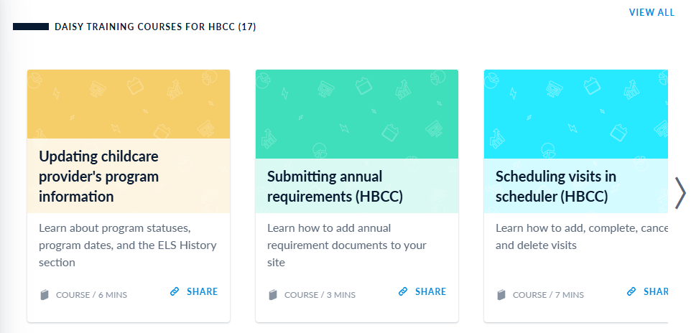
Elevate (Bridge)

Slide 51
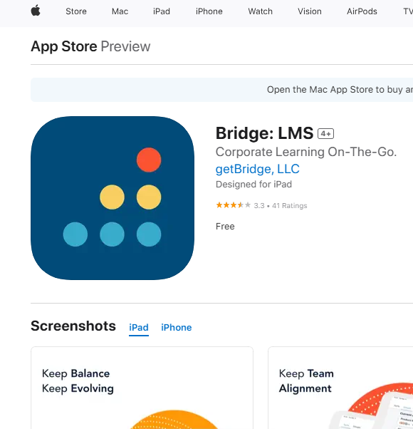
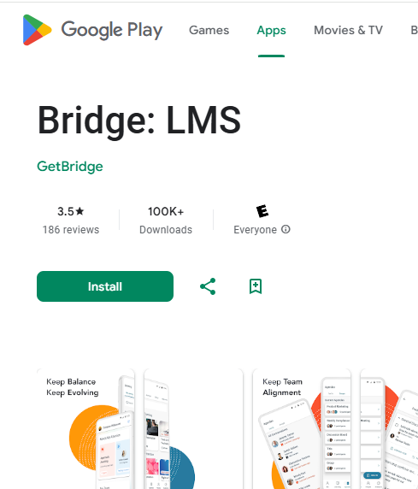
Elevate (Bridge)

Slide 52
Turn-key training
Emphasize the essential role of data in the ParentChild+ program
Guide and plan individualized program curriculum with families and/or providers informed by data
Make sure ELS understand why they collect data and how important their roles is in data collection
How site management level can support data collection and data entry
How to understand the data collected in the context

Slide 53
Steps to being data driven
1
Provide training on data
ELSs should understand and use information to make better decisions
2
Set clear targets and metrics
Measurable goals that align with the program’s mission
Prioritize data quality
Focus on collecting accurate, relevant, and timely data to ensure insights are actionable
3
Act on insights
Interpret the data in the program and community context, and make a plan
4

Slide 54
Any questions?

