Slide 1

Equal Possibilities from the Start
Social Identity and
Race Equity
National Coordinators’ Training Institute
Vidya Ragoo, National Director, HBCC Model
October 1, 2025

Slide 2
Parallel Process, Turn-Key Training, and Implications on Home Visiting
Coordinator Experience
ELS Experience
Parent/Provider Experience
Throughout these relationships. ParentChild+ prioritizes the “trainee’s” knowledge, or the parent and the provider knowledge as the starting point for growth. During training, we ask about your goals, your backgrounds, & your values, and we build content from that starting point.

Slide 3

Turn-Key Training and Home Visiting Prompts
Tell me how you came to be an ELS.
Tell me about your journey as a parent/provider.
Discuss your goals as a HV professional.
Discuss the goals you have for yourself as a parent.
What are the goals you have for your child?
What do you need to prepare yourself for home visits?
What do you think your child needs to be ready for school?

Slide 4

Agenda
workbook pages 10 - 15
Equity’s Starting Point
Personal Reflections
Implications in
Home Visiting

Slide 5

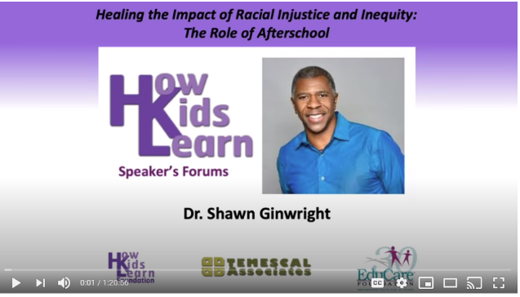
https://www.youtube.com/watch?v=Kba4TwUrFpw&t=2245s

Slide 6
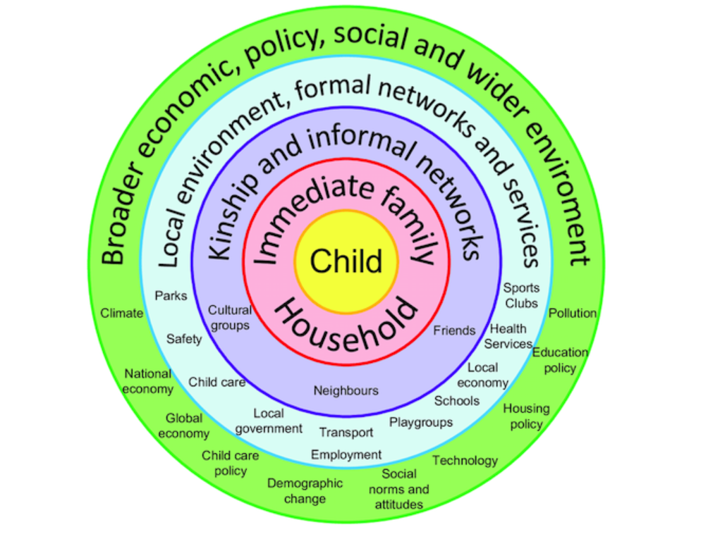


Circles of Influence Model: Building on Strengths, Values, and Culture
(ELEVATE Course 3, Workbook page 10)
Reflect on Self

Slide 7
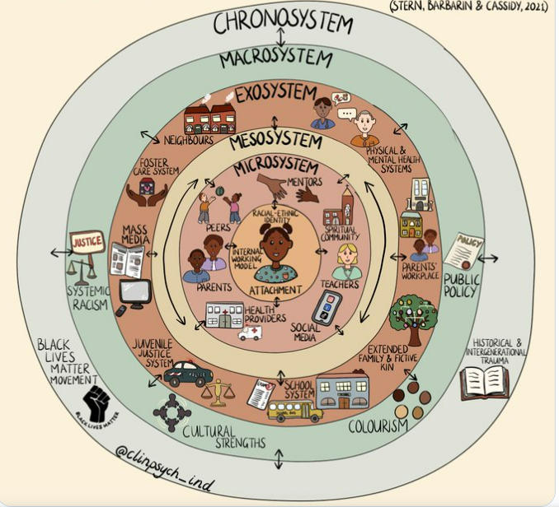
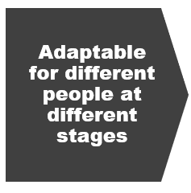
Adaptable for different people at different stages

Slide 8

Cultural Humility
The National Institutes of Health (NIH) defines cultural humility as
“a lifelong process of self-reflection and self-critique whereby the individual not only learns about another’s culture, but the individual starts with an examination of her/his/their own beliefs and cultural identities.”

Slide 9
https://www.youtube.com/watch?v=Kba4TwUrFpw&t=2245s

Slide 10

Community Guidelines

Slide 11

What do you need in this community as we talk about ourselves, our race and culture?

Slide 12
What do you need in this community as we talk about ourselves, our race, and culture?
Individual Needs:
Respect your own experience
Being able to safely use your own words – open communication
Open-mindedness
Kindness
Non-judgmental
Group Needs:
Be Respectful
Forgiveness for what we don’t know
Open-mindedness
Kindness
Non-judgmental
Notes:
Some of these experiences can be triggering, so I want to encourage you to take care of yourself. If you need to pause, take a step away from the camera, breathe deeply or take a break please do. Some of this work is personal and can be triggering, so self-care comes first. We also want to encourage risk. If you’re feeling safe enough to share, please step outside of your comfort zone and share. This will help us experience what parents and ELSs experience when they resist doing the work because of their comfort zone.

Slide 13
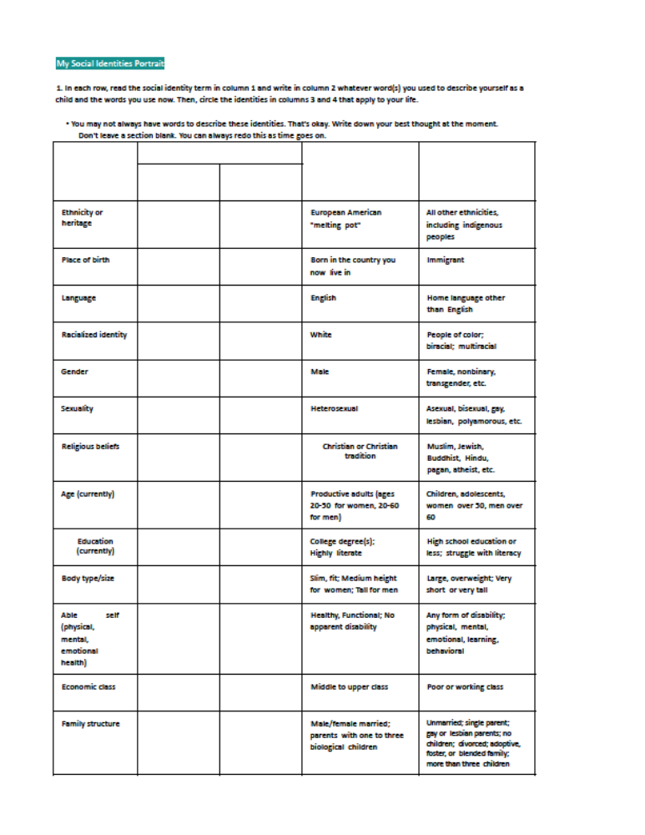


Slide 14


Slide 15

Personal Reflection Activity:
MY SOCIAL IDENTITY
Workbook, page 12,
1st column

Slide 16
Personal Reflection Activity:
MY SOCIAL IDENTITY
Workbook, page 12,
2nd column

Slide 17
Personal Reflection Activity:
MY SOCIAL IDENTITY
Workbook, page 12, last 2 columns.
Circle which group appropriately fits your identity.

Slide 18

Consider your Comfort Level
Using the community’s guidelines and your social identities portrait, look at the questions at the bottom of the worksheet.
Respond in your small groups.
Prejudice/Discrimination and/or Privilege/Visibility
Harder and/or Easier
Divvy the time between group members, ex. 3-4 min each. Listeners listen; sharers share. No feedback.
Remember to use community guidelines.

Slide 19
Consider your Comfort Level
Using the community’s guidelines and your social identities portrait, look at question #2.
Respond in large group.
Which identities have had the biggest impact on you?
In which identities do you feel the most pride?

Slide 21
Race Equity

Slide 22

Leadership Considerations

Slide 23
Developing a Race Equity Framework for Our Work
Developing and applying a racial equity lens requires looking both internally and externally – building both personal, interpersonal, and institutional awareness.
All people can achieve their full potential in life, regardless of race, ethnicity or the community in which they live. Racial justice — or racial equity —goes beyond “anti-racism.” It is not just about what we are against, but also what we are for.”
We are committed to early education of children and the strengthening of families that is focused on achieving equitable positive outcomes from the start and that leads to future success and community impact.

Slide 24

How do leaders promote EQUITY in:
Staff Meetings?/Home Visits?
Listen more, advise less
Establish shared guidelines
Clarify the plan
Ask where support is needed
Make people feel seen, felt, heard
Eye contact, recognize, repeat what you heard is what they said
Ask for pronunciations -
Make people feel seen and heard
Little things are the big things
Respect personal identity – what name would you like to be called?
Start with cultural, community reflections
Acknowledge the dynamics – who is the main caregiver? Who impacts the child’s growth?
We do have a sharing at the beginning such as some Ice-breaking questions about childhood, families and personal thoughts.
5 B’s: beautiful – seeing people from the inside – until we learn their name.

Slide 25

Reflect on
Reflect on Self.
Invite
Invite Others into a Community.
Create
Create a Safe Space.
Ask
Ask Open-ended questions to get a sense of where people are.
Ask
Ask people to identify themselves.
Ask
Ask how they would like to be treated.
Create
Create a space where you can be true to yourself, others can be true to themselves, and judgement is suspended. Strengths are observed.
Know
Strengths are observed.
Lead.
Know your why and know that this will continuously change. Lead with Race Equity

Slide 26

Know Your Why

Slide 27
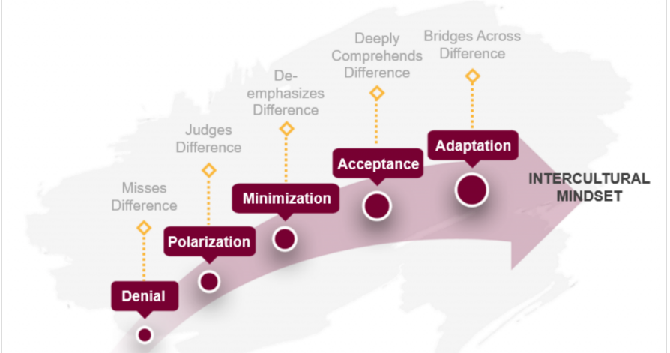
Notes:
https://idiinventory.com/generalinformation/the-intercultural-development-continuum-idc/

Slide 28
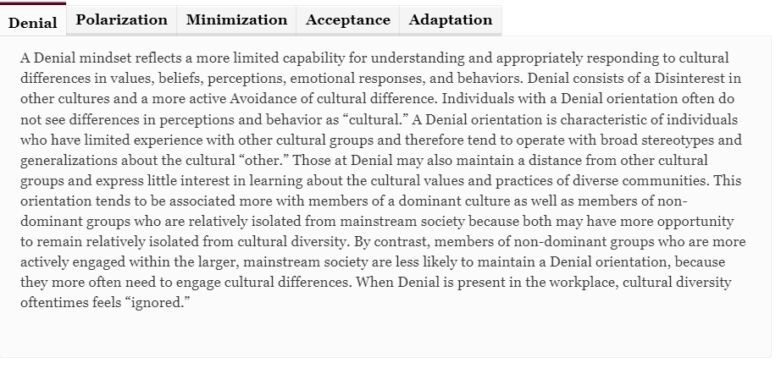
Denial

Slide 29
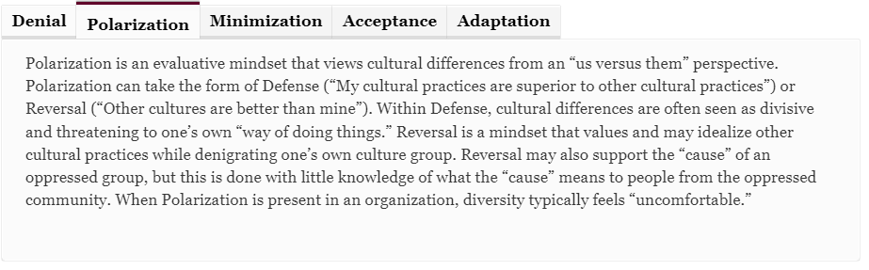
Polarization, video 6:19

Slide 30
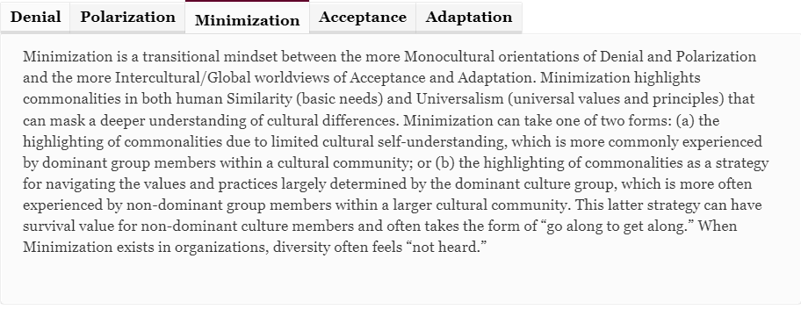
Minimization, video 11:38

Slide 31
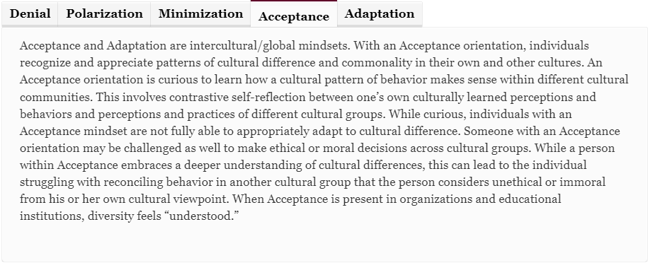
Acceptance, video 17:17

Slide 32
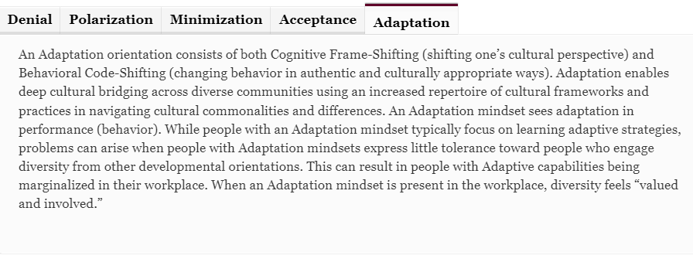
Adaptation, video 19:57

Slide 33
Notes:
https://idiinventory.com/generalinformation/the-intercultural-development-continuum-idc/

Slide 34
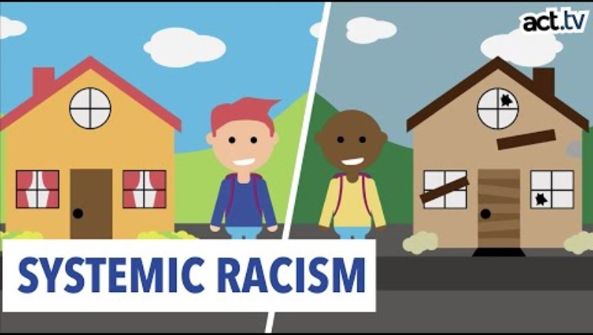
Ecological Systems
Differ
Have an impact on family outcomes
Is rooted in systemic racism
Encompasses generational and race-based outcomes
Covert or Overt

