Slide 1

Development Parenting + Child Development
Oct 8th, 2025
Sandra Saldana + You Zhou

Slide 2



About the trainers
I AM
ABOUT ME
Sandra Saldana
She/her
Research and Data Associate
I’m a member of the research and evaluation team. I lead data quality check ins for 70 sites, report on internal data collection findings, and support research projects.
RANDOM FACTS
Argentina/Brazil

Slide 3



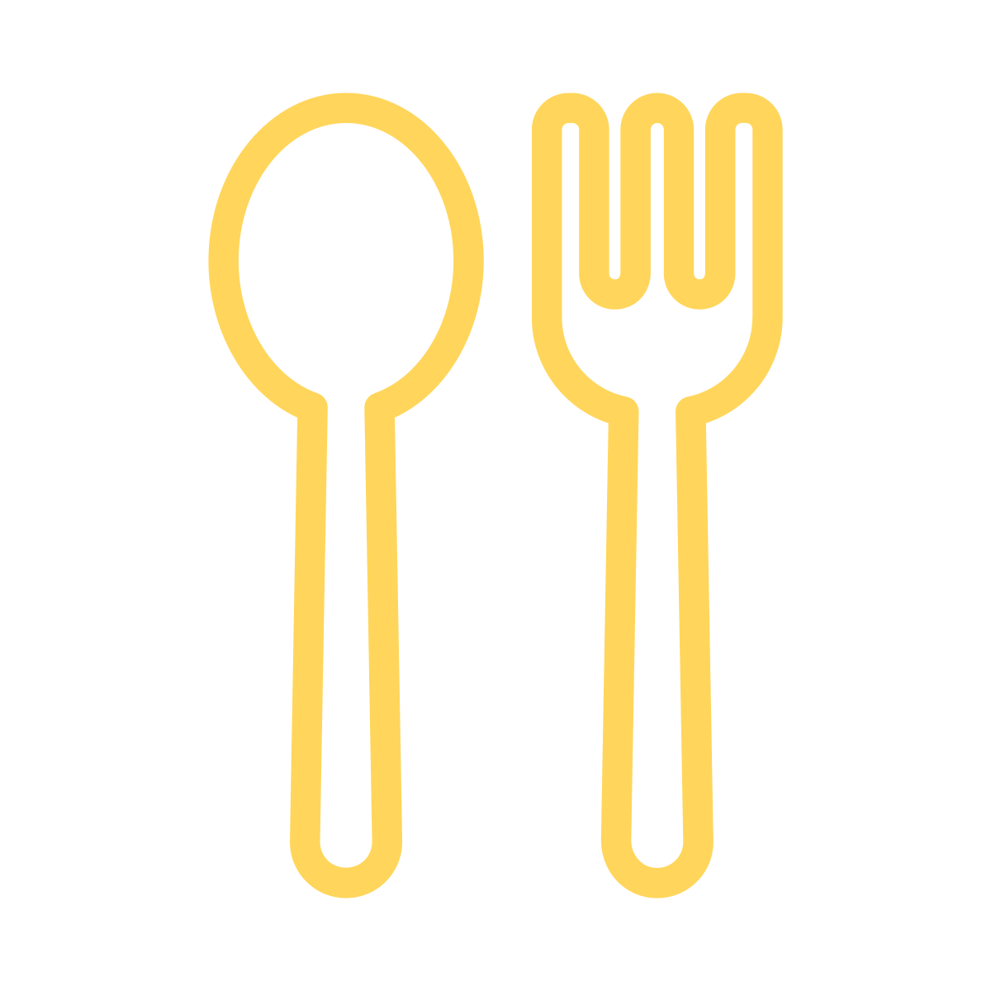


About the trainers
I AM
Dr. You Zhou
Associate Director
Research + Learning
International
Psychology
Things I like

Slide 4
Aims
What is developmental parenting?
What are the key areas of child development?
How to support child development through developmental parenting.

Slide 5

Developmental
Parenting

Slide 6

What is Developmental Parenting (DP)?
Definition: A set of parenting practices meant to be developmentally appropriate and adjusted as children's needs and skills change (Roggman et al., 2008)
(1) Parenting that develops naturally over time
(2) Parenting behaviors we can help/support parents develop
Notes:
As we go through this training we will see how they

Slide 7

Breakout Room Activities
Based on your experience:
What are some of the barriers or challenges you think that could prevent parents from developing Developmental Parenting naturally?
What facilitates or helps caregivers with developmental parenting?
Workbook p25

Slide 8
Summary Notes
Barriers
Facilitators
Parents' lack of confidence
Parents may lack of knowledge of developmental parenting
Mental health issues
Overall stress
Anything weighed down families heavily
Workload and time, lack of time of parent-child interaction
Language barriers
HV helps build parents' confidence
Supportive network
Counselling, therapist
Being with other parents
Positive role models

Slide 9




The Four Dimensions of DP
  Affection
Whiteboard: What do you think these dimensions should capture?
  Responsiveness
  Encouragement
Workbook p25
  Teaching
Link: https://www.canva.com/design/DAGecPLDDjQ/oKH9RSLqyyUmBfMW4ZpVBw/edit?utm_content=DAGecPLDDjQ&utm_campaign=designshare&utm_medium=link2&utm_source=sharebutton

Slide 10
Domain definition
Affection: Warmth, physical closeness, and positive expressions toward child
Responsiveness: Responding to child’s cues, emotions, words, interests and behaviors
Encouragement: Active support of exploration, effort, skills, initiative, curiosity, creativity and play
Teaching: Shared age-appropriate communication and play, cognitive stimulation, explanations and questions

Slide 11
Proven Evidence
Affection | Responsiveness | Encouragement | Teaching
Less antisocial behavior Better adjustment More compliance Great cognitive ability More school readiness | More secure attachment Better cognitive and social development Better language development Fewer behavior problem Better emotion regulation and empathy | Less negativity Willingness to try challenging tasks Better cognitive and social development Better language development | Better cognitive and social development Better language development More conversation More emergent literacy skills

Slide 12

10-minute break

Slide 13

Child Development

Slide 14
Key Areas of Child Development
  Communication
  Problem Solving
  Gross Motor
  Personal Social
  Fine Motor
  Social Emotional

Slide 15
Key Areas of Child Development
Communication: child's language skills, what a child understands and what they can say
Gross Motor: how they use their arms and legs and other large muscles for sitting, running and other activities
Fine Motor: child's hand and finger movement and coordination
Problem solving: skills of thinking and learning, how they play with toys and solve problems
Personal-Social: self-help skills (e.g. feeding, dressing, toileting) and social interactions with others
Social-Emotional: autonomy, compliance, adaptive functioning, self-regulation, affect, interaction, social-communication
Notes:
Autonomy: Your child’s ability or willingness to self-initiate or respond without guidance (moving to independence).
Compliance: Your child’s ability or willingness to conform to the direction of others and follow rules.
Adaptive functioning: Your child’s success or ability to cope with bodily needs (sleeping, eating, toileting, safety).
Self-regulation: Your child’s ability or willingness to calm or settle down or adjust to physiological or environmental conditions or stimulation.
Affect: Your child’s ability or willingness to demonstrate their own feelings and empathy for others.
Interaction: Your child’s ability or willingness to respond to or initiate social responses with parents, other adults, and peers.
Social-communication: Your child’s ability or willingness to interact with others by responding to or initiating verbal or nonverbal signals to indicate interests, needs, or feelings.

Slide 16
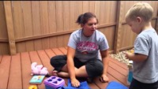
Video Observation of 18-24m
Observe what can the child do (3’47-6’16)

Slide 17
Observation of child development
Communication:
Gross Motor:
Fine Motor:
Problem solving:
Personal-Social:
Social-Emotional:
Workbook p25

Slide 18
Notes
Gross motor: Walking, sits up and down, kneels on his own
Fine motor: Held cup, cup fell, put it back up with one hand while holding something else. Held two objects in one hand.
Problem solving: Closed the book, he was able to choose where the car was under the napkin; said it was not an apple.
Communication: Some babble, and had some individual words like "lion" and he says "night, night"
Personal-social: Plays in response to Mom; reacts to Mom's cues.
Social-emotional: Expressed his preference for not reading, he closed the book after saying "no" loudly.

Slide 19
A typical 24m old
Very active, expanding language, eager to explore, strive for independence, marked by parallel play, temper tantrums
Communication: begin to put two to three words together
Gross Motor: walks and runs well, may jump, begin to throw, kick and catch balls, can stand momentarily on one foot
Fine Motor: building blocks, turns pages in a book
Problem solving: start to sort shapes and colors, find hidden toy
Personal-Social: begin to have bladder and bowel control
Social-Emotional: "no", don't fully understand sharing or waiting, wants to do everything by himself, even though he can't
Other useful but optional references: all 20 teeth appear by 3 years old; 10-12 hours night time, day nap 1-2 hours

Slide 20
Some resources
Social Emotional Development Guide for parents (24 months)
Child Development Activities (24 months)

Slide 21
10-minute break

Slide 22

Supporting Child Development
through Development Parenting

Slide 23
The Connection between Family Well-being, DP and Child Well-being
Physical health
Mental health
Self-regulation
Social Competence
Cognitive Competence
Child well-being
Affection
Responsiveness
Encouragement
Teaching
Engagement
Positive Discipline
Coparenting
Developmental Parenting
Parent Physical Health
Parent Mental Health
Family Self-Sufficiency
Family Resiliency
Family well-being
Newland, L. (2015) Family well-being, parenting, and child well-being: pathways to healthy adjustment. Clinical Psychologist, 19, pp3-14
Notes:
Family well-being provides a foundation for developmental parenting and child well-being, as evidenced by an extensive number of studies

Slide 24
Your role in supporting child development
Parents support child development directly! Not us!
We support developmental parenting and child development through:
Observation (the foundation)
Coaching/facilitating parent-child interactions
Providing resources for the families

Slide 25
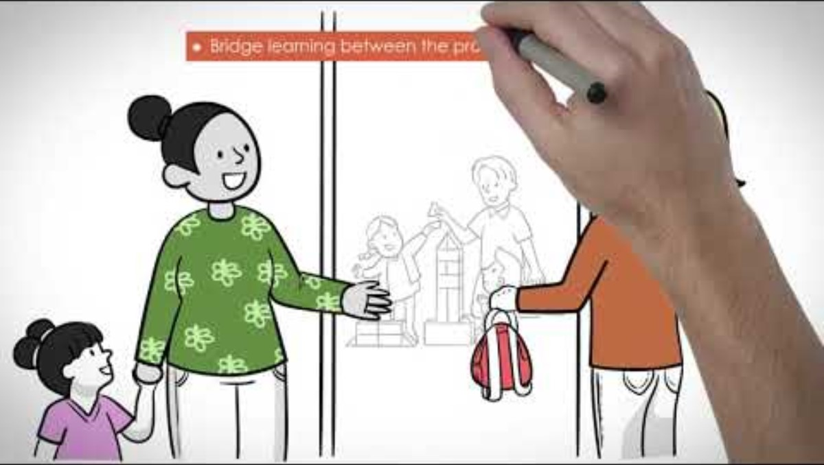
Observation

Slide 26
Observation vs. Interpretation
Observation – Objective; the developmental characteristics of the child
Interpretation – Subjective; Connects child development to your own ideas and responses
Workbook p19
Data-driven approach observations

Slide 27
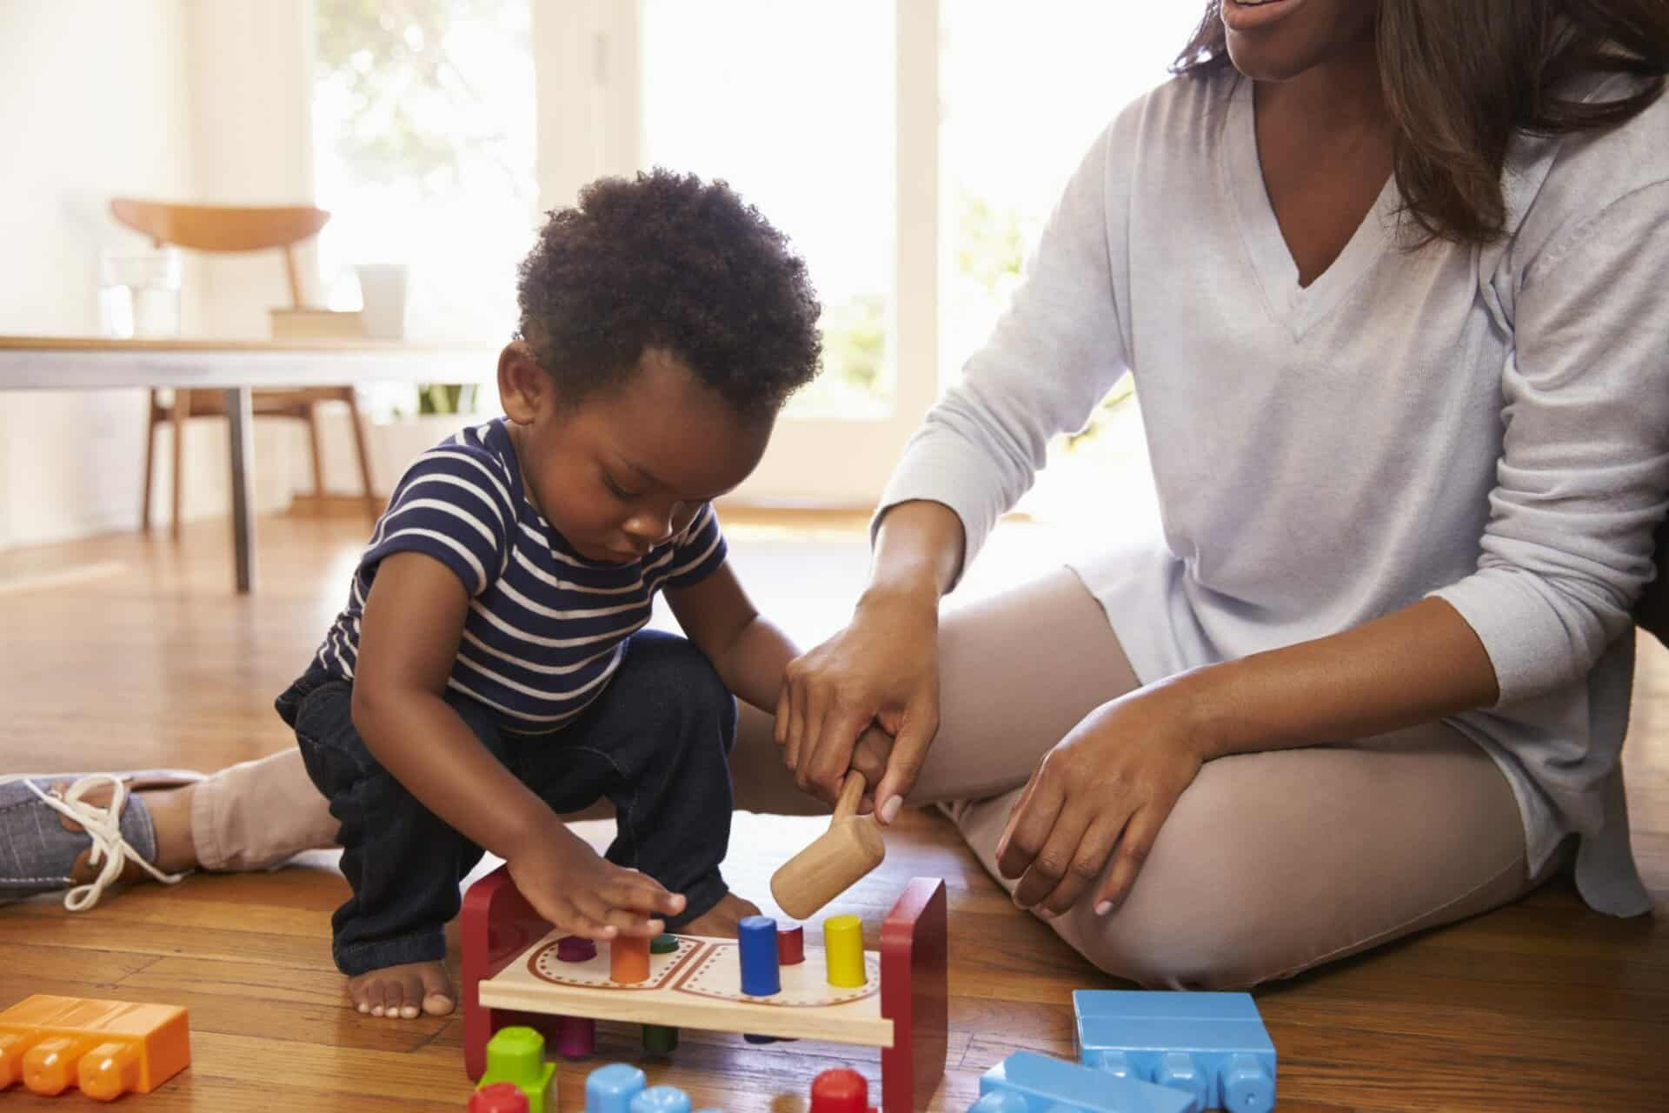
What do you observe?

Slide 28
Objective | Subjective/Interpretation
Toy blocks - blue | He is having fun with the blocks
He's holding a hammer with one of his hands | Mom was trying to prevent the child from hitting something
Boy and mom are together; playing together | Mom is helping the child with the hammer
Mom is holding the hammer with child
Child is pushing orange block down
They're at home (chairs, tables) with nature
Sitting close together

Slide 29
Objective vs Subjective Observation
Workbook p19
Data-driven approach observations
Objective | Subjective
Objective observations are based on what we observed using our senses, we record exactly what we see, hear, taste, touch, and smell | Subjective observations are often influenced by our past events, personal experiences and opinions, and can be biased based on our cultural backgrounds
Objective information is based on the facts we gather. If we don’t see it, we don’t report it. | Subjective information is based on our opinions, assumptions, personal beliefs, feelings or can be based on suspicions, rumours, and guesses
Objective Terms: "Seems to be;" "Appears to..." "I noticed that" | Subjective Words to Avoid: Just; because; but; always, never; can’t; I think; happy, smart, helpful, pretty, angry, shy, likes, loves, hates, sad

Slide 30

Incorporating DP into Practice
Interaction-centered
Affection
Strength based
Responsiveness
Observational skills
Encouragement
Reflective thinking
Teaching
Notes:
Respects parent as child’s teacher (+) • Builds developmental parenting skills (+) • Builds parent confidence in parenting (+) • Helps parent use child development information (+) • Helps parents keep parenting during a crisis (+) • Establishes an enduring context for a child’s development (+) • Requires more practitioner training and skills (–)

Slide 31
Incorporating DP into Practice
Observe child development
Coaching​
Observe developmental parenting
Reflect and provide feedback to the parents based on DP strengths
Notes:
Respects parent as child’s teacher (+) • Builds developmental parenting skills (+) • Builds parent confidence in parenting (+) • Helps parent use child development information (+) • Helps parents keep parenting during a crisis (+) • Establishes an enduring context for a child’s development (+) • Requires more practitioner training and skills (–)

Slide 32
Observe and give feedback on DP
Workbook p25
Watch video clip (link)
Think about DP dimensions (affection, encouragement, responsiveness and teaching) and list specific strengths
Step further: how to translate observations to feedback directly to parents. Describe what you see the parents do that match with DP, how the child responded, and why that interaction is good for the child's development.
Example:
When you said "good job" to Billy after putting the toy in the correct shape, he smiled and seemed encouraged to keep going. This is encouragement in developmental parenting. Encouraging him to handle the puzzle by himself helps him practice fine motor skills, his problem- solving skills and it will make him feel good about what he can do.

Slide 33
Incorporating DP into Practice
What are signs of effective ELS practice?
What are indicators that the practice has room for improving?
Workbook p25

Slide 34
Notes
Growth for parent to be teacher
Adult allows child to take initiative in play
Child is happy to see ELS, looking forward to visits
Family is ready with the materials, books and toys ; engaged during visit, know visits are important
Families cancelling a lot, lack of engagement
Play is adult-led as opposed to child-led most of the time

Slide 35

ABCs of Good Practice
A: Facilitative Attitudes
Be responsive to family strength and culture
Be flexible in strategies and activities
Be supportive and accepting in relationships
Roggman, L.A., Boyce, L.K., & Innocenti, M.S (2008) Developmental parenting: a guide for early childhood practitioners. Baltimore: Paul H. Brookes Publishing
Notes:
When to intervene and when not to.

Slide 36
ABCs of Good Practice
B: Facilitative Behaviors
Focus on child development
Engage parent and child together
Support developmental parenting behaviors
Collaborate with parents
Involve other family members
Build on family activities/strength

Slide 37
ABCs of Good Practice
C: Facilitative Content
Developmentally appropriate
Try to be consistent but with some flexibility adjusted to children's needs and skills
Family-friendly materials and activities that promote developmental parenting but can also benefit parent and children in daily activities when on their own
Notes:
You have better judgment on when to intervene and when not to intervene

Slide 38
Turn-key training
How to incorporate the concept of Developmental Parenting into your training and practice
How to incorporate child development knowledge into training and practice
How to support child development through developmental parenting: observation, facilitating the parent-child relationship/coaching, and connect families with resources

Slide 39
Assessment training
PIEL training Oct 29th, 2025
ASQ training (ASQ-3 & ASQ-SE2) Nov 5th & 7th, 2025
CCIS Nov 6th, 2025
FCCERS-R Nov 13th, 2025

Slide 40
Any questions?

