Slide 1
Family Collaboration:
Enrollment process

Slide 2
Breakout room questions
(pg 21 # 1-2 only):
Introduce yourself to your new group!
What are some skills, traditions, or ways of knowing that have been passed down to you from your family or community?
How have your culture, community, and personal experiences shaped the way you navigate challenges or support others?

Slide 3
Funds of Knowledge
(lived experience assumptions)
Help build meaningful relationship with families.
Families have abundant knowledge that we can learn
Our job is to discover knowledge and use it to engage families in meaningful activities.
The home and community are repositories of knowledge, and it is our job to discover.

Slide 4
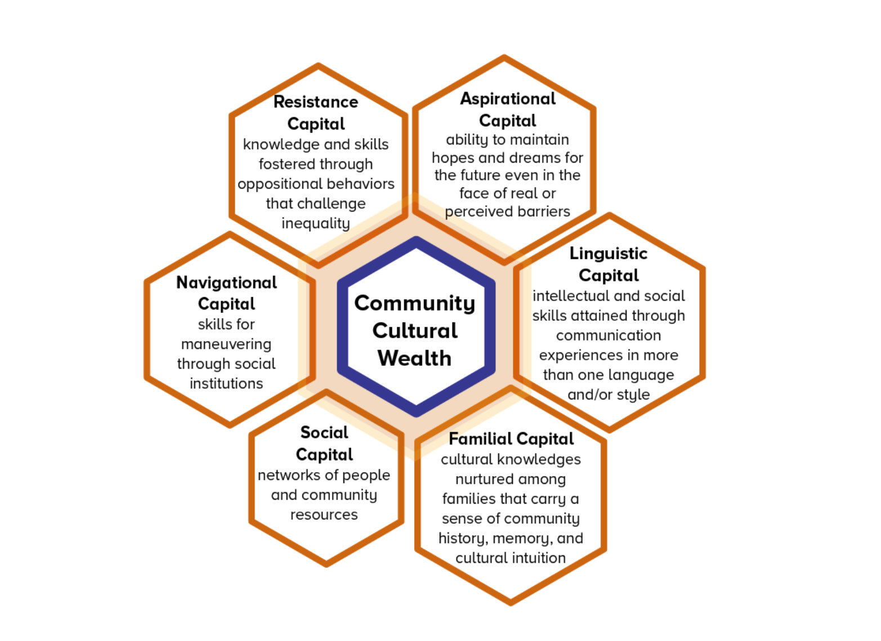

Yosso, 2005

Slide 5
Breakout room questions
Pg 22 (Qs #1-2 only): What type of open-ended questions can you ask to get to know the families/caregivers better?
What questions can you ask to uncover what they already know or do as a family?

Slide 6
Now role play together
Home Visitor: open the conversation, use 2–3 open-ended, asset-seeking questions, reflect what you heard. If possible, how might it bridge or transition to the formal intake questions.
Caregiver: respond naturally, drawing from the prompt note; feel free to add one detail to make it real.
Observers: listen for exact phrases that surfaced strengths and note which Yosso lens (p. 18) they map to.

Slide 7
Family Enrollment:
A Process and a Relationship

Slide 8
What does enrollment look like?
Lana, Coordinator (Philly)
"It depends on if family is referred or not. Referred families tend to know more about the program, so it might take less visits to enroll them.
The first call is to explain the program and determine 'Are you really interested?'
The second meeting is over Zoom and it's an actual intake process. I always tell families they don’t have to answer all the questions on the {Family Information] form.
Third, I ask them if they need to sit on it or ask more questions OR then I introduce the ELS. I give plenty of time for Parent and ELS to talk.
The fourth visit is in-person and it's the ELS first visit. "

Slide 9
What does enrollment look like?
Aisha, Coordinator (Philly)
"Most of referrals for new families are coming from other NGOs in the community, like diaper banks and food organizations. We go on-site there and describe the program to them. We say that there are free toys and books, and this is what gets their attention. Often, mothers have heard about the program before. Here, we ask for their phone number.
Then we call them and tell them more, like 'It’s a program for the parent and the child.' We will explain that the next step is the enrollment process “only for the program.”
Next we follow-up with a Zoom session, we complete the enrollment form [Family Information Form].
The third meeting is in-person and that's when I introduce the ELS and, at this point, we want to get to know the child. We get to know them and start identifying the child’s interests. We also mention the possibility to do referrals at this point. It is three or four steps to enroll a family."

Slide 10
What does enrollment look like?
Ana, Coordinator (Philly)
The first visit is to explain the enrollment process.
In the second visit is in-person, I bring my paper and forms, which makes the process more legitimate, like saying you are now a "part of something.”
This intake visit can take up to an hour and a half, not just doing the form but also having a conversation with the family. You should have a sense of humor about some questions in the form. It's important to break down walls and start to get comfortable.
On the third visit, I ask if they are ready to do the introduction to the home visitor. The ELS will bring a book and toy for the third visit and give them a Resource Binder. The most important question we ask them is “What do you want from this program?" Or “What can we for you?”

Slide 11

Enrollment Process Takeaways (JF)

Slide 12
Family Enrollment:
A Process and a Relationship

Slide 13
Enrollment process steps
1️⃣ Initial Outreach – Coordinator connects via referral or direct contact.
2️⃣ Multiple Touchpoints (3–4) – Mix phone, text, virtual, in-person. Flexibility builds comfort.
3️⃣ Program Introduction – Use clear, strengths-based “elevator pitch.”
4️⃣ ELS Introduction – Warm handoff to build continuity and connection.
5️⃣ Sample Visit – Bring books/toys, model play, notice strengths.
6️⃣ Confirm Commitment – Address barriers, confirm readiness, and schedule start.

Slide 14
Enrollment and relationship-building
Trust begins before the first visit.
Families bring knowledge, culture, and strengths—our role is to see and name them.
Listen first.
Match communication style to family comfort.
Collaboration during enrollment predicts long-term engagement and retention.

Slide 15
Enrollment it’s the start of a relationship built on mutual respect. Families share their funds of knowledge (home language, culture, routines, hopes) and Coordinators/ELSs share resources, developmental insight and support.

Slide 16
Family Information Form (DAISY) pg 23
Before visit 8
You only need to obtain basic family contact information ONLY
Before visit 46 (halfway of program)
You must have rest of form completed family + household demographic info
    Income
    Healthcare coverage
    Language and race
    Country of birth

Slide 17
Co-planning with families

Slide 18
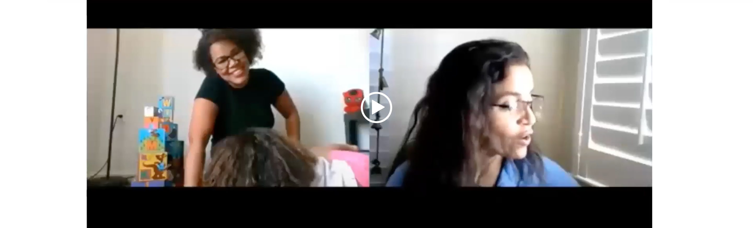
Page 22 Q#3
Show video – JF (https://parentchildplus.bridgeapp.com/author/courses/121/slides/1479)

Slide 19
What did you notice about how the home visitor invited and built on the family’s ideas about using the book?
How did the conversation show shared decision-making and partnership between the home visitor and caregiver?
Given your agency context, how could you apply a similar co-planning approach in your own visits?

Slide 20
Given your agency context, how could you apply a similar co-planning or funds of knowledge approach in your own visits?
Tailoring the visit to the temperament of the child
Incorporate something the child likes or needs (ex: movement, nuerodiverse)
Bringing extra books or arts and crafts activities

Slide 21
Participation Agreement + Family Information Form

Slide 22
Family Enrollment
Participation Agreement
Pg 21 # 3: What "Community Guidelines" might the ELS need or want to make with a family during the enrollment process:
What commitments might families need from ELS?
What commitments might the ELS need from the family?

Slide 23
Family Enrollment:
Participation Agreement
Family need from ELS | ELS need from Family
Timing, schedule, consistency | Family to be "teacher"
Confidentiality, privacy
Illness and cancellation | Illness and cancellation policy
When to use virtual (Zoom) | When to use virtual (Zoom)
Safety | Safety

Slide 24
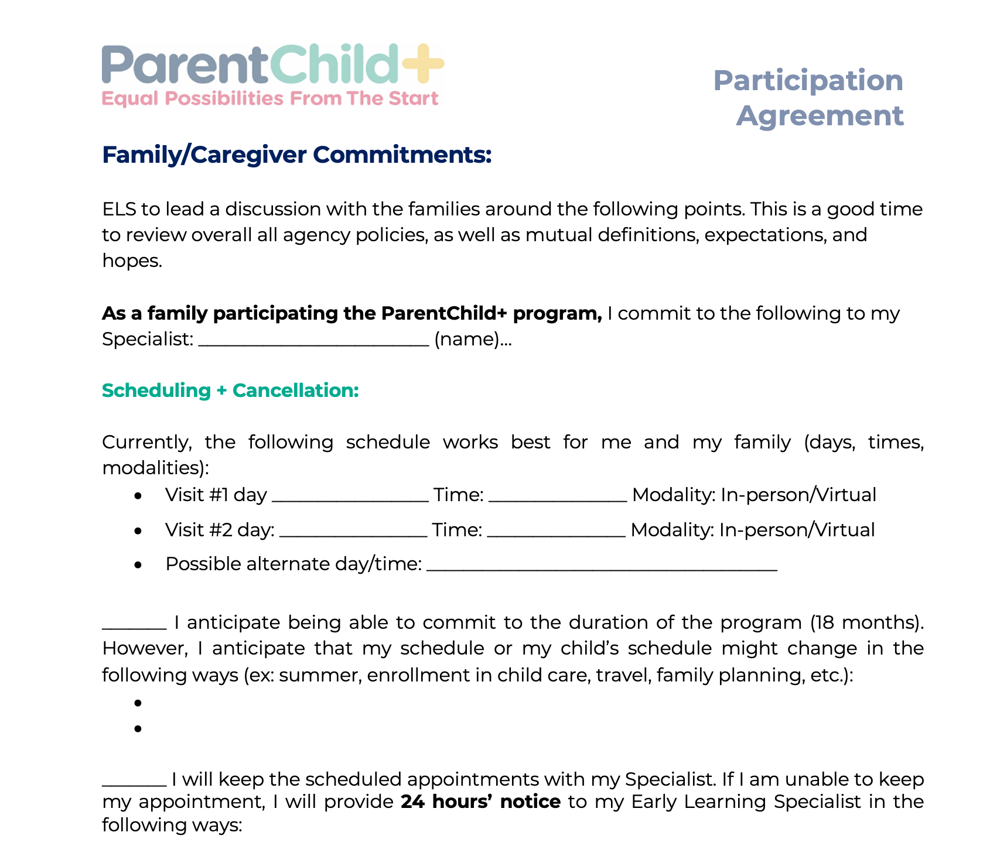

Slide 25
