Slide 1

Books and toys (part 2)

Slide 2
Who is in your community? What population are you serving?
What implications does this have for book or toy selection?
Notes:
Discuss leaving of toy box and book holder or book bag. Discussion of activities that are developmentally appropriate. Discussion of use of guide sheet.

Slide 3

From operations: your community?
Who is in your community?
What are other important factors affecting your community?
What are the implications for purchasing books and toys?
And what might "cultural relevance" or "equity" mean when selecting books?

Slide 4
Your community?
Reflect families’ cultures, languages, and experiences
Use families’ funds of knowledge to guide choices
Ensure representation and cultural relevance
Adapt materials to your community’s strengths and stories

Slide 5
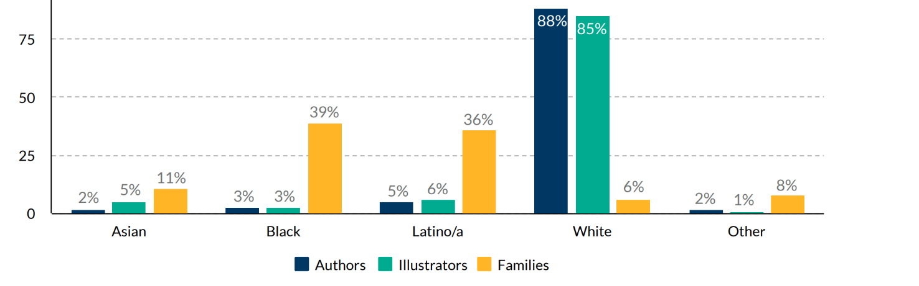
Racial representation of book
authors and illustrators

Slide 6
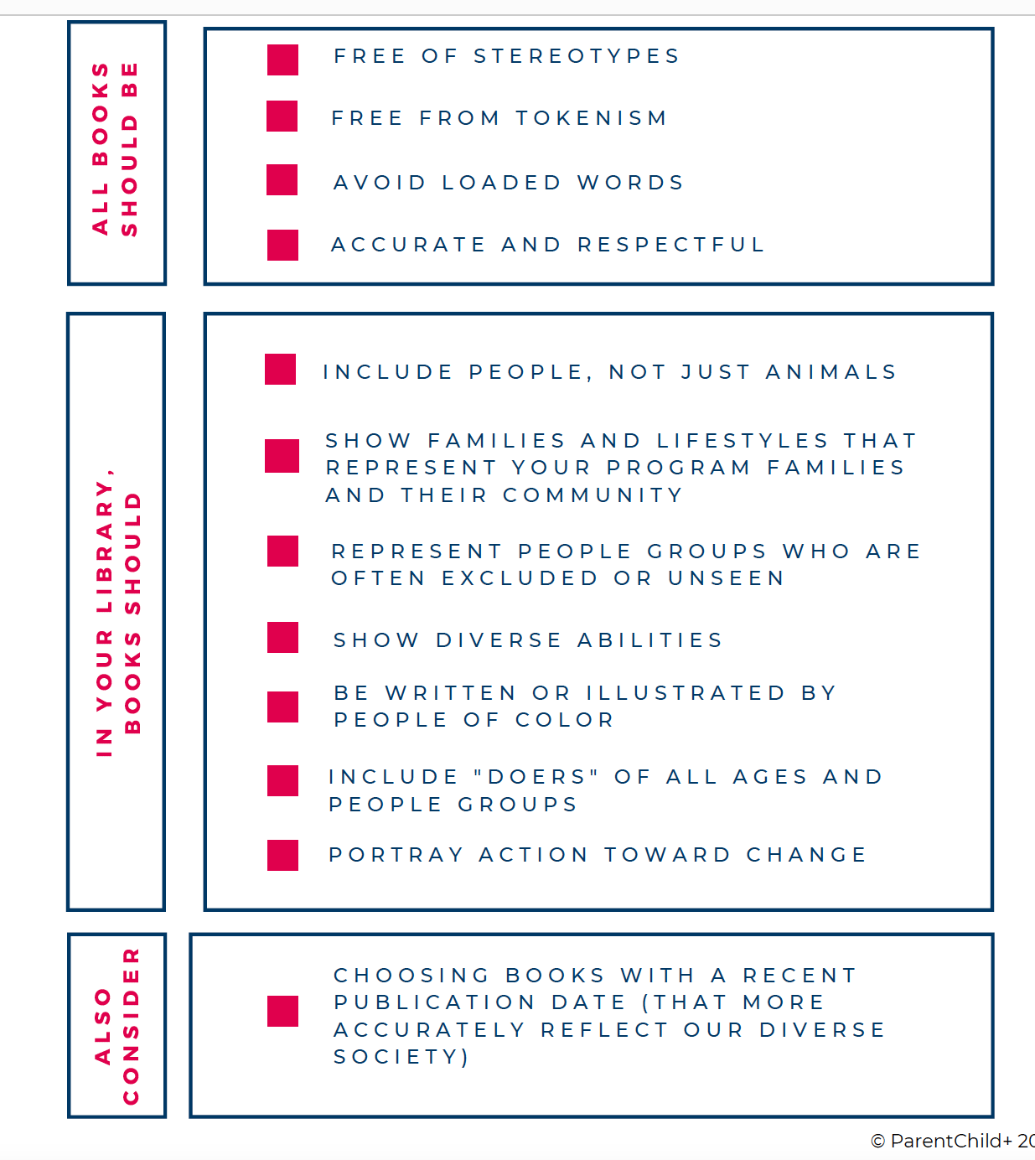
Anti-Bias
Book Checklist
(pg 16)

Slide 7
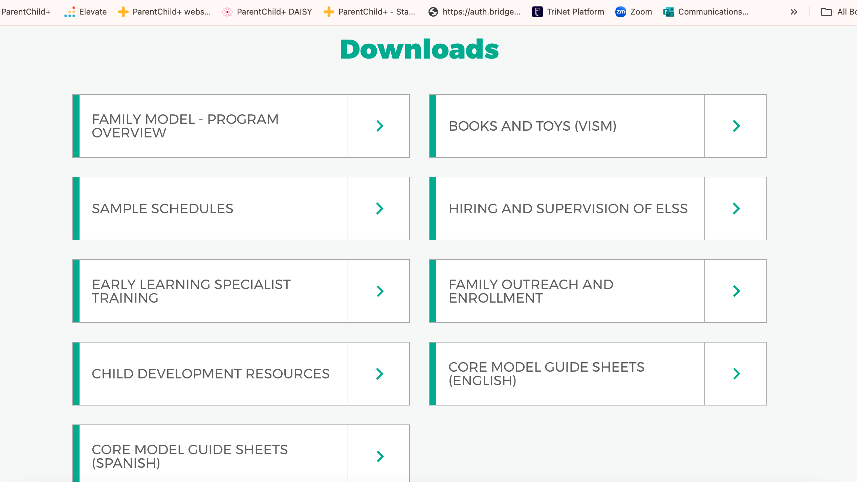

Slide 8
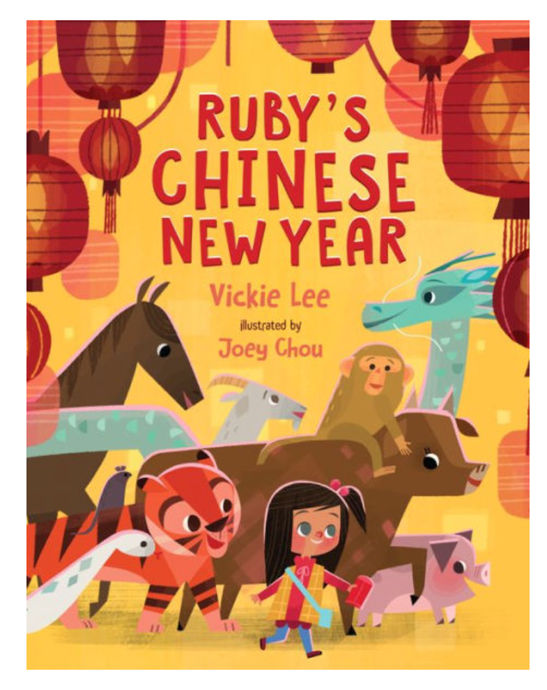
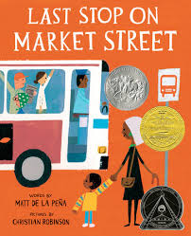
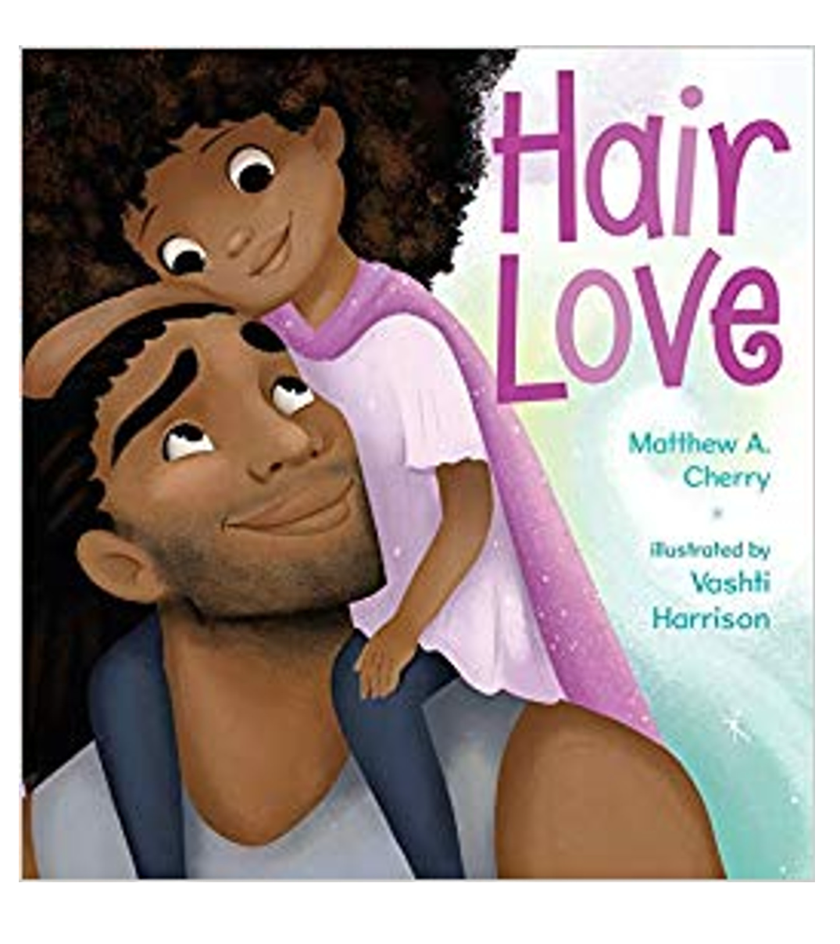
High quality books written by authors of color ​

Slide 9
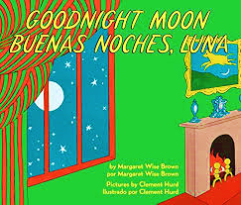
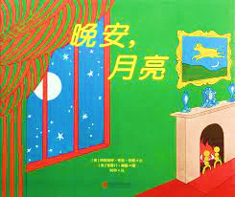
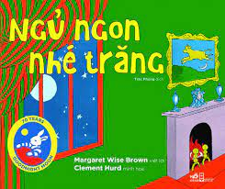
Traditional books with translations

Slide 10
ParentChild+ books and toys (VISM)
Books and toys are gifts that stay with the family
Include books in the family’s home language whenever possible
Each VISM is accompanied by a parent guide sheet
Use available discounts
Conduct an annual team review of all books and toys for relevance
Program totals:
  46 VISMs for Family Model
  23 VISMs for HBCC Model
Notes:
Discuss leaving of toy box and book holder or book bag. Discussion of activities that are developmentally appropriate. Discussion of use of guide sheet.

Slide 11
ParentChild+ books (pg 24)
Developmentally appropriate — materials fit children’s age and stage (2s vs. 3s)
Follow developmental sequence and order
Encourage parent–child interaction and verbal engagement
Engaging and enjoyable : ELS report strong family participation
Address multiple learning areas:
  Social-emotional (e.g., feelings),
  Health (e.g., teeth brushing, handwashing)
  STEM and early math (e.g., counting, exploring, problem-solving)
Notes:
Discuss leaving of toy box and book holder or book bag. Discussion of activities that are developmentally appropriate. Discussion of use of guide sheet.

Slide 12
Why a guide sheet?
Strengthens parents’ understanding of how children learn through play
Highlights everyday interactions that build development
Encourages active engagement and shared enjoyment
Extends learning beyond the visit with simple home ideas
Builds confidence and creativity in adapting activities
Notes:
Discuss leaving of toy box and book holder or book bag. Discussion of activities that are developmentally appropriate. Discussion of use of guide sheet.

Slide 13
What is on a guide sheet (p 24)?
Name of the book or toy, picture, and author/illustrator
How the book or toy fits the child’s stage (safety and developmental differences for 2- vs. 3-year-olds)
Explanation of how it supports child development or school readiness skills
Ideas for extended play and ways to continue the activity
Optional prompt for conversation or observation for the caregiver to try
Notes:
Discuss leaving of toy box and book holder or book bag. Discussion of activities that are developmentally appropriate. Discussion of use of guide sheet.

Slide 14

What is on a guide sheet?
If time, create guide sheet for blocks on page 17.
How would a two-year-old vs a three-year-old play with this?
What developmental domains might this address for each age?
Notes:
Discuss leaving of toy box and book holder or book bag. Discussion of activities that are developmentally appropriate. Discussion of use of guide sheet.

