Slide 1

Equal Possibilities from the Start
Facilitating the Parent-Child Relationship
Oct 2025

Slide 2
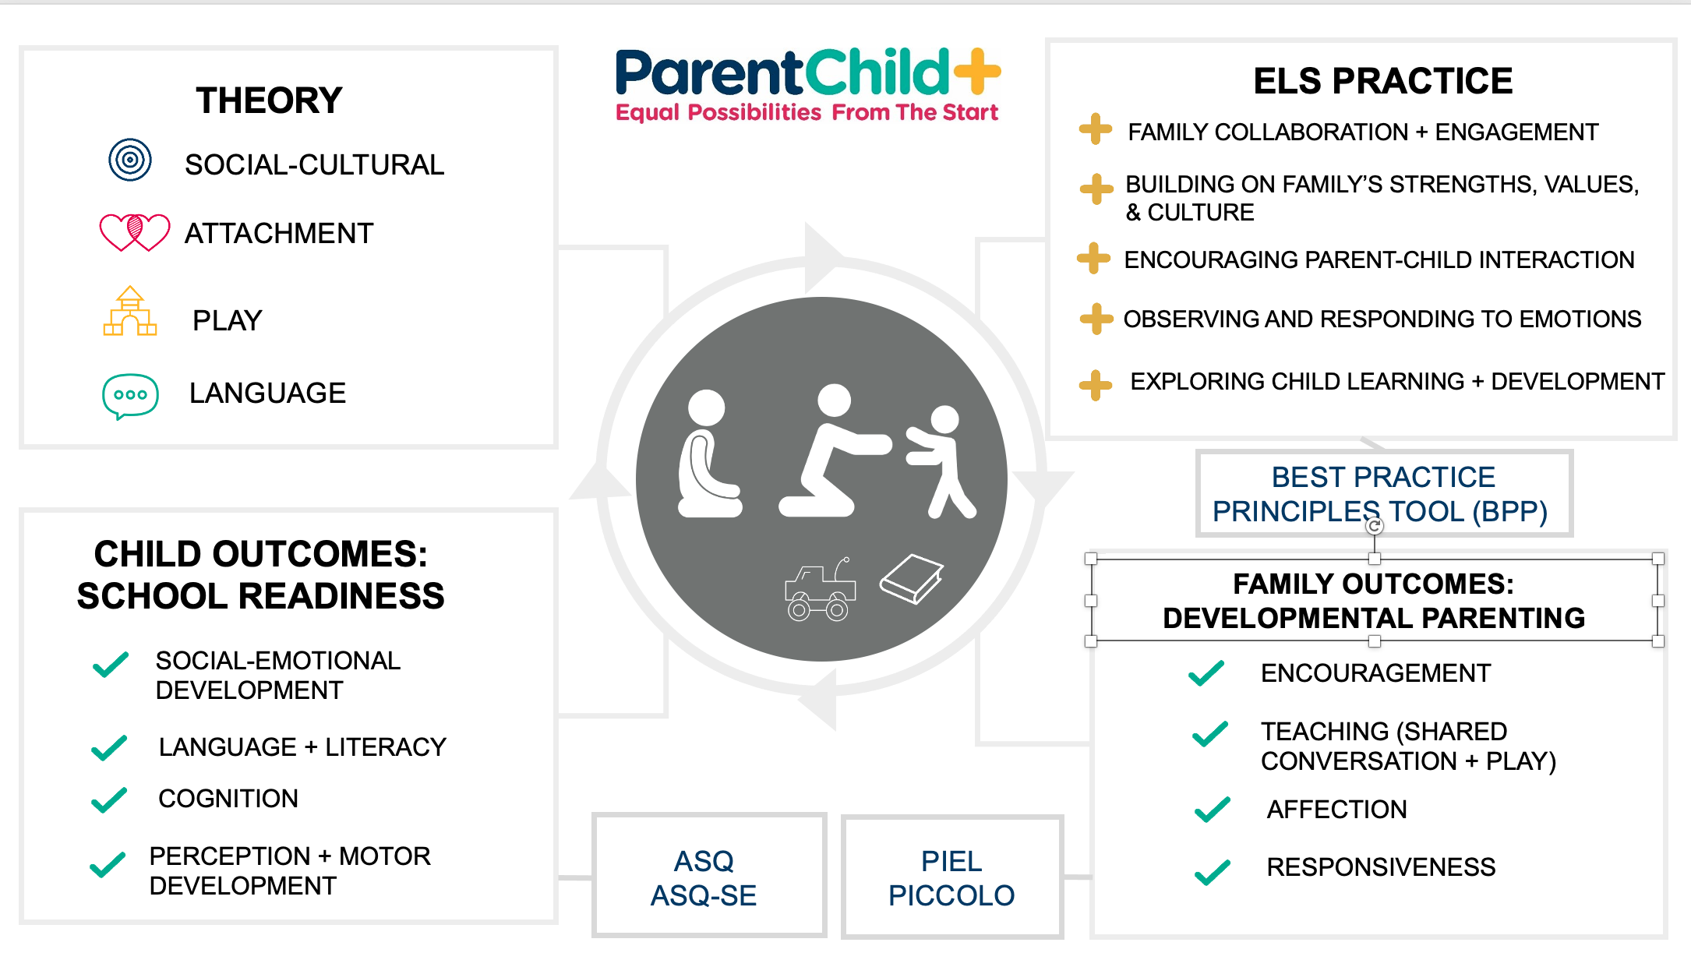

Slide 3

"Coaching" +
"Facilitation of caregiver"

Slide 4

Agenda
Facilitation strategies
Video observation
Home visit practice + OSCAR approach

Slide 5
Goals of session
Improve understanding of ELS and facilitation techniques at level of family
Continue with strategies:
What it looks like? What can you try out?
Practice with video!

Slide 6
Why do you facilitate the parent-child relationship?

Slide 7
Facilitating the parent–child relationship honors parents as the primary developmental resource in their child’s life.
Children thrive when their parents are supported to see, delight in, and respond to them consistently.
By centering facilitation, it strengths the parent-child relationship that underpins all later learning, well-being, and resilience.

Slide 8
Facilitation skills
For family :
Parent and child are the star of the visit
Parent is in the driver seat
For ELS :
Relies on a reflective, developmental, or learning stance
Relationship-based, collaborative, and trusting process
(NAEYC)

Slide 9
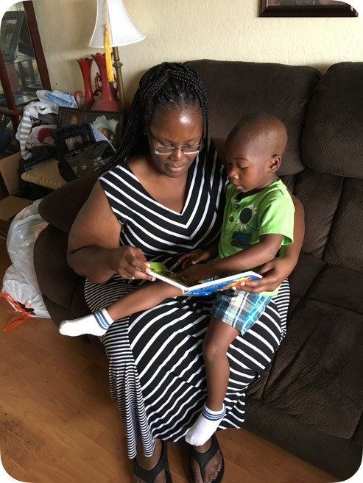
Observe and share strengths

Slide 10
Facilitation data

Slide 11
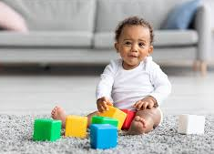
Child engagement
Extent of Interaction with Child
Child development focus is sustained in PC+ visits
  All videos showed 60% to 100%
  Grand majority (97%) of videos showed 80% to 100%

Slide 12
Who should be primarily interacting with the child?
ELS
Parent
Child

Slide 13

Content of Home Visit
Grand majority (97%) focused on child development
This is a strength
3% Parent focused

Slide 14
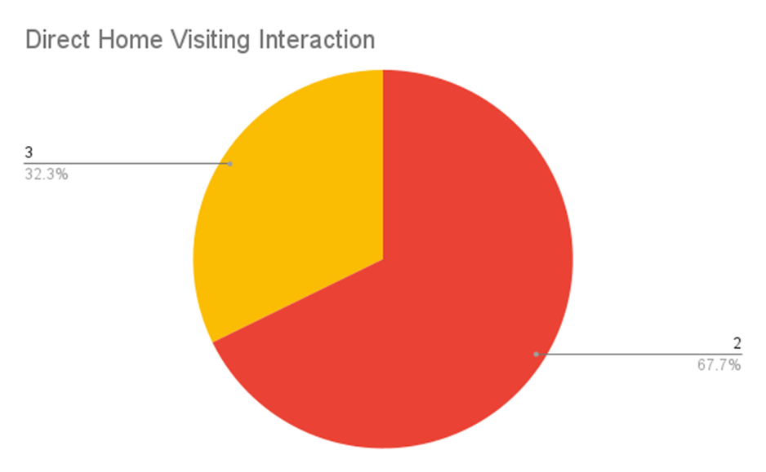
Who Primarily Interacted with the Child?
ELS
32%
ELS & Parent
68%
Notes:
What's missing? Thoughts about this finding?

Slide 15
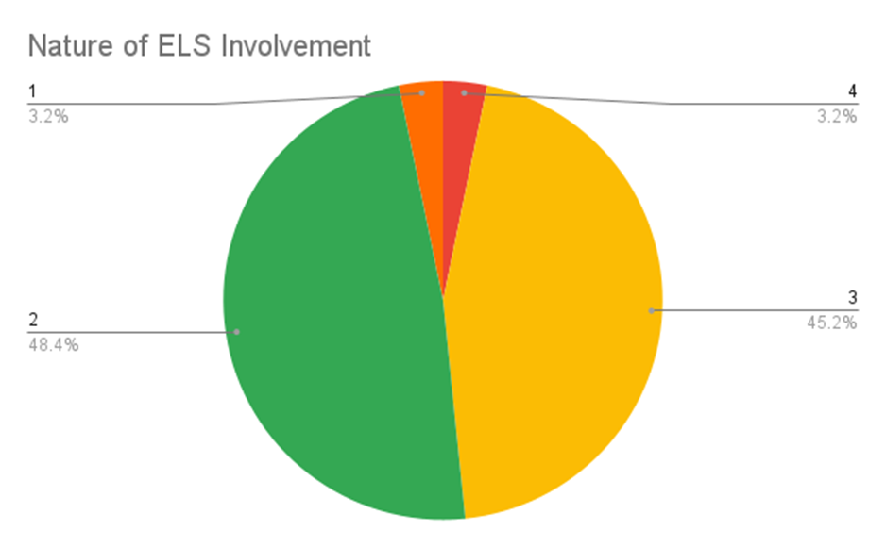
Nature of ELS Involvement
Facilitating + Coaching the caregiver
3%
Other
3%
Direct Engagement
In Parent-Child
Interaction
48%
Direct Engagement
With Child
45%

Slide 16
Why are we interested in facilitating the parent-child relationship?
Traditional Modeling | Facilitative Approach
Visitor demonstrates skill for child | Visitor observes and gently prompts the parent-child interaction
Parent watches the visit | Parent leads interaction while visitor supports reflection
Feedback on child or parent performance | Reflective dialogue (“What did you notice about his response?”)
Focus on "technique" of play | Focus on relationship quality and mutual understanding
Short-term skill gains (band-aid) | Long-term parental confidence and relational growth

Slide 17

Facilitating parent-child relationship – deep dive

Slide 18
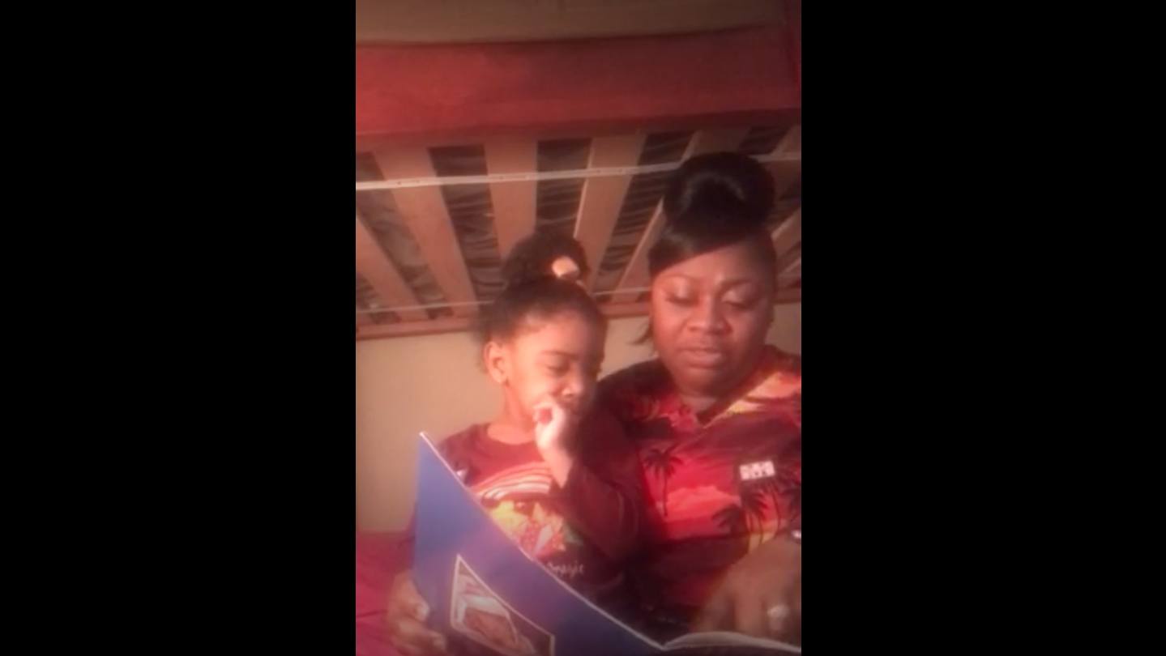

Slide 19
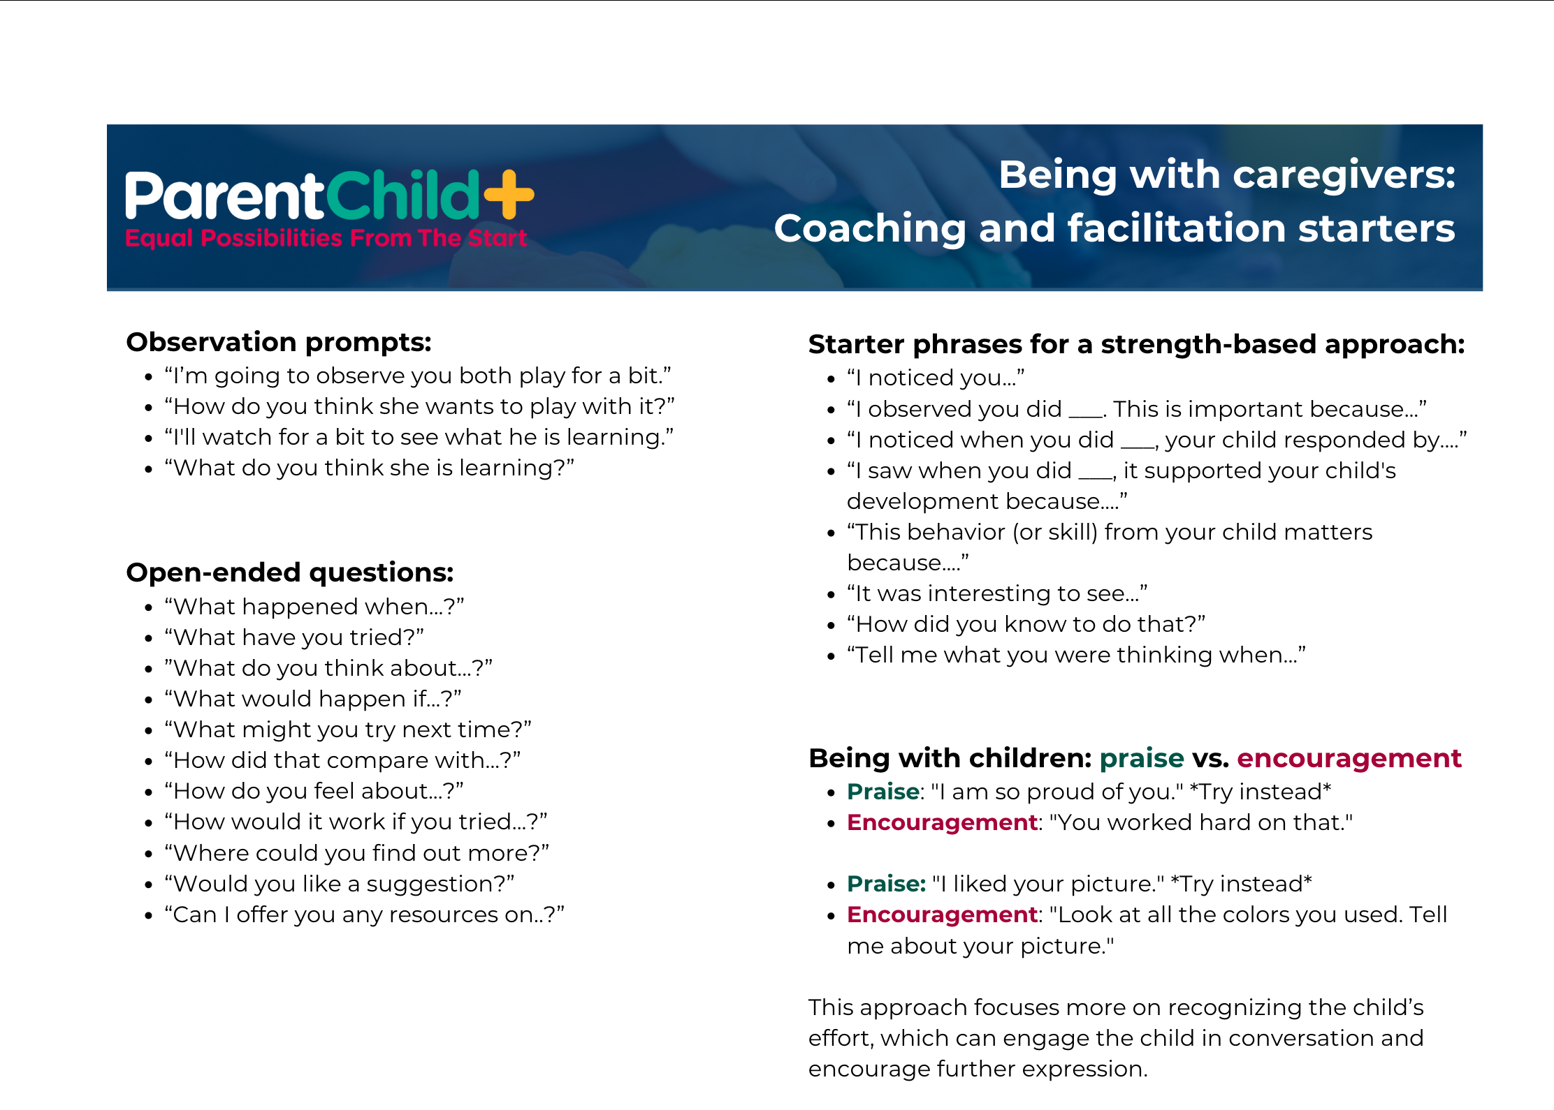
Pg 27

Slide 20


Practice Facilitation
As an ELS, what would you say to Mom?
2- What are Mom's strengths?
1 - What do you observe?
3 - How does Mom support child development?

Slide 21
Strategies to support facilitation
OSCAR - Observe, comment, ask, reflect
Observe parent-child interaction (3-4 mins)
Sit close to parent
Comment/connect to parent strengths and child development
Ask reflective questions

Slide 22
What does ELS gain from observation?

Slide 23
The Importance of Observation
Allow space for parent to take the lead (silence may feel uncomfortable)
Observe parent-child interaction
Observe child and how they respond to parent or engage with materials
Is parent practicing any new skills? Are they working on goals with child? If so, it's a chance for ELS to observe them (coaching)

Slide 24

Observation
2-4 minutes at a time

Slide 25
2-4 mins
Observation
2-4 mins
Observation
2-4 mins
Observation

Slide 26
OSCAR
"S" for sit next to parent
Supports the idea that comments are directed at parent rather than child
Really, just be sure ELS is not in between the parent and child

Slide 27
OSCAR – Comment + connect
Comment on parent strengths
Connect to child development
Comments directed at parent rather than child

Slide 28
OSCAR – Ask reflective questions + reflect on the visit together
Ask questions that help families reflect on their interactions with children (reflectin or reflection record)
  What worked?
  What didn't work?
  Co-planning

Slide 29
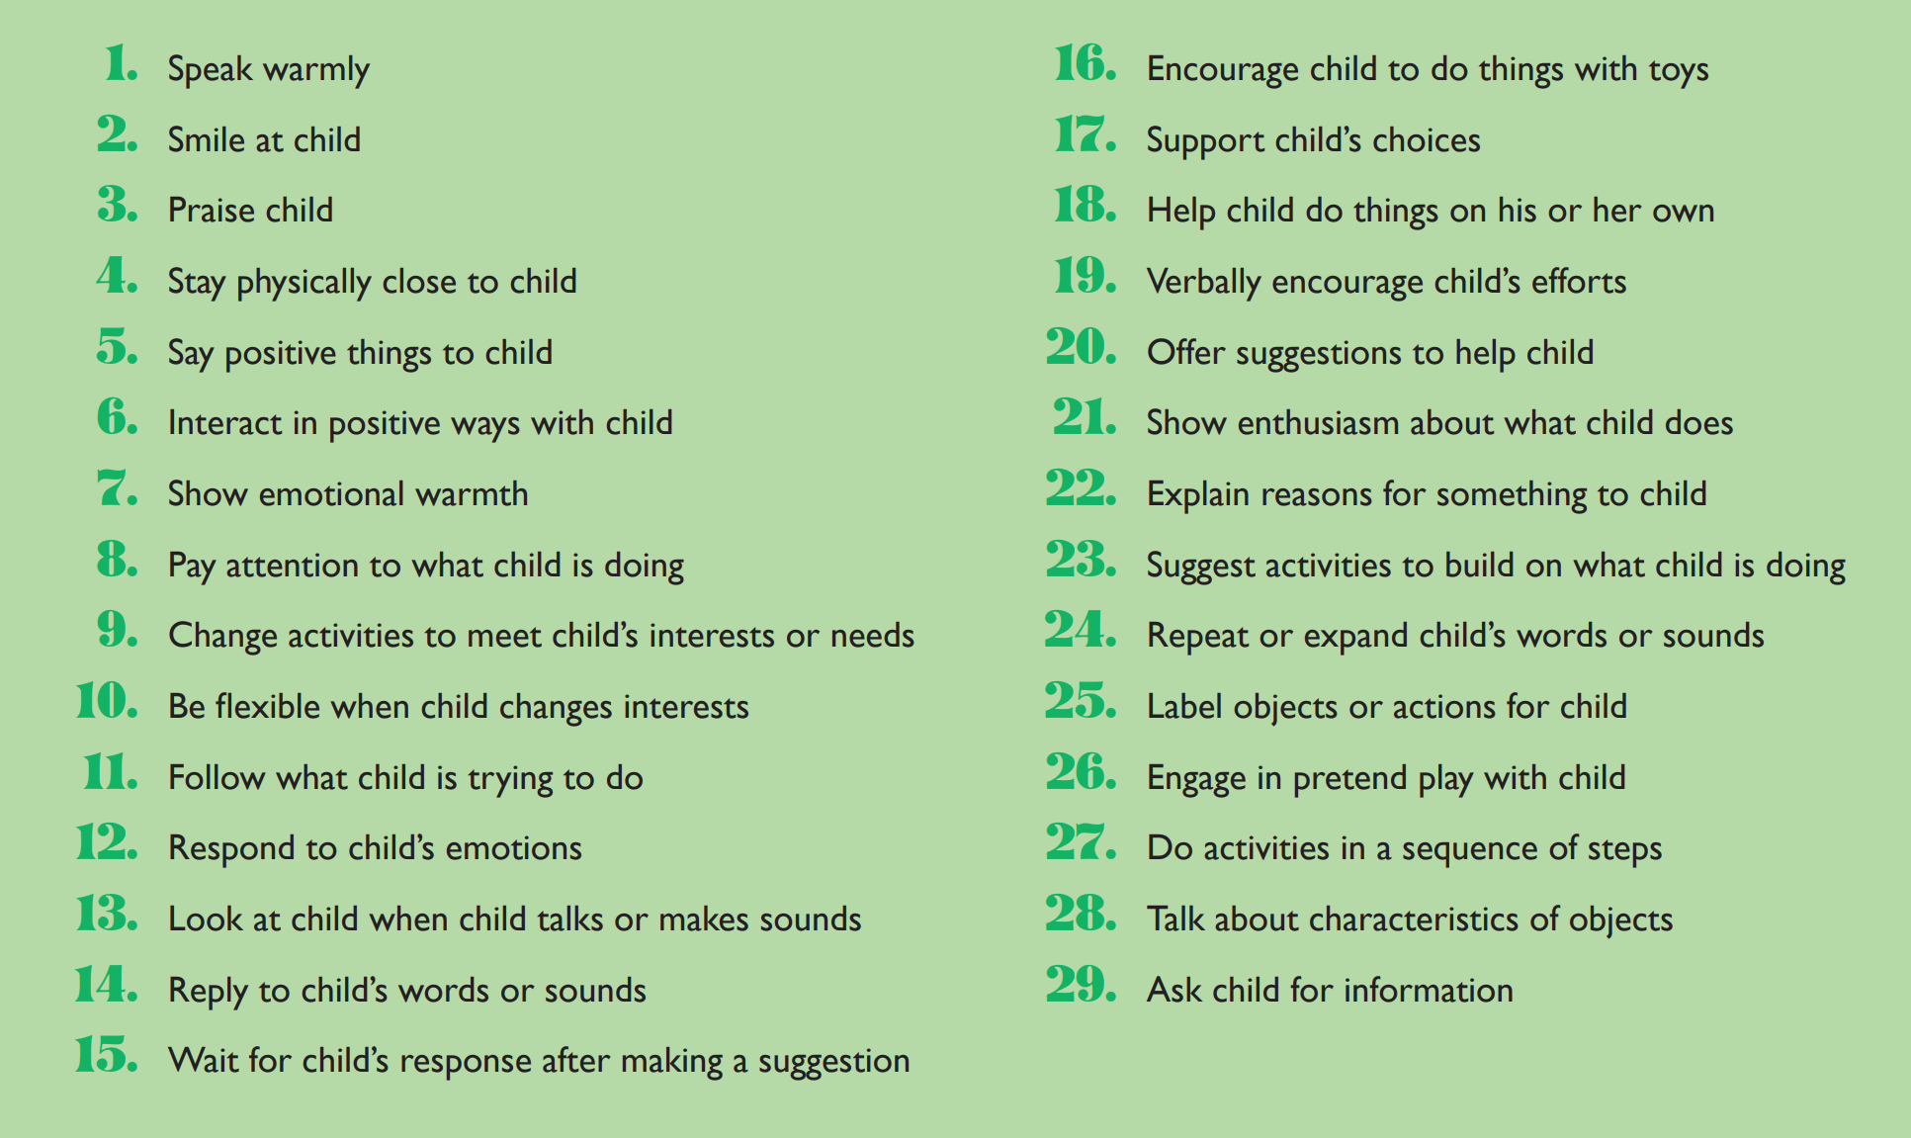
PICCOLO 29 things parents do to support school readiness
"29 Things Parents Do to Predict School Readiness"

Slide 30
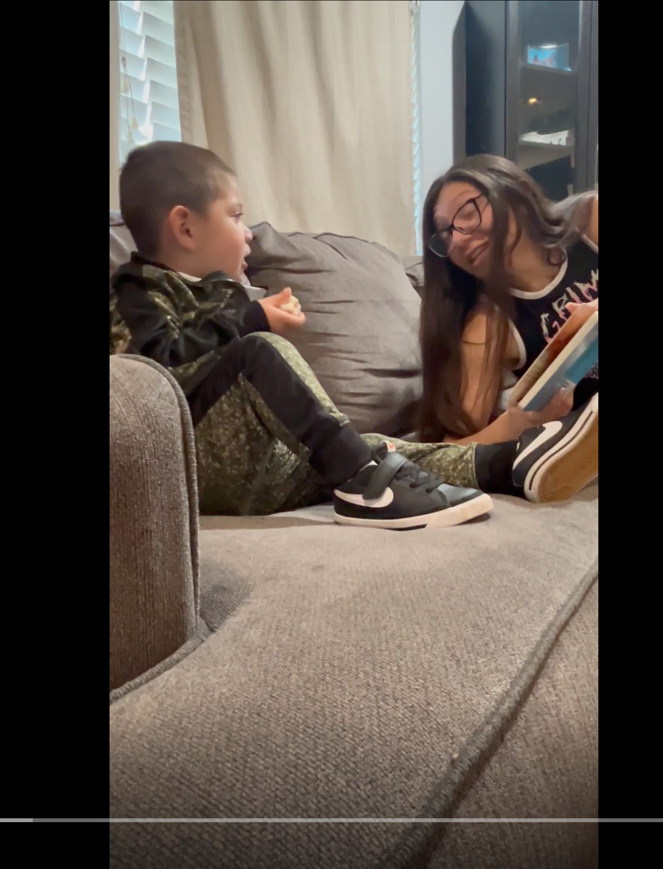
Video One (3 mins)
1) What did you observe about the parent?
2) How do you react an ELS to this parent?
(Use 29 Things or Coaching Starters if helpful)
Link: transcribed Yolo_4_24_25_PICCOLOrEC_Nawid-2.mp4

Slide 31
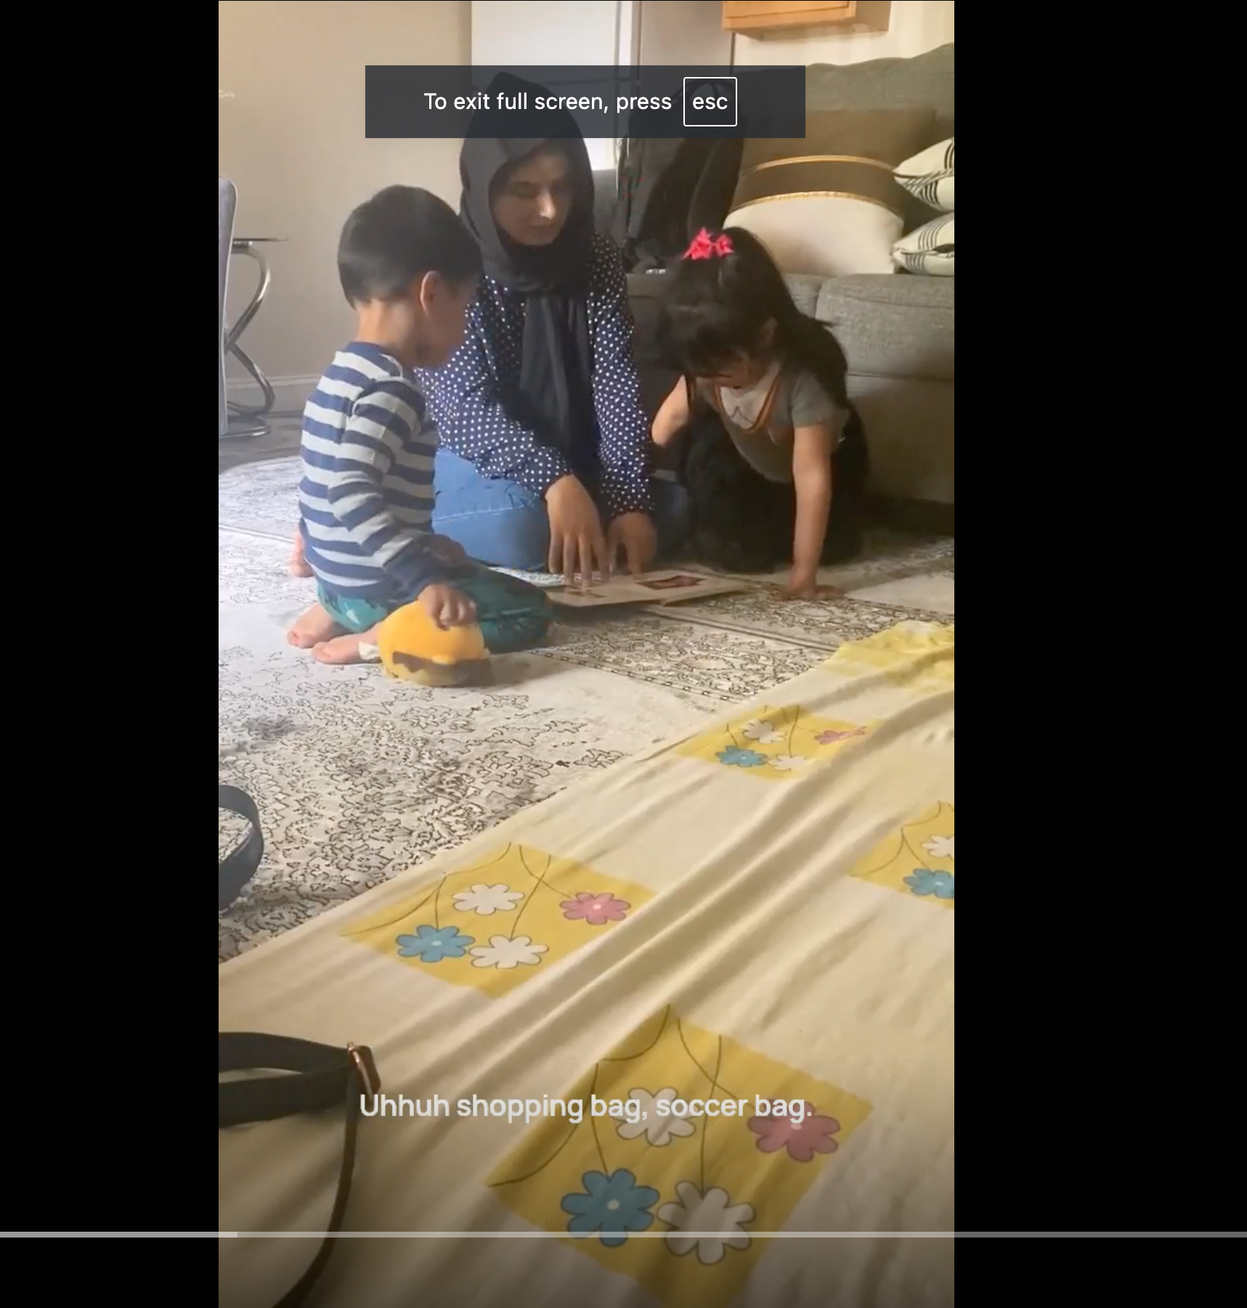
Video Two (3 mins)
1) What did you observe about the parent?
2) How do you react an ELS to this parent?
(Uses 29 Things or Coaching Starters if helpful)
transcribed Yolo_4_24_25_PICCOLOrEC_Nawid-2.mp4

Slide 32
End of session

Slide 33
Your ELS has practiced OSCAR Language.
Now what?
How can you support her professional development?

Slide 34
ELS Observation
2x annually
Live, in-person
Recorded
Within 48 hours, complete Best Practice Principles for Coaching

Slide 35
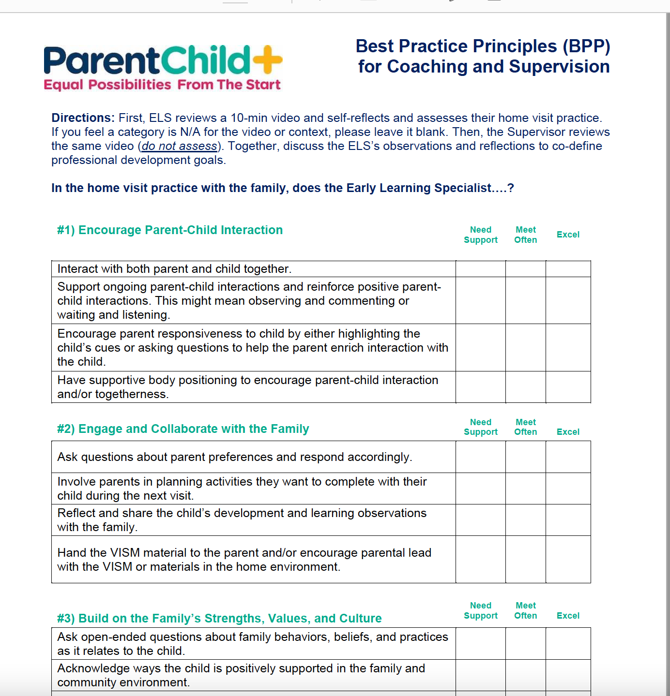
Best Practice Principles (pg 29-30)

Slide 36

Program quality assurance + improvement
Coordinator must observe each ELS 2x annually – live and in-person or recorded
Followed by a coaching session
Coordinator has eye on the quality and fidelity of the practice

Slide 37
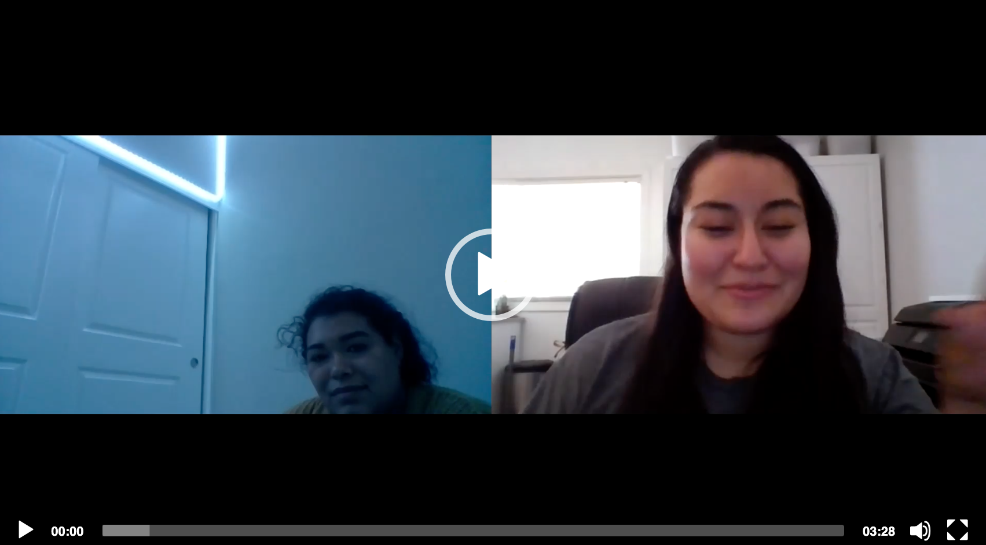

Slide 38

BPP is not:
Not an assessment or job performance tool
Does NOT address these scenarios:
              Entering and exiting the home
              Referrals, case management, parent groups
              Difficult situations or conversations
              Boundaries and ethics

Slide 39
Self-evaluate (pg 30)
You are the ELS, using domain 4, how would you self-evaluate?

