Slide 1
Day 1 - Session 1:
Facilitation vs Coaching
Routines of a Home Visit
What happens in the beginning, middle and end of a visit?

Slide 2
Breakout Room
In your own words, define what it means to "facilitate" vs. "coach" families. What is the difference?
Page 29

Slide 3
Facilitating - Coaching
Family-centered
Interactive
Collaborative
Strength-based​
​
Goal-oriented​
​
Lifelong​
​
not teaching or training to be “better”
not evaluation
not expert advice
not therapy
not modeling

Slide 4
Terminology
Facilitating – guiding the experience
Creates a welcoming, supportive space
Keeps the visit flowing and engaging
Encourages parent–child interaction
Promotes learning through observation and participation

Slide 5
Terminology
Coaching – partnering for growth
Works alongside parents toward shared goals
Encourages reflection and problem-solving
Provides feedback and celebrates progress
Builds parent confidence and independence

Slide 6
Why facilitation of parent-child interaction + parent coaching?
Facilitation maintains parent as the child's "first and best teacher"
  Affirms caregiver capacity, competence, and strengths
  Builds developmentally supportive behaviors of the parent
(Moss et al., 2011; Peterson et al., 2007; Roggman et al., 2016),

Slide 7
How do you start a home visit?
2814_Medina, OH.MOV

Slide 8
Opening - Building Connection
(first 5-7 mins)
Enter home, greet the family
Opening routines
Check in with open-ended questions
Explain purpose of book or toy / review guide sheet

Slide 9
What happens during the visit?
Facilitation in Action
Watch the home visit video clip.
While watching the video, please note all of Mom's strengths. How does she support her child’s development?
Using the prompts on the ELS checklist, what might you say to this parent to acknowledge her strengths? Write down what you would say if you were an ELS in this moment.
2546_Child Care of the Berkshires (Northern), MA.mp4

Slide 10
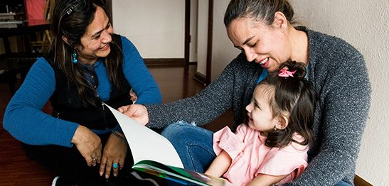

Slide 11
Facilitation is when the Early Learning Specialist helps parents and caregivers take the lead in their child’s learning and supports positive interactions during the visit.
Coaching is the process of working collaboratively with parents and caregivers to help them achieve their goals while supporting their child’s learning and development.

Slide 12
Modeling can be a powerful tool, but there are some cautions to keep in mind when modeling for caregivers:
Modeling can limit thinking:
Modeling can limit thinking and hold back parent abilities.
Modeling can foster dependency:
Modeling can foster a dependency culture and take the place of deep learning.
Modeling can be stressful:
Modeling can be stressful and high pressure.

Slide 13

Coaching – Like teaching someone to drive a car or ride a bike – you can’t ”model” it and expect them to learn, they must experience it themselves!
Lori Rogman, Developmental Parenting

Slide 14
How might you close or end a visit?
(last 5 mins)

Slide 15
How might you close or end a visit?
Closing rituals (songs or routines to signal the end)
Reflect on the visit
Set and re-affirm family goals
Engage in family co-planning – ideas that can be incorporated?
Access to resources and referrals

Slide 16
