Slide 1

Turnkey Training:
Coordinators Role as Trainers

Slide 2
What are some training techniques you can use with ELS?

Slide 3
Training Techniques
Polls – Close-ended
Questions – Open-ended
Reflection
Videos
Writing Prompts
“Homework” and then training
Training and then “homework”
Literature
Tell a story
Shadowing

Slide 4
How will you assess whether ELSs have absorbed and implemented new learnings?

Slide 5
Observations in person (2x annually)
Observation by video recording
Reflection record notes
One-on-one reflective supervision
Reflective team meetings (2 hours a week)
Role play or fish bowl exercises
Parent check-ins
Assessments or self-assessments
Routines of a home visit and video recording
Best practice principles for coaching, goal setting
Coaching cycles

Slide 6

Training + coaching is an ongoing iterative cycle.

Slide 7
Training Content and Resources

Slide 8

Training Workbook

Slide 9
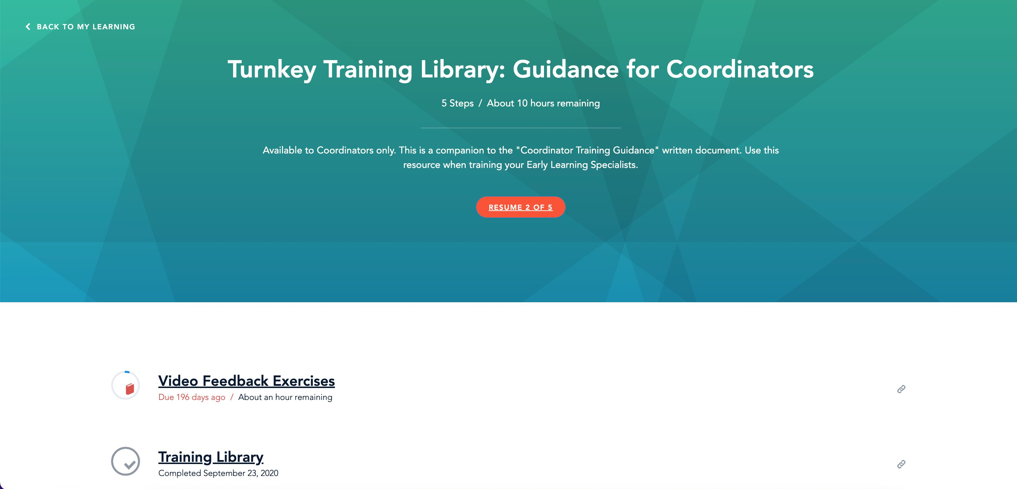
Turnkey Training in Elevate

Slide 10
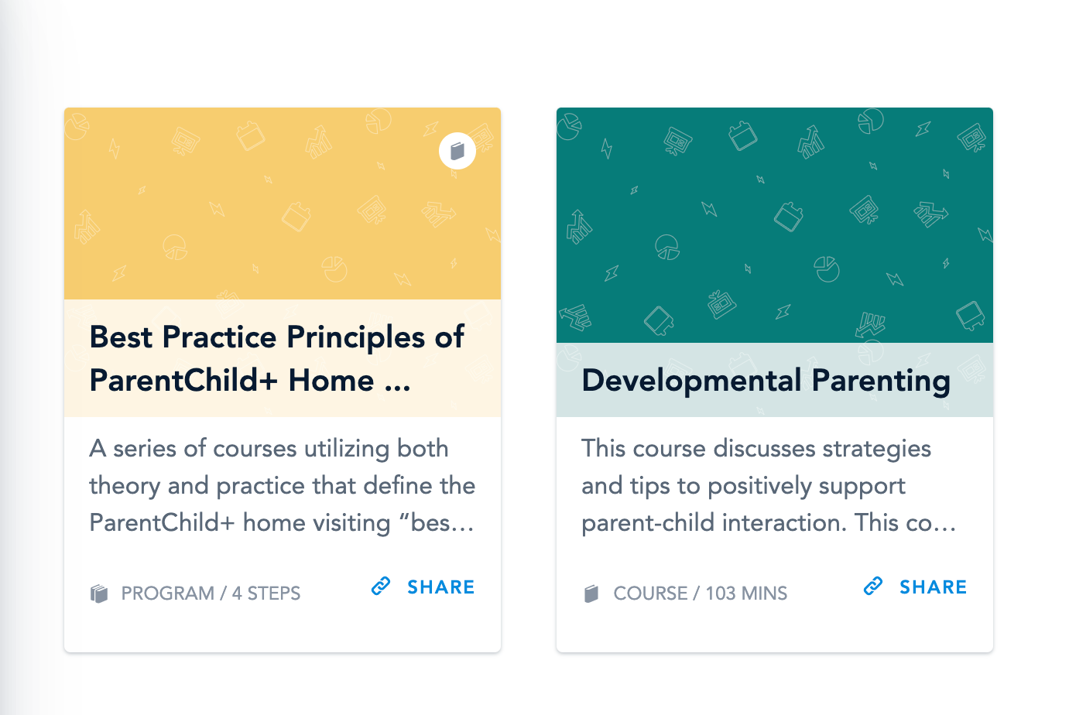
Elevate Courses

Slide 11

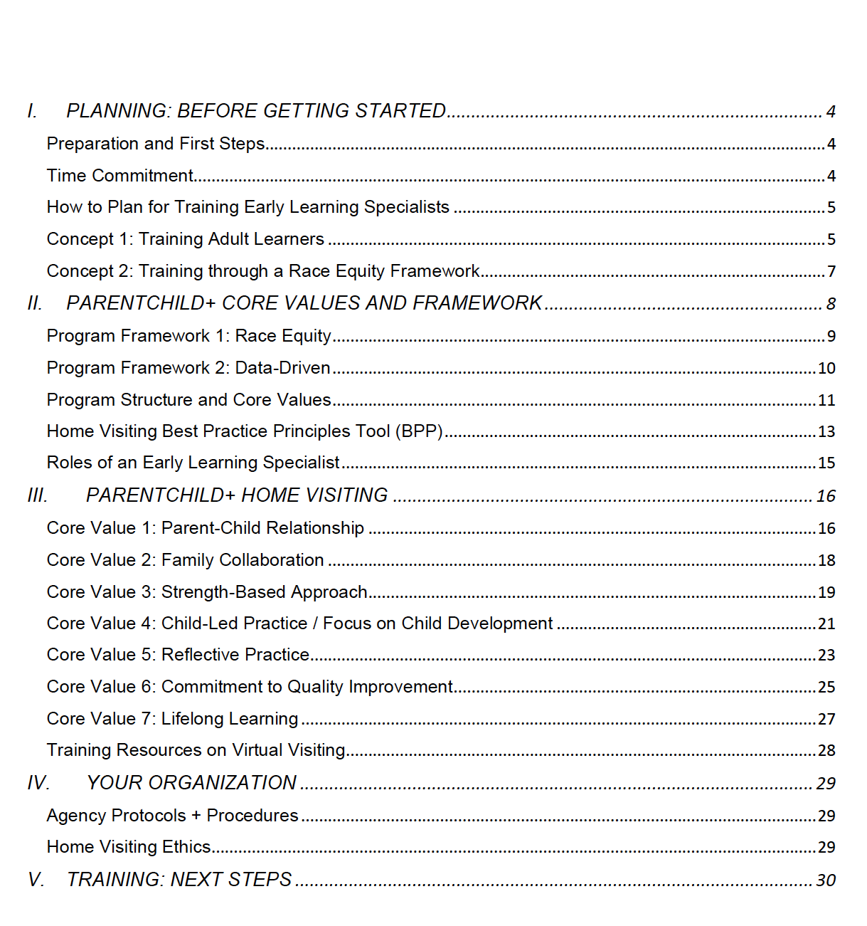
Turnkey Training Guidance

Slide 12

Group Activity – pg 42
Using your experience with this training, and the Table of Contents in the Turnkey Training Guidance, together as a team start to develop an initial training agenda for ELSs.
1. Brainstorm: What are the topics that need to be covered?
2. Organize: What is the order that makes the most sense?
3. Design: Create a flexible agenda that meets the needs for your organization and staff. What training techniques will you use for each session? How will you evaluate ELS professional development?

Slide 13
Training reflection questions
How did National Center create a strengths-based mindset?
How did we create the conditions for adult learning and peer connections?
How did we establish community learning guidelines?
How do you know what the agenda is?
How are we demonstrating resources that can support you?
How do you envision a parallel process with your ELSs?

