Slide 1

Equal Possibilities from the Start
ELS Coaching:
Coordinators as Coaches

Slide 2

Agenda
Workbook p. 34-38
The use of Video in Coaching
Practice-based coaching
Experiential practice

Slide 3

Questions
Have 1-2 people share an experience of being video taped.
Tell us about a time where you had to watch yourself on video.
Who was the audience and what were you feeling?

Slide 5
Community Guidelines in ELS Video Coaching
Be sensitive to | Coordinators might prepare with
Amount of energy and time, logistically setting up can be hard | Logistically support advise
Am I going to make a mistake? Perhaps more critical of self | Sympathy and empathy, feelings of discomfort
Humbling | .

Slide 6

What is practice-based coaching
(p 38)?

Slide 7
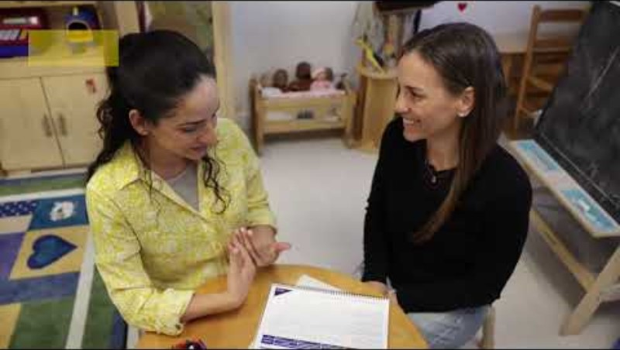

Slide 8
Practice-based Coaching
(PBC)
Practice-based: An established and shared set of practices that are evidenced-based and often evolve from a professional skillset or "best practices."
Coaching is a relationship-based process led by a Coach who often serves in a different professional role than the recipient(s).
Coaching is designed to build capacity for specific skillset of team and is focused on goal-setting to achieve those goals (Adopted from NAEYC)

Slide 9
Strengths-based observation
Reflection and feedback
Shared goals and action planning
Coaching Cycles

Slide 10

Best Practice Principles, p 35
#1) Encourage Parent-Child Interaction
#2) Engage and Collaborate with the Family
#3) Build on the Family’s Strengths, Values, and Culture
#4) Observe, Reflect, and Respond to Parent-Child Emotions
#5) Explore of the Child’s Learning and Development

Slide 11
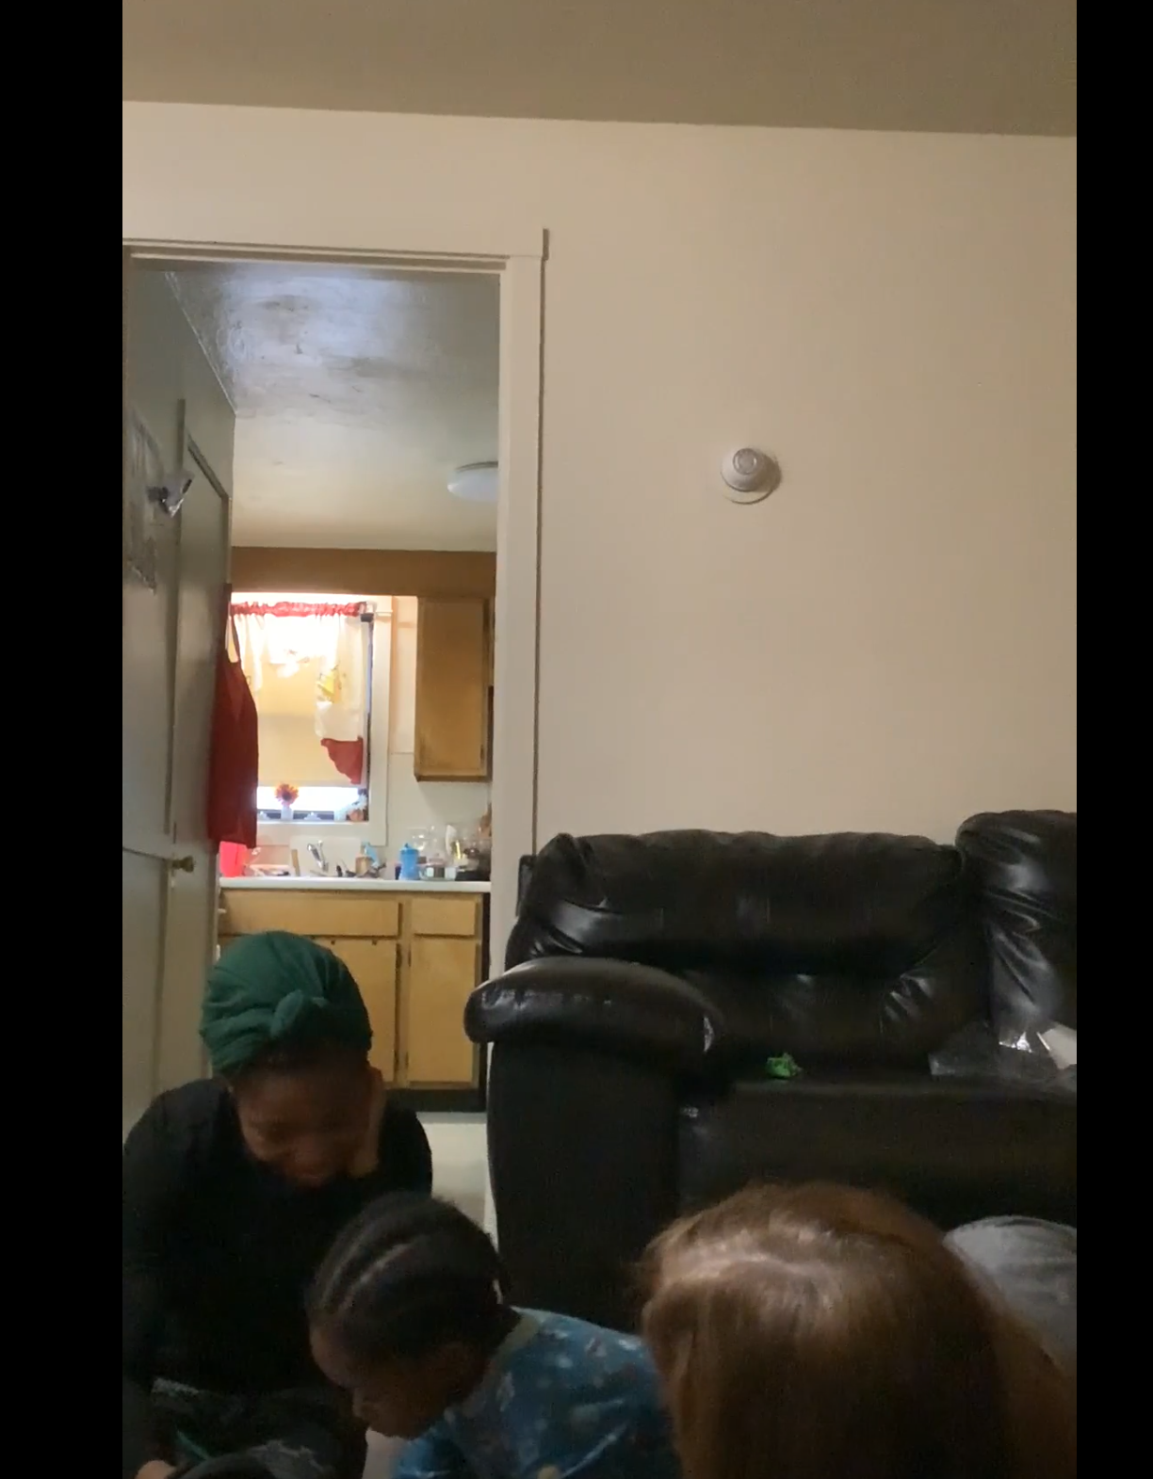

Slide 12

BPP area #2:
Engage and collaborate with family

Slide 13
Preparing for Practice-Based Coaching
As you watch video and observe ELS, note the BPP Focus (area 1)
What does ELS do to encourage the parent-child interaction
What are ELS Strengths?
List some open-ended questions you can ask ELS to prompt ELS reflection (samples page 36)?

Slide 14
Planning for the use of Coaching Cycles
When can new coordinators start coaching ELS?
What staff can participate in a coaching cycles?
What do you need to implement a coaching cycle?

